Slide 1
Aim: How did the United States attempt to contain the spread of Communism and eventually become involved in the Korean conflict?
Cold War key terms to be familiar with:
Taft-Hartley Act (1947)
GI Bill (Servicemen's Readjustment Act of 1944)
Post-War Boom
Impact of The "Sunbelt," Suburbanization, Baby Boom
Yalta
Post-War US-Soviet Relationship
The United Nations
What was Post-War Germany like? - Nuremberg Trials, Partition of Germany, Berlin Airlift & Blockade
Truman Doctrine
The Marshall Plan
Voice of America
NSA
CIA
Selective Service System
NATO
Occupation of Post-War Japan & Growing Problems in Europe and Asia for the United States
Red Scare 1950s - Loyalty Review Board, HUAC, American Spies
1948 Elections
Korean War - Causes, NSC-68, the Role of the UN, the MacArthur Controversy
Notes:
Lesson Plan for Tuesday, March 3, 2008: RQ26B, Finish Cold War notes

Slide 2
Our so far Cold War Timeline
Soviet Blockade & Berlin Airlift
June ‘48 – May ‘49
The Iron Curtain is created March 5, 1946
Sources of Soviet Conduct “X”
July, 1947
Truman Doctrine
March, 1947
George Kennan’s Long Telegram is sent
February, 1947
Marshall Plan proposed
June, 1947
Marshall Plan APPROVED!
April, 1948

Slide 3
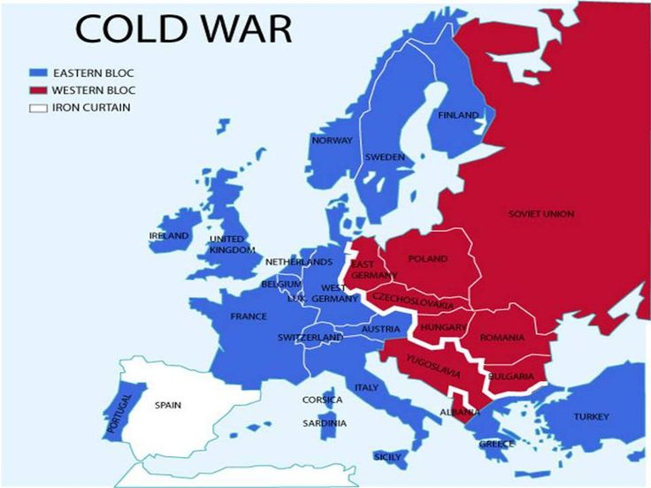
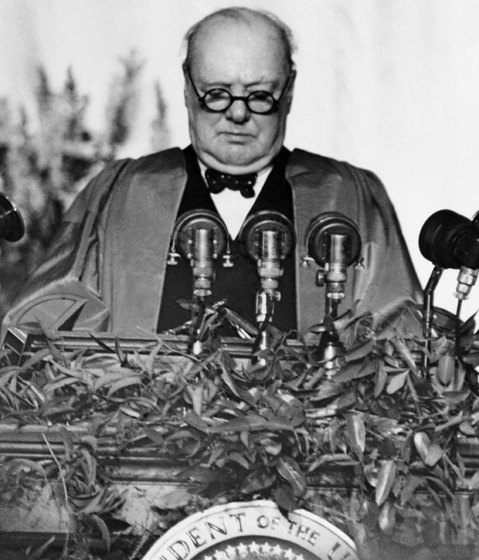
The Iron Curtain
Stalin’s response? . . . In substance, Mr. Churchill now stands in the position of a firebrand of war. And Mr. Churchill is not alone here. He has friends not only in England but also in the United States of America. In this respect, one is reminded remarkably of Hitler and his friends. Hitler began to set war loose by announcing his racial theory, declaring that only people speaking the German language represent a fully valuable nation. Mr. Churchill begins to set war loose, also by a racial theory, maintaining that only nations speaking the English language are fully valuable nations, called upon to decide the destinies of the entire world.
1946: Winston Churchill made the “Iron Curtain” speech at Westminster College (Fulton, Missouri)
“Iron Curtain” = line of eastern European “satellite” nations under control of the USSR after WWII
WARNED that the ”Iron Curtain" of communism is descending to the west from the USSR; there must be a division between the free West and communist East

Slide 4
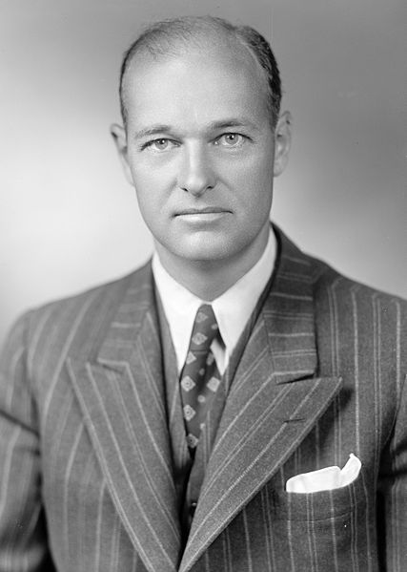
George F. Kennan “CONTAINMENT” (July 1947)
U.S. diplomat - served in Moscow
Sent the LONG TELEGRAM
Proposed policy of containment
Author “X”
July 1947: Foreign Affairs article “The Sources of Soviet Conduct” (A WARNING ABOUT THE USSR’S TENDENCIES)
Soviets are DETERMINED to expand!
Soviets CANNOT BE TRUSTED!
USSR wants to smash Western democracy!
“... the main element of any United States policy toward the Soviet Union must be that of a long-term, patient but firm and vigilant containment of Russian expansive tendencies...” and “Will not lead to any immediate victory but will eventually force the USSR to live in peace with the West”

Slide 5
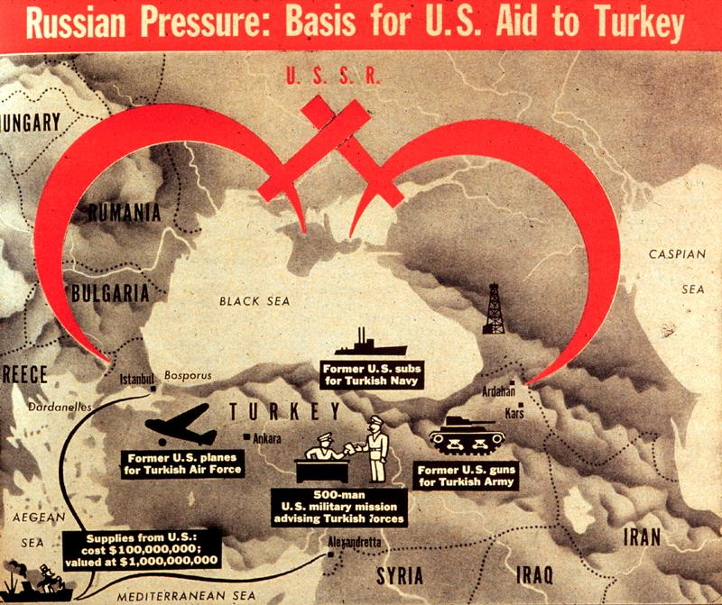
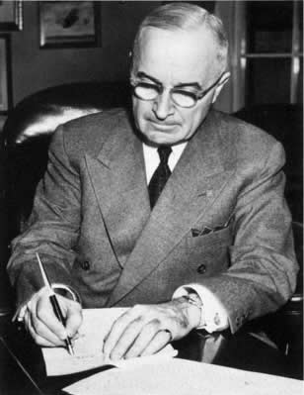
Truman Doctrine (1947)
Monroe Doctrine
Roosevelt Corollary
Truman Doctrine
???
This commitment to stopping the spread of Communism was viewed by the Soviet Union as an informal declaration of a cold war
President Truman: U.S. will support any “free peoples” resisting “armed minorities”
AKA → any nation that the U.S. government believes is threatened by communism
Immediate objective: send U.S. aid to anti-communist forces in Greece and Turkey
Notes:
America needed to aid “free peoples” resisting attack by “armed minorities” (primarily monetary aid). Greece and Turkey looked ready to topple, so the US gave them about $400 million
- Set the stage for the Marshall Plan (US rebuilt most of western Europe and helped counter communist takeovers there) – “containment” in action

Slide 6
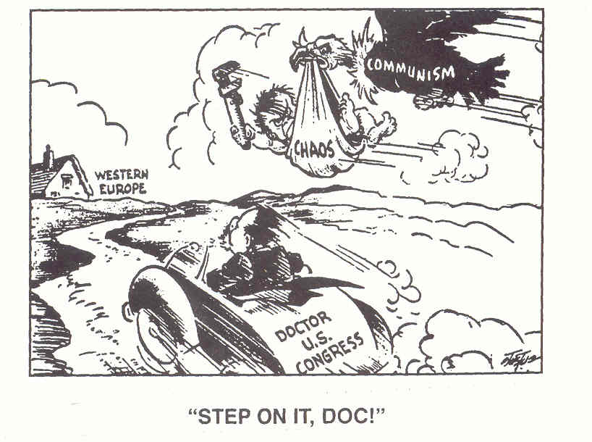

Slide 7
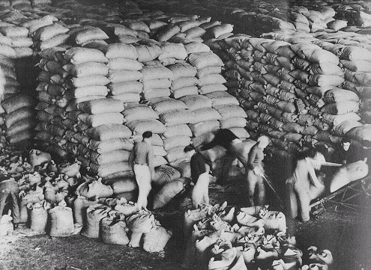
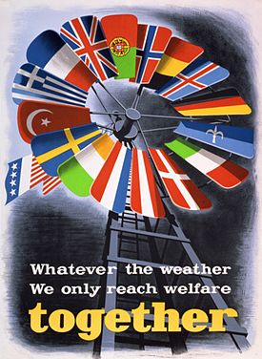
US Marshall Plan, June 5, 1947
European nations had difficulty recovering after WW2 which led to U.S. fears of Communist coups in Europe
The Marshall Plan offered aid ($12 billion) to help Europe recover
Economies revived & Western Europe safe from “communist threat”!
USA trade boost
Soviets REFUSED! Don’t want to become “dependent”
BUT, we will see what happens in Germany…

Slide 8
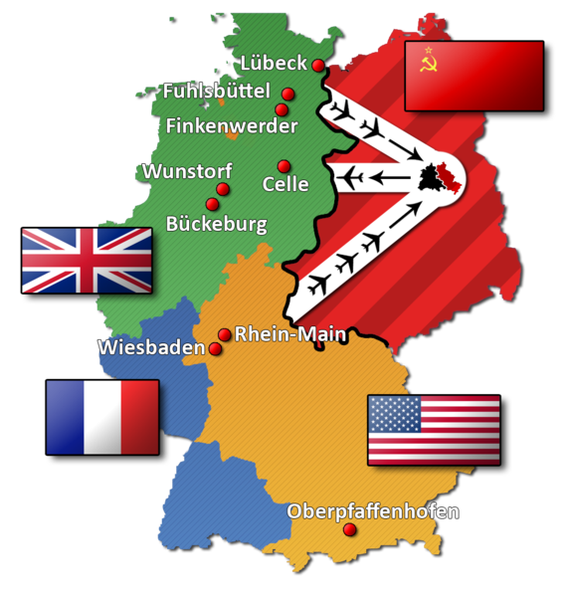
Soviet Blockade and Berlin Airlift
(June 24, 1948 - May 12, 1949)
June 1948: BLOCKADE - Soviets cut off all land transportation links to Berlin (East Germany), causing a shortage of food and goods
The West's answer = Berlin Airlift
an operation to move goods and foodstuff to Berlin by air, thus bypassing the blockade

Slide 9
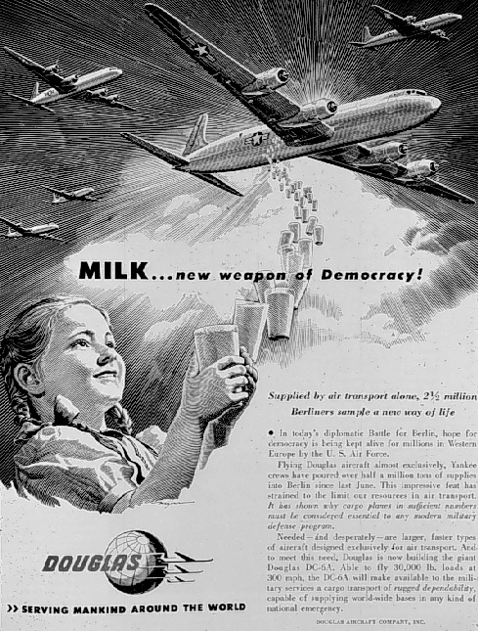
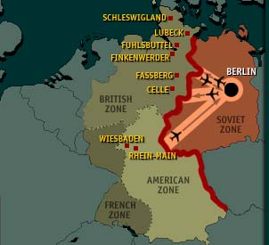
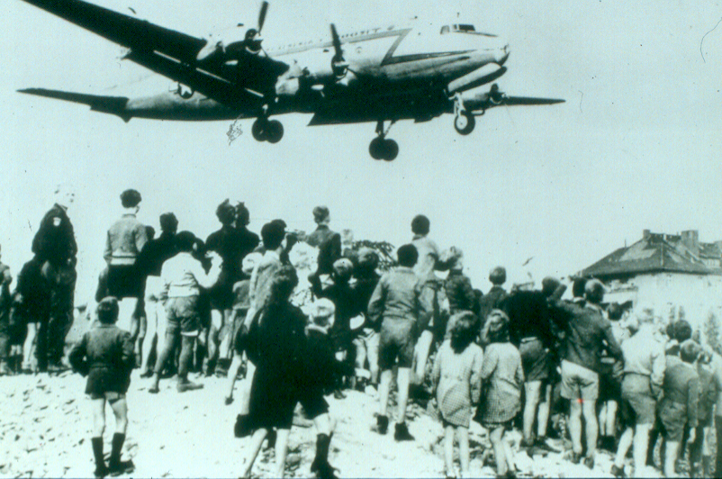
Berlin Airlift
Here comes help!

Slide 10
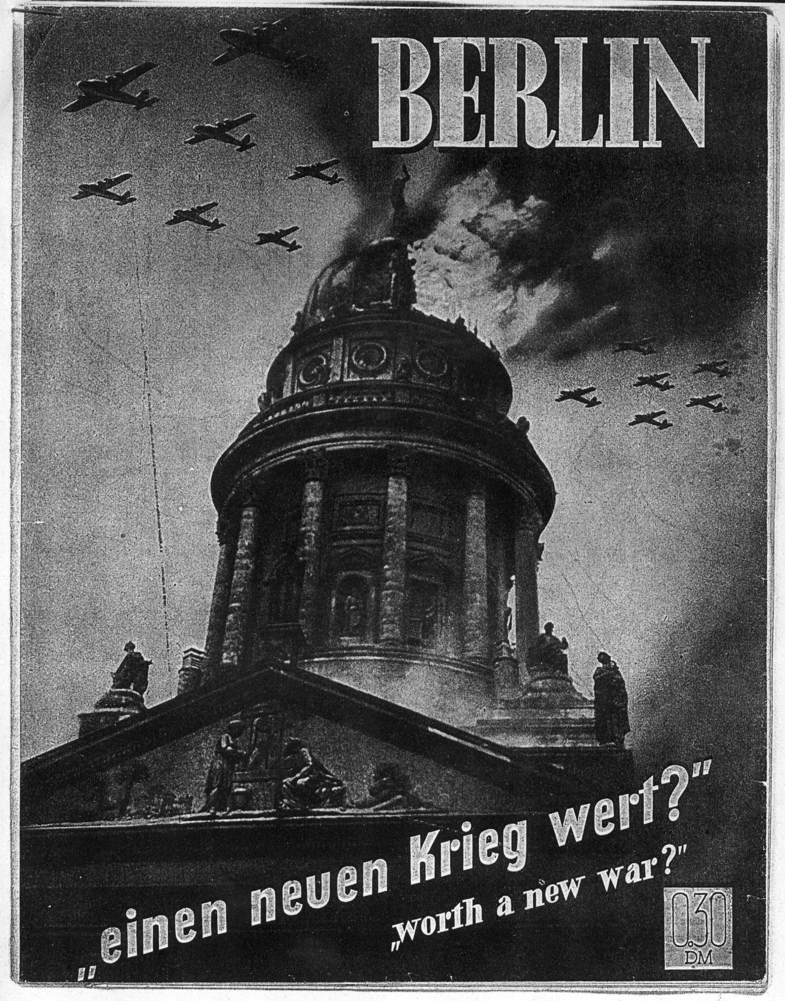
What do you think?
Berlin: Worth a new war?
The Berlin Airlift operation continued until September 1949, four months after the Soviets had lifted the blockade, in order to replenish the city's reserves.

Slide 11
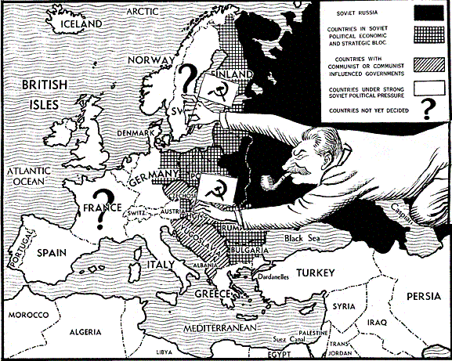
Now that the USSR is really exerting their communist beliefs/power over Eastern Europe, what do you think will happen NEXT?

Slide 12
NATO
TAKE A PIC
Fears of Soviet aggression led to the formation of the North Atlantic Treaty Organization in 1949:
GOAL: Provide collective security for Western Europe, the USA, Canada, Greece, & Turkey
General D. Eisenhower = 1st supreme commander
The Cold War now had an ideological (Truman Doctrine) & economic (Marshall Plan) base & military enforcement (NATO)
Washington’s Farwell Address (1796) – AVOID PERMANENT ALLIANCES WITH EUROPEAN NATIONS! This is a major departure from the traditional U.S. policy of isolationism

Slide 13
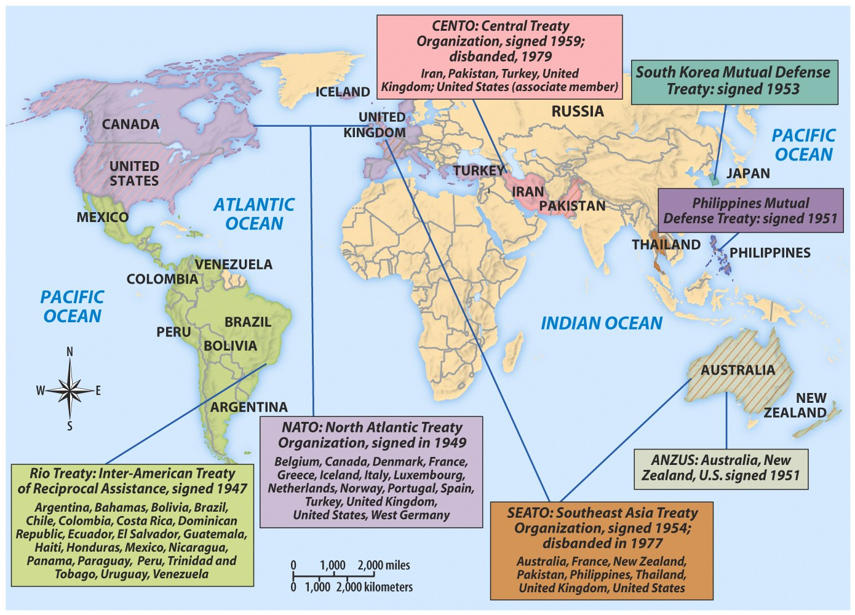
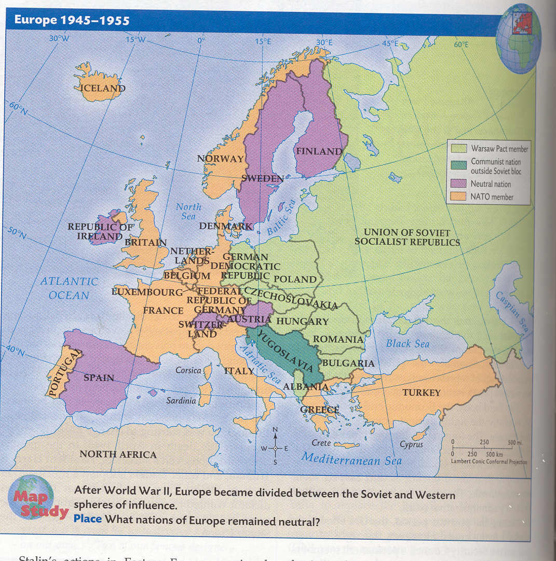
The USSR responded in 1955 with the formation of the Warsaw Pact

Slide 14
The Military Dimension
3 new agencies were created so the military could better respond to threats to U.S. security
Dept of Defense to direct the army, navy, & the new air force
Central Intelligence Agency to collect & manage information among all government agencies
National Security Council to advise the president on national security

Slide 15
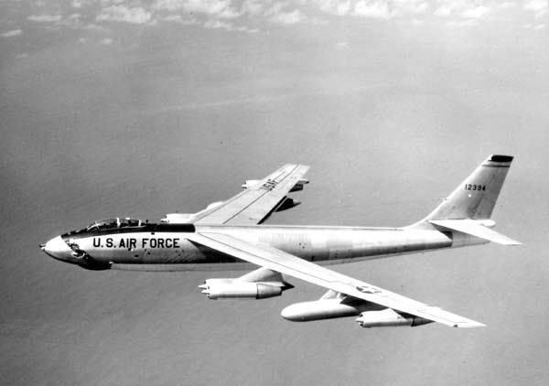
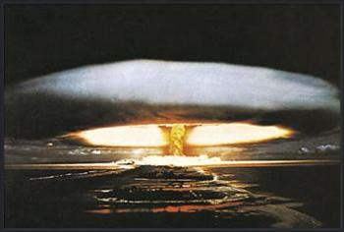
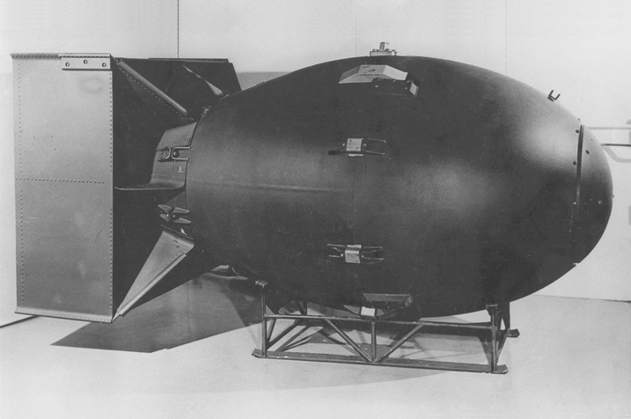
The Nuclear Arms Race
Delivering a Hydrogen Bomb
The Soviet testing of the atomic bomb motivated the USA to regain its advantage; In 1952, the U.S. tested the 1st hydrogen bomb (1,000 times more powerful than the a-bomb)
The American monopoly on nuclear weapons technology ended in 1949 when the USSR successfully tested their own atomic bomb
The Soviets responded with their own h-bomb in 1953

Slide 16
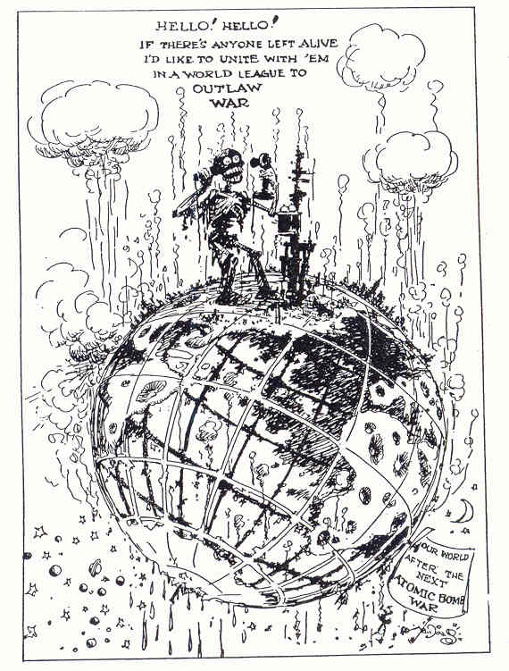
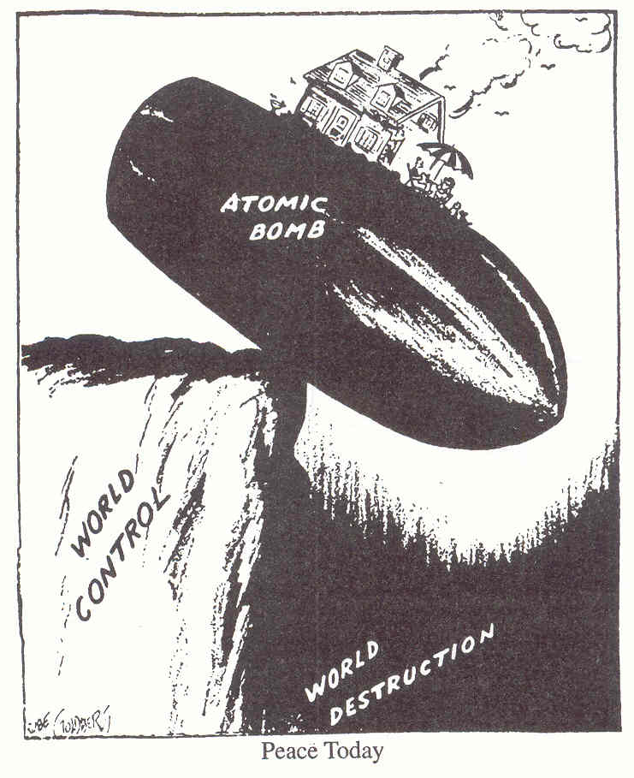

Slide 17
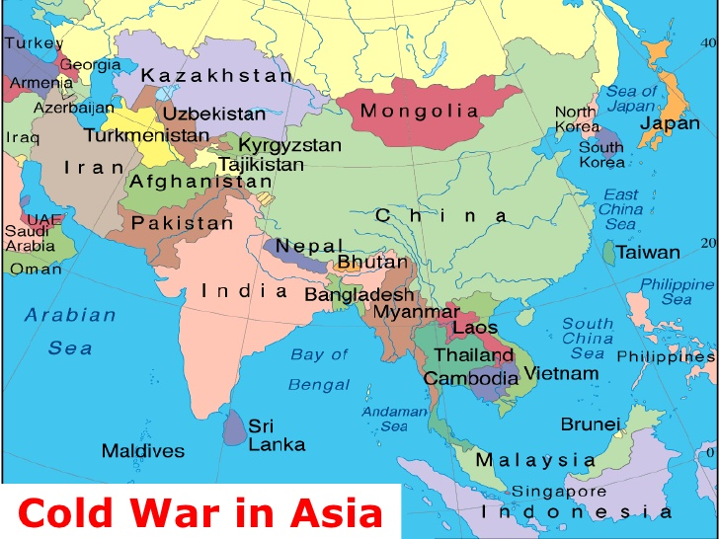
The Cold War Expands

Slide 18
The Cold War in Asia
COPY LATER, review from GLOBAL
The U.S. refused to recognize Communist China & continued its diplomatic relations with the Kuomintang Nationalists in Taiwan
By 1952, Asia also was divided:
In 1949, Truman “lost” China after a Mao Zedong’s defeat of Chiang Kai-shek & Kuomintang
In 1950, China signed a mutual assistance treaty with the USSR

Slide 19
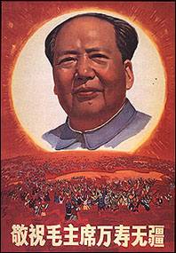
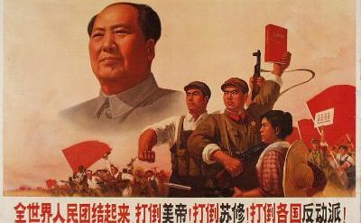
Based upon this chart, why were Mao & the Communists so popular among the Chinese people?
Industrial workers
Chinese Communist propaganda
What message does this poster project?
Farmers
Loyal communists
Notice the sun
Women
Notice the Chinese people
Chinese Communist propaganda
Who might this poster appeal to?

Slide 20
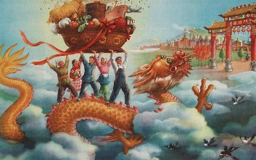
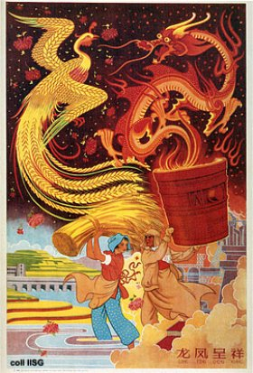
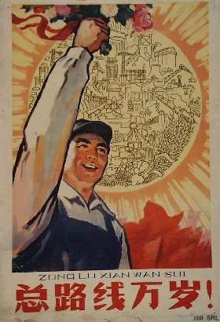
Great Leap Forward propaganda
“Struggle hard for 3 years. Change the face of China. Catch up with Britain & [America].”

Slide 21
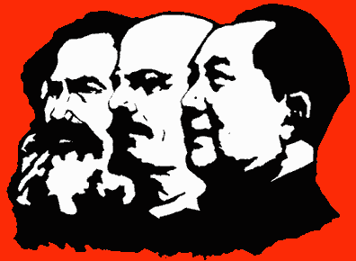
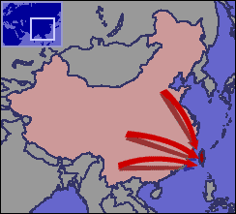
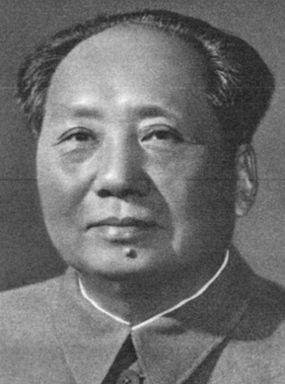
Chinese Civil War
VS.
Nationalist Leader Chiang Kai-shek (Kuomintang)
Communist Leader Mao Zedong

Slide 22
Statement by Secretary of State Dean Acheson, August 5, 1949
The unfortunate but inescapable fact is that the ominous result of the civil war in China was beyond the control of the government of the United States. Nothing that this country did or could have done within the reasonable limits of its capabilities could have changed that result; nothing that was left undone by this country has contributed to it. It was the product of internal Chinese forces, forces which this country tried to influence but could not.
And now it is abundantly clear that we must face the situation as it exists in fact. We will not help the Chinese or ourselves by basing our policy on wishful thinking. We continue to believe that, however tragic may be the immediate future of China and however ruthlessly a major portion of this great people may be exploited by a party in the interest of a foreign imperialism, ultimately the profound civilization and the democratic individualism of China will reassert themselves and she will throw off the foreign yoke. I consider that we should encourage all developments in China which now and in the future work toward this end.

Slide 23
How did the USA plan to react to the Soviet atomic bomb and Communist revolution in China?
“A more rapid buildup of political, economic, and military strength and thereby of confidence in the free world than is now contemplated is the only course which is consistent with progress toward achieving our fundamental purpose. The frustration of the Kremlin design requires the free world to develop a successfully functioning politic and economic system and a vigorous political offensive against the Soviet Union. These, in turn, require an adequate military shield under which they can develop. It is necessary to have the military power to deter, if possible, Soviet expansion, and to defeat, if necessary, aggressive Soviet or Soviet-directed actions of a limited or total character."

Slide 24
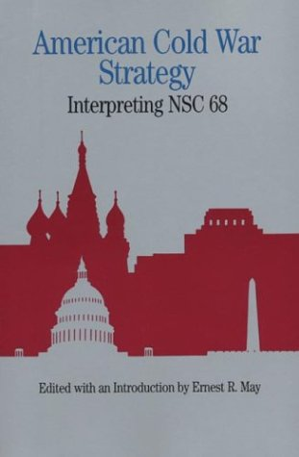
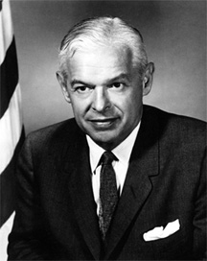
In response to the Soviet atomic bomb & Communist revolution in China, the USA developed NSC-68 (National Security Council -1950)
U.S. defense plan goes from containment to liberation from communism
Massive US arms buildup to fight the “fanatical” & “permanent” threat of communism
“The U.S.S.R.’s desire for world domination requires not only to this Republic but civilization itself take a stand”
–NSC 68
Notes:
NSC-68: “A more rapid buildup of political, economic, and military strength and thereby of confidence in the free world than is now contemplated is the only course which is consistent with progress toward achieving our fundamental purpose. The frustration of the Kremlin design requires the free world to develop a successfully functioning jpoliticand economic system and a vigorous political offensive against the Soviet Union. These, in turn, require an adequate military shield under which they can develop. It is necessary to have the military power to deter, if possible, Soviet expansion, and to defeat, if necessary, aggressive Soviet or Soviet-directed actions of a limited or total character. The potential strength of the free world is great; its ability to develop these military capabilities and its will to resist Soviet expansion will be determined by the wisdom and will with which it undertakes to meet its political and economic problems.”

Slide 25
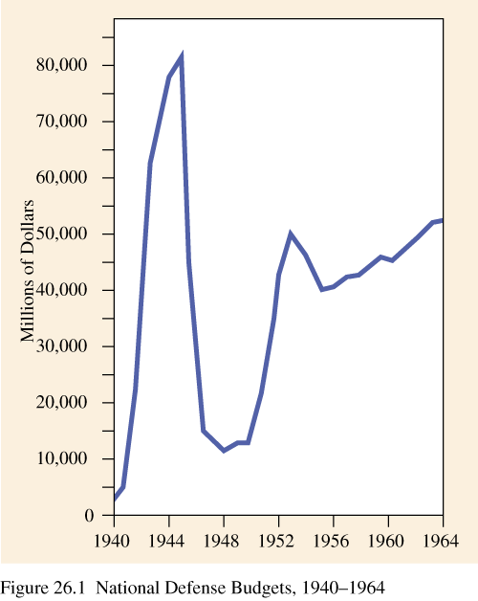
National Defense Budget as a result of NSC-68

Slide 26
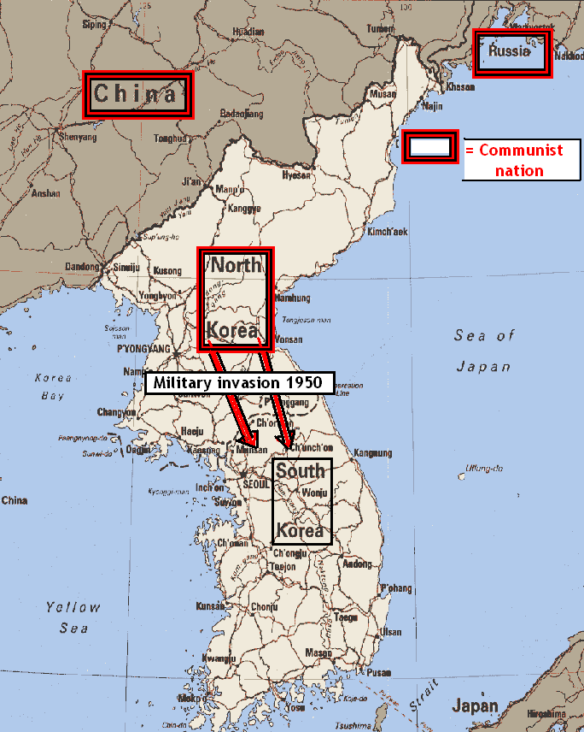
To what extent did Korea become a “hot spot” of the Cold War?
“The Soviet Union is engaged in a monstrous conspiracy to stamp out freedom all over the world. It must be clear to everyone that the United States cannot--and will not- allow this to continue.
The only question is: What is the best time to meet the threat and how is the best way to meet it?
The best time to meet the threat is in the beginning. It is easier to put out a fire in the beginning when it is small than after it has become a roaring blaze.” –Pres. Harry Truman 1950
According to Truman and the map, what and where is the “threat”?

Slide 27
From your Korean War homework worksheets you completed over break…
Why was there both a Soviet and US army presence in Korea after WWII?
Where were their territories divided?
How did Truman respond to the actions of North Korea?

Slide 28
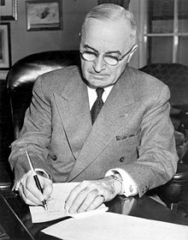
VIDEO – Truman speech (Korea)
In your own words, what explanation did President Truman give for sending Americans to go to war in Korea?
Thursday April 6, 2017
Trump addressed the nation regarding a military bombing strike on Syria…
As you watch, what similarities do notice between Truman’s and Trump’s addresses to the nation?
VIDEO

Slide 29
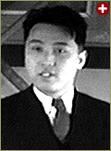
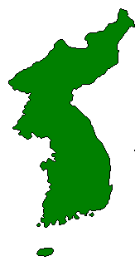
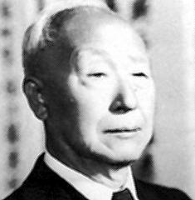
Korean War [1950-1953]
Kim Il-Sung
Syngman Rhee
“Domino Theory”

Slide 30
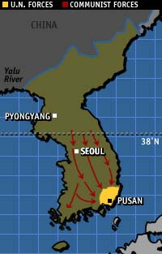
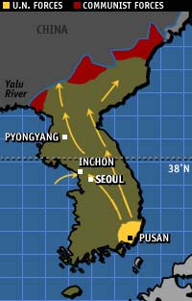
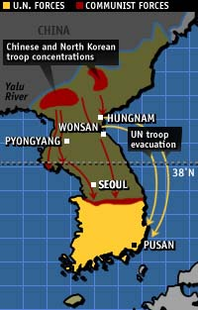
Truman was unable to end the Korean War
United Nations Counter-Attack
September-October 1950
North Korean Invasion
June-September 1950
Chinese Advance
October-January 1951
Eisenhower made the Korean War a campaign issue in 1952

Slide 31
Who was involved in the UN Military Action in Korea besides the US and South Korea?
“When hostile North Korean forces crossed the 38th parallel in Korea in June of 1950, the United Nations Security Council called for an immediate end to hostilities. When its further demand that North Korea withdraw forces from the southern half of the Korean peninsula fell on deaf ears, the UN Security Council recommended that members of the United Nations join forces to repel the attack. Twenty-one nations agreed to contribute arms, money, medical supplies, and/or troops to rid South Korea of the Communist aggressor.”
General Douglas MacArthur, as head of the US military presence in Korea and Japan, was placed in charge of task for sent to handle this “police-action”
“Fifteen foreign nations other than the United States and South Korea sent combat forces to serve in the United Nations Command in Korea during the Korean War. Five noncombatant nations provided hospitals or ambulance units. Approximately 150,000 foreign servicemen fought, and foreign casualties included 3,360 killed, 11,886 wounded and 1,801 servicemen missing in action. There were 1,376 foreign prisoners of war repatriated to 12 countries in 1953.”
Country | Dates of Service
Australia | July 1, 1950 to February 12, 1954
Belgium | January 31, 1951 to June 15, 1955
Canada | July 30, 1950 to September 7, 1955
Colombia | June 15, 1951 to October 11, 1955
Ethiopia | May 7, 1951 to January 3, 1965
France | July 22, 1950 to November 6, 1953
Greece | December 9, 1950 to December 11, 1955
Luxembourg | January 31, 1951 to June 15, 1955
Netherlands | November 23, 1950 to December 6, 1954
New Zealand | August 1, 1950 to October 6, 1954
Philippines | September 19, 1950 to May 13, 1955
South Africa | November 16, 1950 to October 31, 1953
Thailand | November 7, 1950 to June 23, 1972
Turkey | October 19, 1950 to September 4, 1953
United Kingdom | June 30, 1950 to 1957 (date unknown)

Slide 32
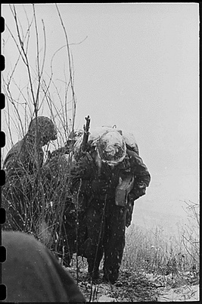
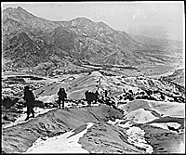
What are are some of the impressions you are given about the US presence in Korea during the Korean War?
U.S. military patrols in Korea battle bitter cold, December of 1950
Men of the 19th Infantry Regiment work their way over the snowy mountains about 10 miles north of Seoul, Korea, attempting to locate the enemy lines and positions. 01/03/1951
Notes:
http://asianhistory.about.com/od/warsinasia/ig/Korean-War-Photos

Slide 33
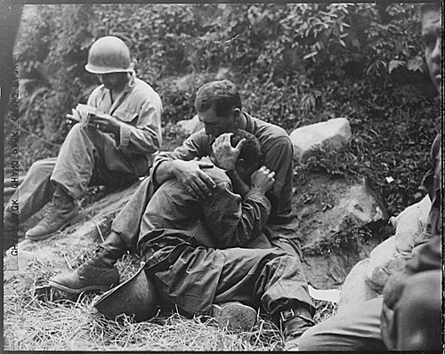
What are are some of the impressions you are given about the US presence in Korea during the Korean War?
A soldier collapses with grief after his buddy dies, and is comforted, at Haktong-ni. August 28, 1950.
Notes:
http://asianhistory.about.com/od/warsinasia/ig/Korean-War-Photos

Slide 34
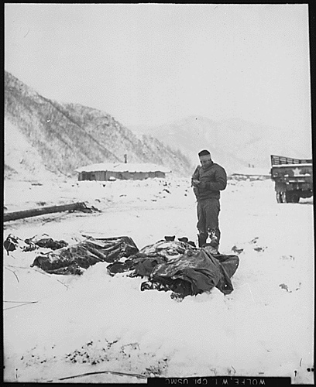
What are are some of the impressions you are given about the US presence in Korea during the Korean War?
An injured chaplain prays over the bodies of dead U.S. Marines at Kotori, December 3, 1950.
Notes:
http://asianhistory.about.com/od/warsinasia/ig/Korean-War-Photos

Slide 35
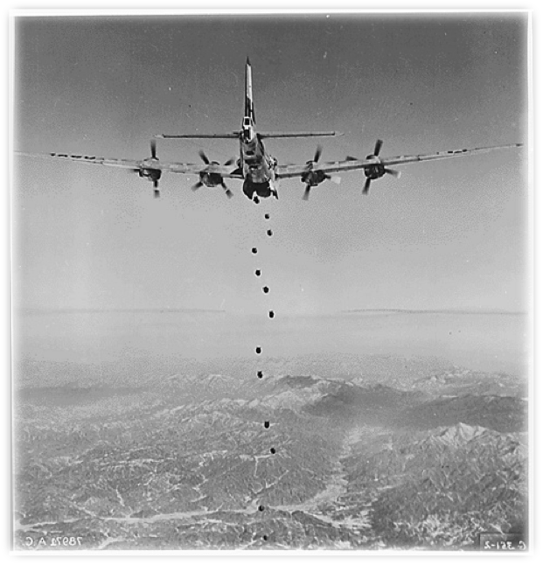
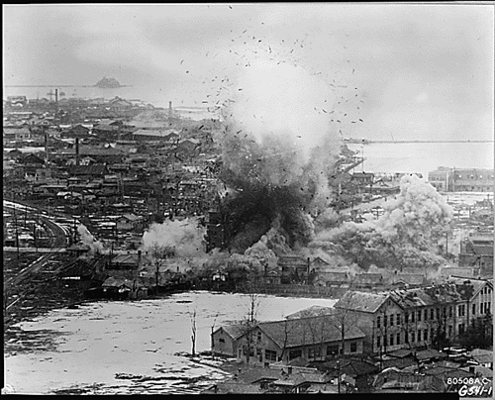
A UN bomber makes a run over North Korea, February of 1951.
A church in Wonsan that was used as an ammunition dump by the Communist forces is bombed, March of 1951.
What are are some of the impressions you are given about the US presence in Korea during the Korean War?
Notes:
http://asianhistory.about.com/od/warsinasia/ig/Korean-War-Photos

Slide 36
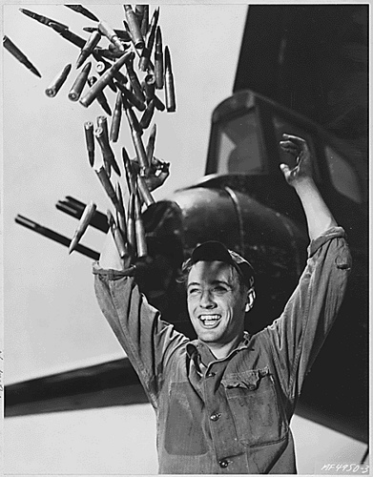
U.S. airman reacts to news that a truce has been declared, and the Korean War is (unofficially) over. July, 1953.
What are are some of the impressions you are given about the US presence in Korea during the Korean War?
Notes:
http://asianhistory.about.com/od/warsinasia/ig/Korean-War-Photos

Slide 37
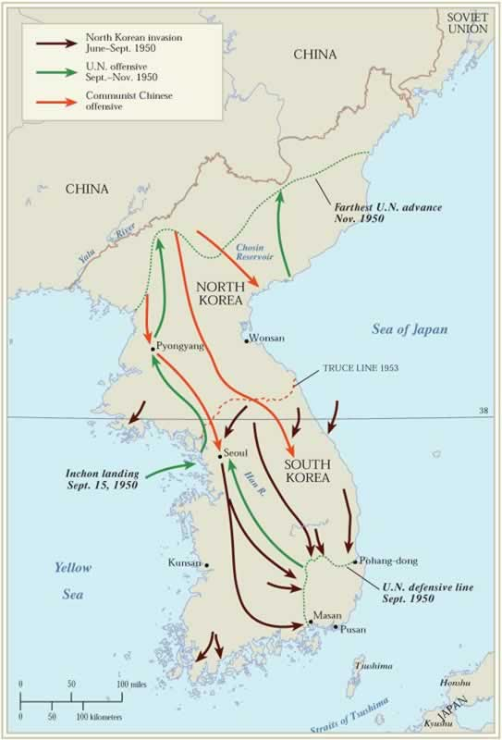
According to your Korean War (1951) homework worksheet…
Excerpt “A” –
What did General Douglas MacArthur think should be done to win the Korean War in early 1951?
How far do you think he would be willing to go to stop the Chinese from getting involved in the conflict?
Excerpt “B” –
Why did Secretary of State Acheson feel this was a bad idea?

Slide 38
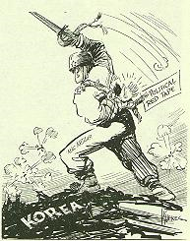
The MacArthur Controversy
In 1951, MacArthur recommended an attack on Chinese supply bases and suggested the possible use of an atomic bomb in China. This was after both a brilliant amphibious attack at Inchon that allowed UN forces to retake Seoul and the disastrous intervention of the Chinese forces that prevented an all-out victory for S. Korea in November of 1950
Why was MacArthur’s behavior deemed as “unprofessional?” How did that impact Truman?
Do you agree or disagree with Truman’s decision to fire General MacArthur? Why or Why not?
President Truman felt that these actions might draw the Soviet Union further into the conflict and lead to WWIII.
In March, Truman drew up a cease-fire proposal and a few days later MacArthur announced that he might expand the war to China. This was one in a series of statements made by MacArthur that openly defied Truman’s stated war policy. Truman wrote about MacArthur's announcement:
"It was in open defiance of my orders as President and Commander in Chief......By this act MacArthur left me no choice.....I could no longer tolerate his insubordination."
“I fired him [MacArthur] because he wouldn’t respect the authority of the President… I didn’t fire him because he was a dumb son of a bitch, although he was.”
On April 11, 1951, Truman fired MacArthur from all his commands in Korea and Japan. Despite this incident, MacArthur returned home a hero – not as a disgraced officer
Notes:
http://iconicphotos.files.wordpress.com/2009/04/distinguished-service-medal-from-truman.jpg?w=480&h=544
www.trumanlibrary.org/whistlestop/dailyfastfacts/ff011599.htm

Slide 39
On July 27th, 1953, the Korean War ended…
A peace treaty (armistice) was signed after 3 years of intense negotiation, the election of General Dwight D. Eisenhower to the presidency (who campaigned on ending the war and visited Korea), and threats of nuclear war against N. Korea
CRITICISMS of EISENHOWER’S DECISION
Senator William Jenner of Indiana called the armistice the “last tribute to appeasement.” House Speaker Joe Martin complained that Ike had not sought victory. Some suggested that if President Truman had agreed to the terms Eisenhower accepted he would have been impeached.
Eisenhower ignored the criticism. “The war is over,” he told press secretary James Hagerty. “I hope my son is going to come home soon.”

Slide 41
…& the U.S. became involved in France’s attempt to end an independence attempt by communist Ho Chi Minh

