Slide 1
NEXT REVIEW VOCAB DUE NEXT MONDAY 3/27 (PERIOD 2)
NEXT EXAM TUESDAY 3/28 (imperialism, WWI, 1920s, Great Depression)
REVIEW VOCAB (PERIOD 3) DUE NEXT FRIDAY 3/31
DO NOW: In your notebook, answer the following…
What actions of the 1920s might have contributed to the Great Depression?
What event is often the first to come to mind when you think of the Great Depression?
I ain’t got no home

Slide 2
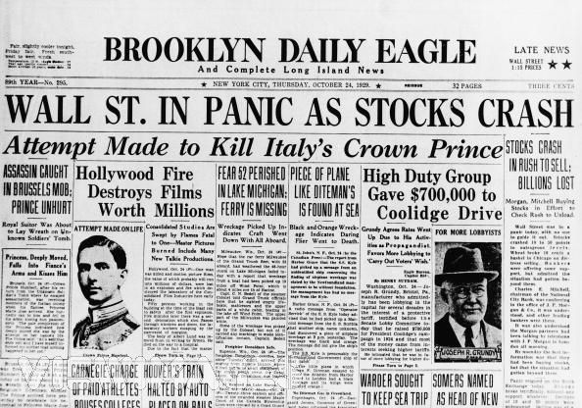
AIM: What factors led to the beginning of the Great Depression?

Slide 3
Review HOMEWORK Activity
SAQ PRACTICE: Answer ONE of the following…
Briefly explain ONE example of how religion and science were a source of conflict in American society during the 1920s.
Briefly explain ONE important difference in the immigration legislation of the 1920s in comparison to other periods.

Slide 4
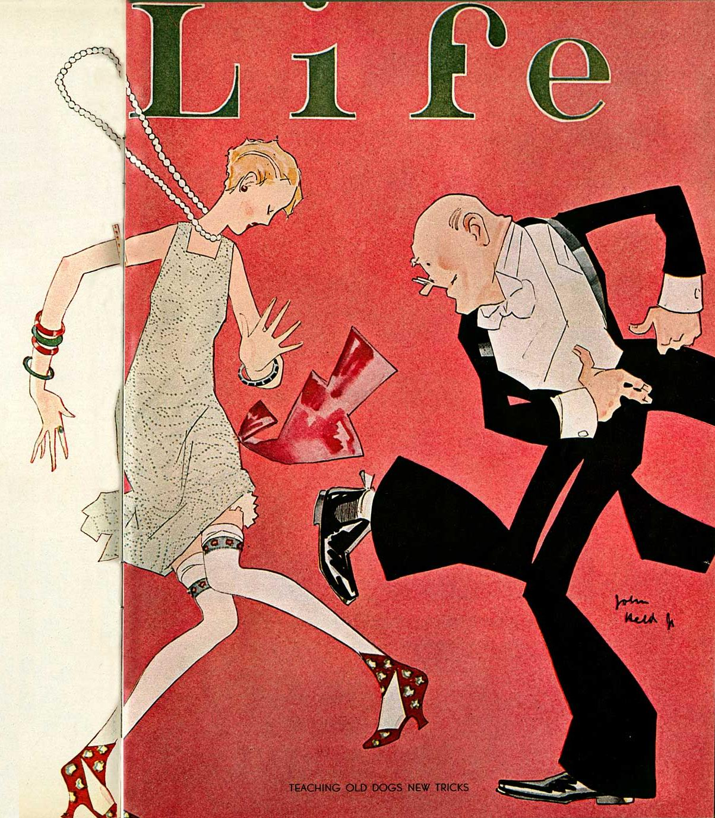
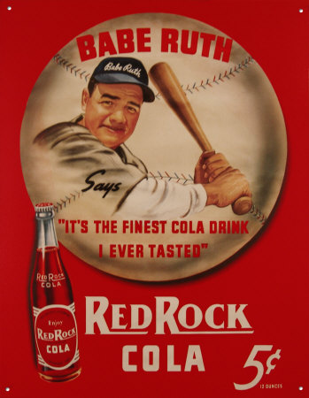
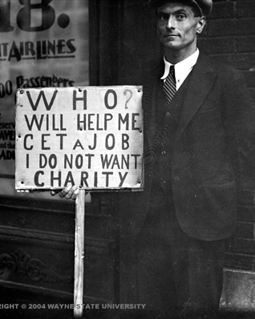
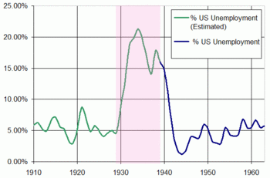
The 1920s were a decade of consumer spending and the economy looked healthy on the surface
Income did increase in the 1920s, but there were severe PROBLEMS with the U.S. economy
In October 1929, the “Roaring Twenties” came to an end and the Great Depression began…why?

Slide 5
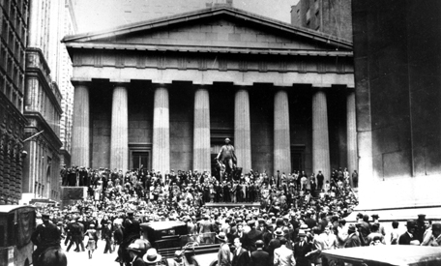
BEFORE the Wall Street Crash
BUSINESS is BOOMIN!
March 1928 – September 1929 = stock prices RISING
September 3 = Dow Jones Industrial Average all time high of 381!
Buying $1,000 worth of stock in 1928? Would’ve doubled in less than a year!
In 1927, the economy had a recession but gov’t & business leaders ignored warning signs.

Slide 6
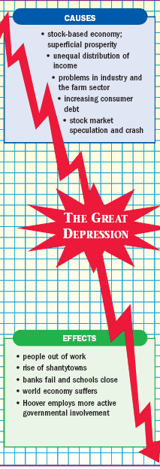
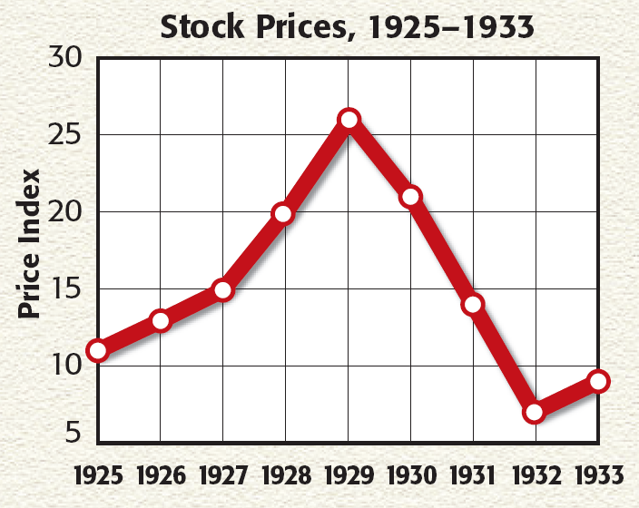
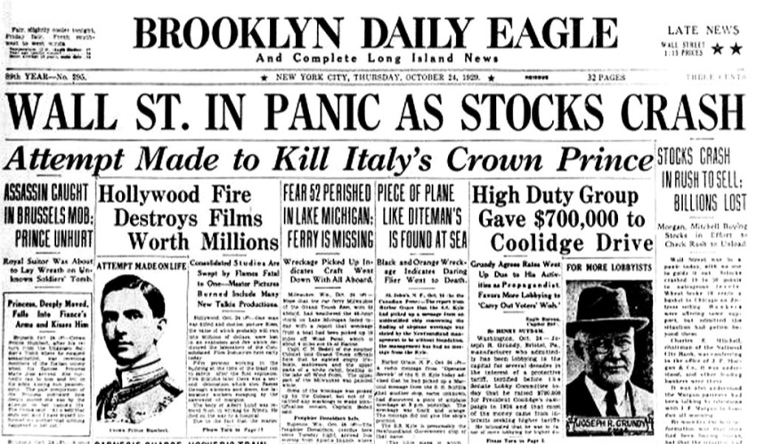
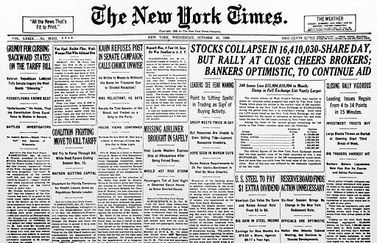
The spark that triggered the Great Depression was the stock market crash in October 1929
On October 29, 1929 (Black Tuesday) the stock market crashed
People rushed to sell = stock prices dropped (investors lost of $30 billion)
Banks lent less money, factories produced less, workers were fired or paid less → consumers had less money to spend → factories & businesses closed…
Risk-takers who bought on the margin, could not pay off their debts!
Notes:
By 1929, some economists had warned of weaknesses in the economy, but most Americans maintained the utmost confidence in the nation’s economic health. In increasing numbers, those who could afford to invested in the stock market. The stock market had become the most visible symbol of a prosperous American economy. Then, as now, the Dow Jones Industrial Average was the most widely used barometer of the stock market’s health. The Dow is a measure based on the stock prices of 30 representative large firms trading on the New York Stock Exchange. Through most of the 1920s, stock prices rose steadily. The Dow had reached a high of 381 points, nearly 300 points higher than it had been five years earlier. Eager to take advantage of this “bull market”—a period of rising stock prices— Americans rushed to buy stocks and bonds. One observer wrote, “It seemed as if all economic law had been suspended and a new era opened up in which success and prosperity could be had without knowledge or industry.” By 1929, about 4 million Americans—or 3 percent of the nation’s population—owned stocks. Many of these investors were already wealthy, but others were average Americans who hoped to strike it rich. However, the seeds of trouble were taking root. People were engaging in speculation—that is, they bought stocks and bonds on the chance of a quick profit, while ignoring the risks. Many began buying on margin—paying a small percentage of a stock’s price as a down payment and borrowing the rest. With easy money available to investors, the unrestrained buying and selling fueled the market’s upward spiral. The government did little to discourage such buying or to regulate the market. In reality, these rising prices did not reflect companies’ worth. Worse, if the value of stocks declined, people who had bought on margin had no way to pay off the loans

Slide 7
Read the 3 excerpts from the New York Times surrounding the days of the Stock Market Crash in 1929.
Answer the questions that follow, analyzing the point of view of the writer at the same time.

Slide 8
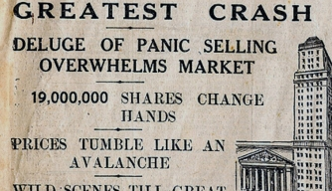
So, what caused the CRASH?

Slide 9
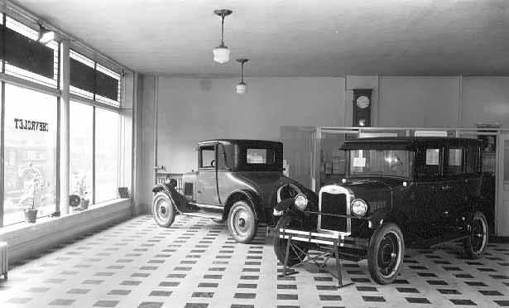
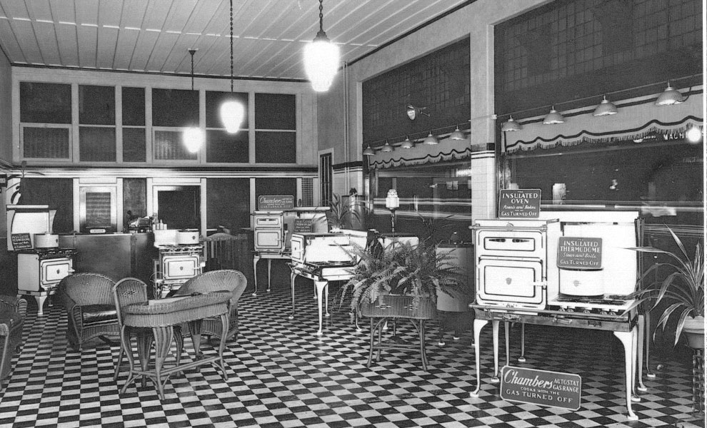
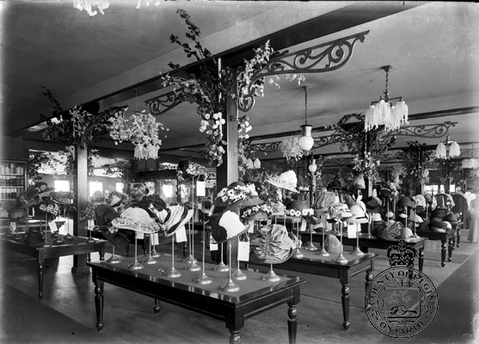
#1 Over-production and under-consumption
By the end of the 1920s, factories produced too many goods (over-production)
People DID NOT NEED as many goods and cars by the end of the decade (under-consumption)
Too much inventory… Not enough buyers

Slide 10
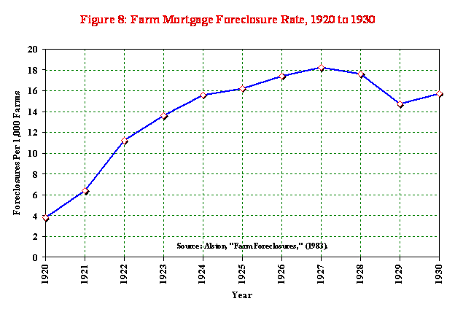
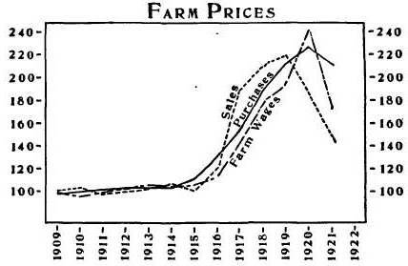
#2 Problems for farmers and industry
End of WWI led to a decline in demand for farm products and a 40% decline in crop prices
Farmers could not pay back loans and many had their farms foreclosed!
Railroads, textiles, coal were losing money and faced competition from cars, synthetic fabrics, natural gas
End of WWI

Slide 11
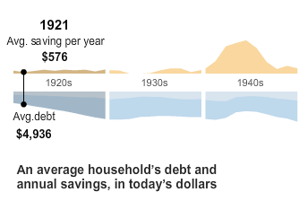
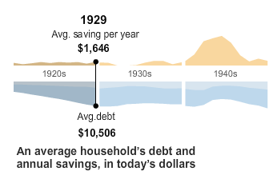
#3 Excessive use of credit = DEBT
Many Americans used credit to live beyond their means = generating large debts = cut back on spending by the end of the decade

Slide 12
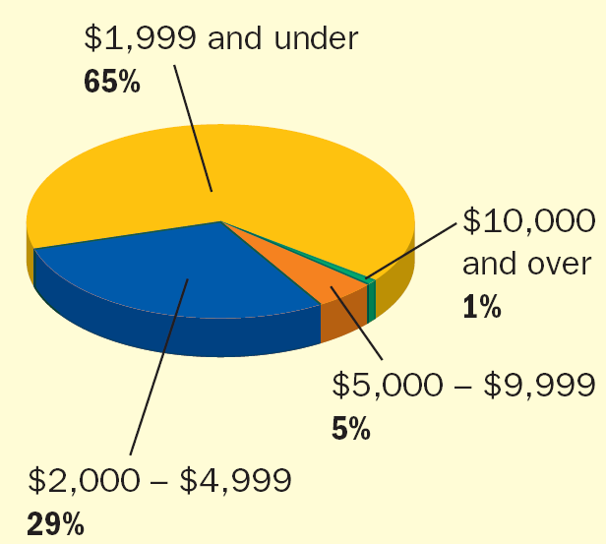
#4 Uneven distribution of income
The decade was not as wealthy as it appeared…
Despite rising wages, the gap between the rich and poor grew BIGGER in the 1920s
70% of Americans were considered “poor” so most of the spending was done by 30% of the population
* An income of $2,500 per year was the minimum amount for a decent standard of living

Slide 13
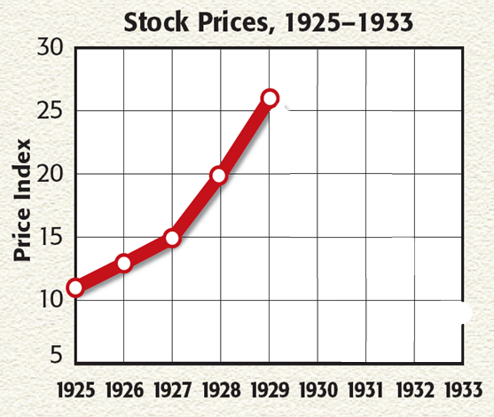
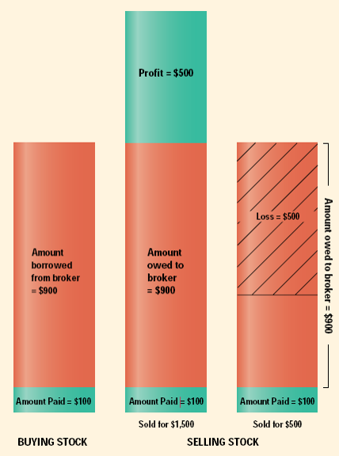
#5 Stock market speculation
Get rich by “playing the market”? NOT SO FAST!
The stock market SOARED throughout the 1920s and people gambled by borrowing money to pay for stocks (called buying on margin)
The stock market was not regulated by the government which allowed some companies to alter their stock prices to increase profits…
Notes:
By 1929, some economists had warned of weaknesses in the economy, but most Americans maintained the utmost confidence in the nation’s economic health. In increasing numbers, those who could afford to invested in the stock market. The stock market had become the most visible symbol of a prosperous American economy. Then, as now, the Dow Jones Industrial Average was the most widely used barometer of the stock market’s health. The Dow is a measure based on the stock prices of 30 representative large firms trading on the New York Stock Exchange. Through most of the 1920s, stock prices rose steadily. The Dow had reached a high of 381 points, nearly 300 points higher than it had been five years earlier. Eager to take advantage of this “bull market”—a period of rising stock prices— Americans rushed to buy stocks and bonds. One observer wrote, “It seemed as if all economic law had been suspended and a new era opened up in which success and prosperity could be had without knowledge or industry.” By 1929, about 4 million Americans—or 3 percent of the nation’s population—owned stocks. Many of these investors were already wealthy, but others were average Americans who hoped to strike it rich. However, the seeds of trouble were taking root. People were engaging in speculation—that is, they bought stocks and bonds on the chance of a quick profit, while ignoring the risks. Many began buying on margin—paying a small percentage of a stock’s price as a down payment and borrowing the rest. With easy money available to investors, the unrestrained buying and selling fueled the market’s upward spiral. The government did little to discourage such buying or to regulate the market. In reality, these rising prices did not reflect companies’ worth. Worse, if the value of stocks declined, people who had bought on margin had no way to pay off the loans

Slide 14
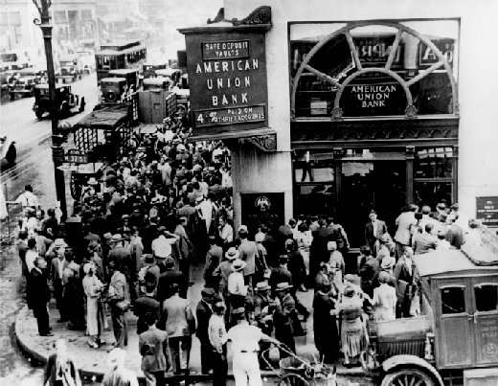
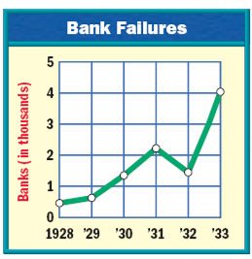
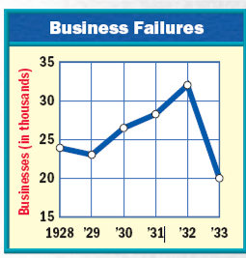
After the crash, people tried to withdraw (take out) their money from banks
The Bank Run
When banks could not produce money for all their customers, the banks FAILED!
This led to a run on banks across the U.S… hundreds of banks failed and thousands of people lost their savings!
The banking failure and stock market crash led to the collapse of thousands of businesses
Notes:
The Stock Market Crashes In early September 1929, stock prices peaked and then fell. Confidence in the market started to waver, and some investors quickly sold their stocks and pulled out. On October 24, the market took a plunge. Panicked investors unloaded their shares. But the worst was yet to come.
BLACK TUESDAY On October 29—now known as Black Tuesday—the bottom fell out of the market and the nation’s confidence. Shareholders frantically tried to sell before prices plunged even lower. The number of shares dumped that
day was a record 16.4 million. Additional millions of shares could not find buyers. People who had bought stocks on credit were stuck with huge debts as the prices plummeted, while others lost most of their savings. By mid-November, investors had lost about $30 billion, an amount equal to how much America spent in World War I. The stock market bubble had finally burst.

Slide 15
Unemployment, 1929-1942
Americans lacked confidence in the future so they tried not to spend money
The decline in consumer confidence made the depression drag on until the 1940s
This downward spiral continued for 4 years; By 1932 unemployment was at 25%
When the Great Depression began, millions of people lost their jobs or took pay cuts to keep their jobs

Slide 16
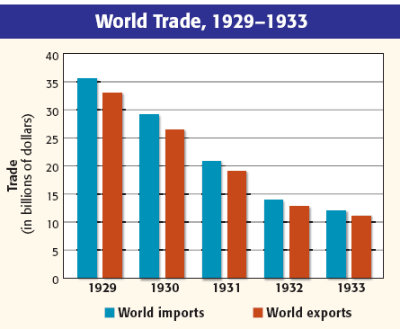
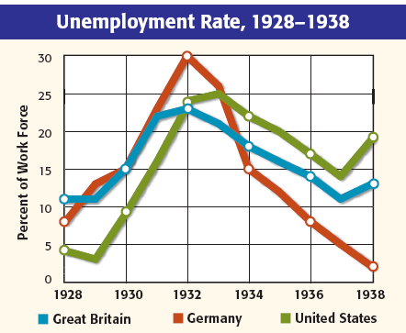
The Great Depression led to a global depression in Europe, Asia, and Latin America
World trade fell by 40%
To encourage citizens to buy from U.S. companies (not foreign competitors) the government passed new high tariffs…
…European nations responded with their own tariffs which made it difficult for U.S. companies to sell their goods overseas

Slide 17
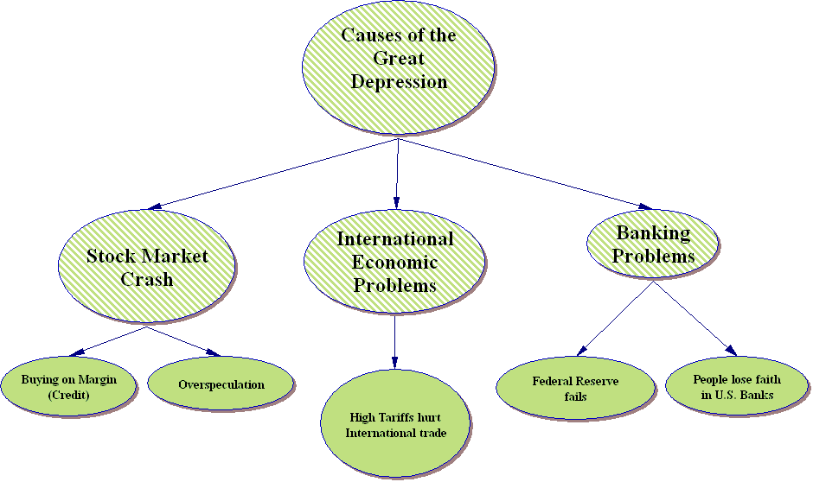

Slide 18
DISCUSSION
1. To what extent do you think idealism about American prosperity and the American dream responsible for the Crash?
2. Why did the causes of the Great Depression led to calls for government action and reform?

Slide 19
Answering AIM: What factors led to the beginning of the Great Depression?
Could it have been avoided?

