Slide 1
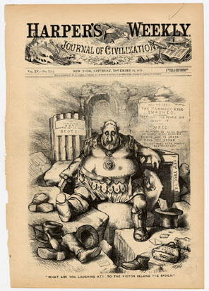
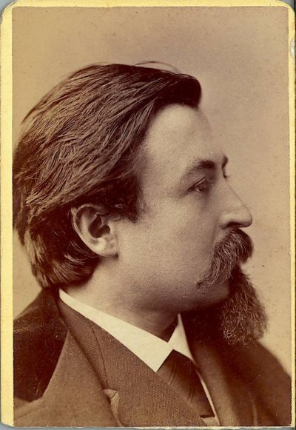
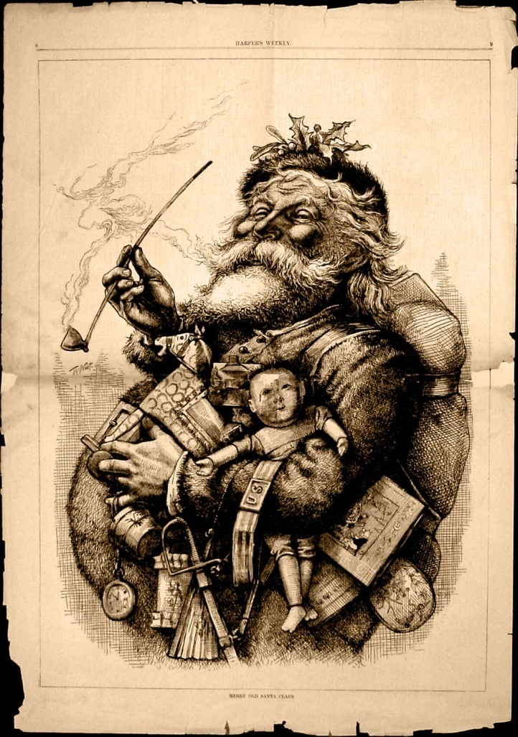
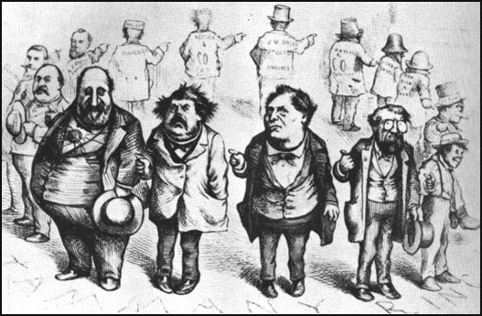
Thomas Nast

Slide 2
THOMAS NAST
Thomas Nast was the artist for Harper's Weekly in the late 1800’s.
"He has been called, the Father of American Caricature."
Nast's campaign against New York City's political boss William Tweed is legendary
Nast's cartoons depicted Tweed as a sleazy criminal
Tweed was known to say, "Stop them damn pictures. I don't care what the papers write about me. My constituents can't read. But, damn it, they can see the pictures."

Slide 3
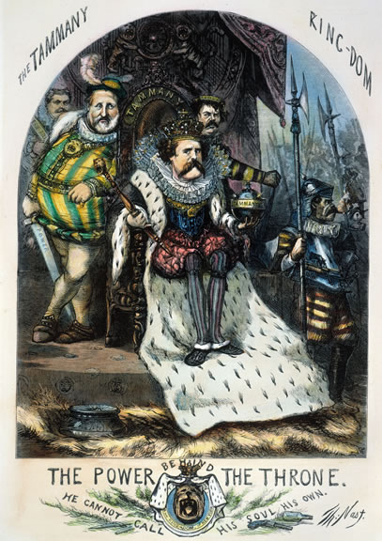
The Emergence of Political Machines
Political Machine
Organized group that controls a cities political party
Give services to voters, businesses for political, financial support
After Civil War, machines gain control of major cities
Machine organization: precinct captains, ward bosses, city boss

Slide 4
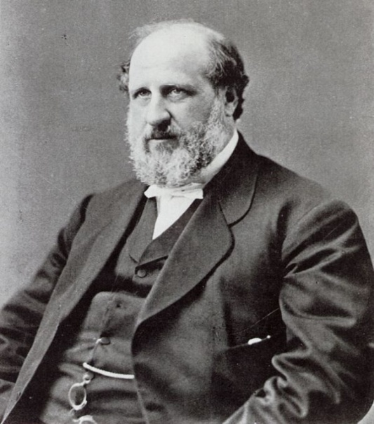
POLITICAL MACHINES
The Role of the Political Boss
May serve as mayor he:
controls city jobs, business licenses
influenced courts, municipal agencies
arranged building projects community services
•Bosses paid by businesses, get voters’ loyalty, extend influence
Immigrants and the Machine
Many captains, bosses 1st or 2nd generation Americans
Machines help immigrants with naturalization, jobs, housing
Election Fraud and Graft
•Machines use electoral fraud to win elections
•Graft—illegal use of political influence for personal gain
•Machines take kickbacks, bribes to allow legal, illegal activities

Slide 5
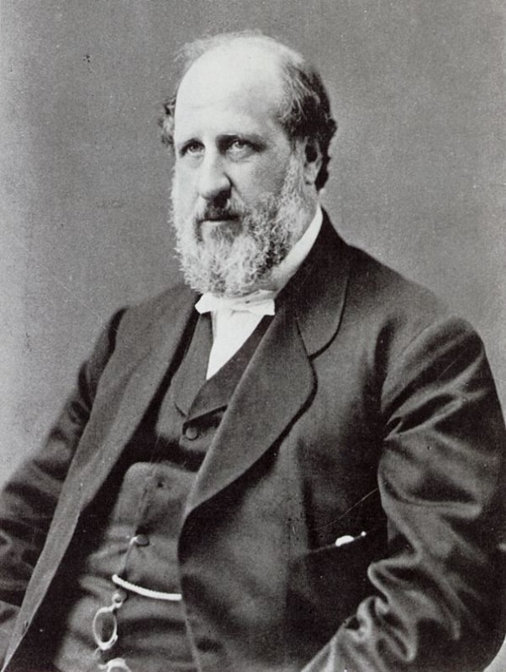
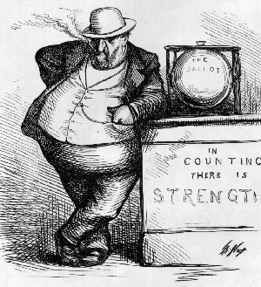
WILLIAM BOSS TWEED
Corrupt political leader put New York City in debt
Political boss
1851 elected to city council
1852 served in Congress
Kept Democratic Party in power in NYC called Tammany Hall
Formed the Tweed Ring
Bought votes, encouraged corruption, controlled NYC politics

Slide 6
WILLIAM BOSS TWEED
Received large fees for interests (*kickbacks) from the Erie Railroad
Tweed Ring milked the city with false leases, padded bills, false vouchers, unnecessary repairs and over-priced goods
*Return of a portion of the money received in a sale or contract often illegal and corrupt in return for special favors.

Slide 7
Thomas Nast

Slide 8
THOMAS NAST
Thomas Nast was the artist for Harper's Weekly in the late 1800’s.
"He has been called, the Father of American Caricature."
Nast's campaign against New York City's political boss William Tweed is legendary
Nast's cartoons depicted Tweed as a sleazy criminal
Tweed was known to say, "Stop them damn pictures. I don't care what the papers write about me. My constituents can't read. But, damn it, they can see the pictures."

Slide 9
The Emergence of Political Machines
Political Machine
Organized group that controls a cities political party
Give services to voters, businesses for political, financial support
After Civil War, machines gain control of major cities
Machine organization: precinct captains, ward bosses, city boss

Slide 10
POLITICAL MACHINES
The Role of the Political Boss
May serve as mayor he:
controls city jobs, business licenses
influenced courts, municipal agencies
arranged building projects community services
•Bosses paid by businesses, get voters’ loyalty, extend influence
Immigrants and the Machine
Many captains, bosses 1st or 2nd generation Americans
Machines help immigrants with naturalization, jobs, housing
Election Fraud and Graft
•Machines use electoral fraud to win elections
•Graft—illegal use of political influence for personal gain
•Machines take kickbacks, bribes to allow legal, illegal activities

Slide 11
WILLIAM BOSS TWEED
Corrupt political leader put New York City in debt
Political boss
1851 elected to city council
1852 served in Congress
Kept Democratic Party in power in NYC called Tammany Hall
Formed the Tweed Ring
Bought votes, encouraged corruption, controlled NYC politics

Slide 12
WILLIAM BOSS TWEED
Received large fees for interests (*kickbacks) from the Erie Railroad
Tweed Ring milked the city with false leases, padded bills, false vouchers, unnecessary repairs and over-priced goods
*Return of a portion of the money received in a sale or contract often illegal and corrupt in return for special favors.

Slide 13
Tweed was convicted for stealing an amount at between $25 million and $45 million from New York City taxpayers through political corruption, although later estimates ranged as high as $200 million.
$25-$200 million is between $1 and $8 billion in todays dollars.

Slide 14
Fraud!
By 1870, the Tweed ring was able to milk the city through such devices as faked leases, padded bills, false vouchers, unnecessary repairs, and overpriced goods and services bought from suppliers controlled by the ring.
Examples of the flagrant abuse of the public’s money were:
1) 40 old chairs and three tables: $179,792.60
(about $2 million today)
2) Repairing fixtures: $1,149,874.50 (about $14 million today)
3) A plasterer's wages during a nine month period: $2,870,464.06 (about $34 million today)
4) 30 months of advertising paid to a Tweed-controlled printing company: $7,168,212.23 (about $87 million today)

Slide 15
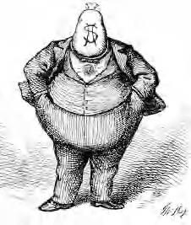
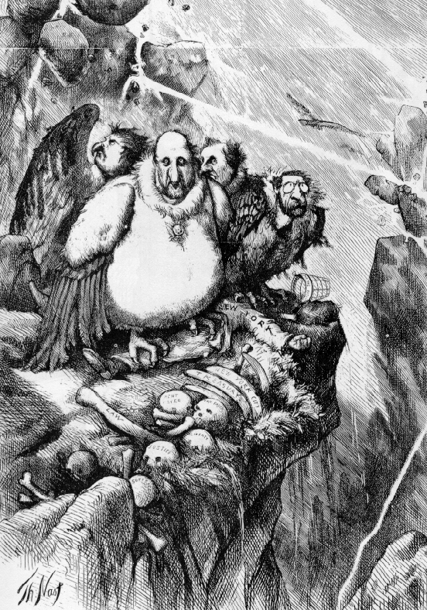
WILLIAM BOSS TWEED
Exposed for his corruption by cartoonist and editor, Thomas Nast
Tweed Ring fell and 1873 Tweed convicted of embezzlement
Later Tweed was arrested on a civil charge and jailed in NYC, later died there

Slide 16
Tweed was convicted for stealing an amount at between $25 million and $45 million from New York City taxpayers through political corruption, although later estimates ranged as high as $200 million.
$25-$200 million is between $1 and $8 billion in todays dollars.

Slide 17
Fraud!
By 1870, the Tweed ring was able to milk the city through such devices as faked leases, padded bills, false vouchers, unnecessary repairs, and overpriced goods and services bought from suppliers controlled by the ring.
Examples of the flagrant abuse of the public’s money were:
1) 40 old chairs and three tables: $179,792.60
(about $2 million today)
2) Repairing fixtures: $1,149,874.50 (about $14 million today)
3) A plasterer's wages during a nine month period: $2,870,464.06 (about $34 million today)
4) 30 months of advertising paid to a Tweed-controlled printing company: $7,168,212.23 (about $87 million today)

Slide 18
WILLIAM BOSS TWEED
Exposed for his corruption by cartoonist and editor, Thomas Nast
Tweed Ring fell and 1873 Tweed convicted of embezzlement
Later Tweed was arrested on a civil charge and jailed in NYC, later died there

