Slide 1
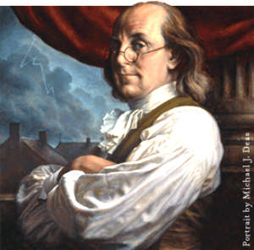
America after the Revolution
Colonists see themselves as a separate society
Distinct from Europe
No kings
The equality of man
More educated and liberal
Many come from the middle-class

Slide 2
During the Revolution, the new United States needed a functioning government
It was URGENT!
You are John Hancock, President of the Second Continental Congress. One MINOR issue is that you have 13 NEWLY INDEPENDENT STATES in America…do you:
Give them power to rule themselves individually like they want?
Have a central government rule over them, but give them some wiggle room to rule themselves at the same time?
Notes:
The Articles of Confederation were crafted from a combination of urgent necessity and past experience. After the colonies declared their independence in 1776, the leaders needed a government to oversee the operation of the war and, if victorious, help the country settle the peace. Fundamental issues needed to be addressed: How much political power should be given to the central government when cooperation among the states was so important? Would France gamble on aiding the fledgling nation if the United States appeared weak? How would the central government speak for all the states while each state maintained its sovereignty?
In 1777, the “Articles of Confederation and Perpetual Union” were drafted and submitted to the states for ratification, but the states didn’t approve the document until March of 1781. The Articles were modeled after the colonial charters, with the legislative branch having supremacy over the other branches. The Articles’ creators made sure that each state would remain sovereign and would retain all power not expressly given to the national Congress. This would insure that all decisions made by the government were subject to discussion and debate and that the states would never face a distant dominant power as when they were colonies under Britain.

Slide 3
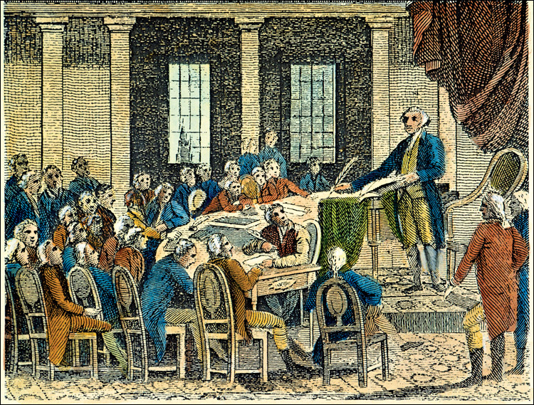
First, new STATE governments…
During the revolution, 13 colonies worked to give each state its own constitution
‘Right the Wrongs’ dealt under British rule:
3 BRANCHES = AVOID TYRANNY
ALL white males with property can VOTE
Natural Rights for ALL
Pennsylvania: “"All men are born equally free and independent."

Slide 4
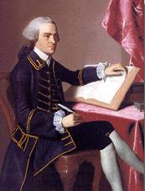
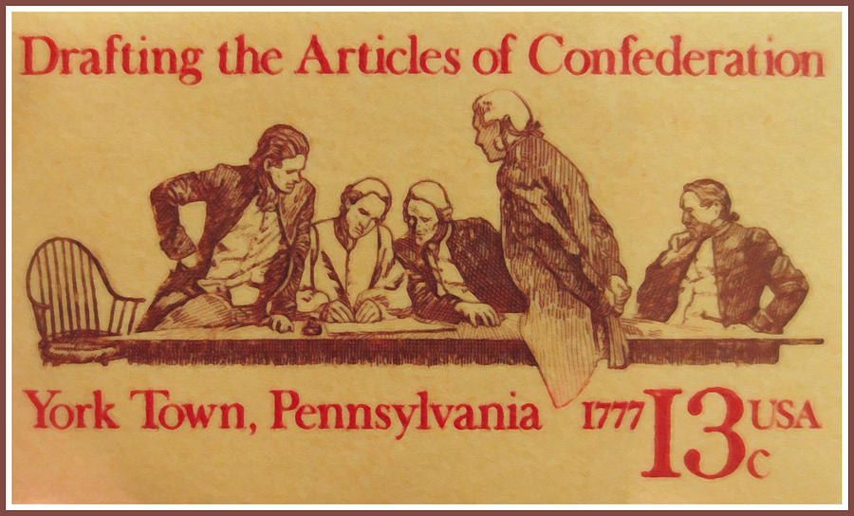
While the Declaration of Independence was being drafted…
1777- John Dickinson drafts the Articles of Confederation = the FIRST United States constitution
REMEMBER: states STILL had individual state constitutions
Is this going to work?

Slide 5
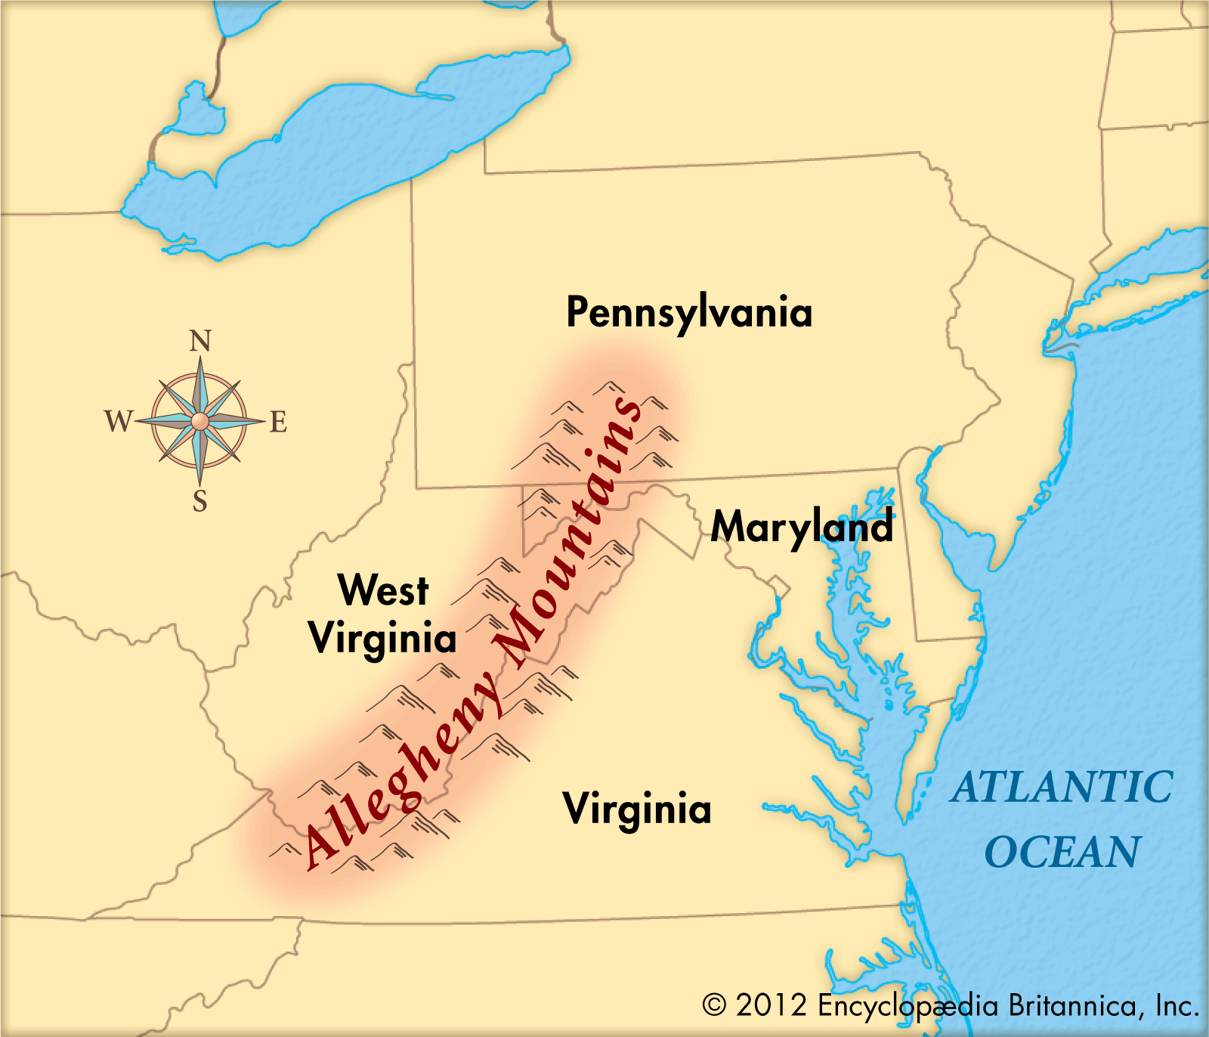
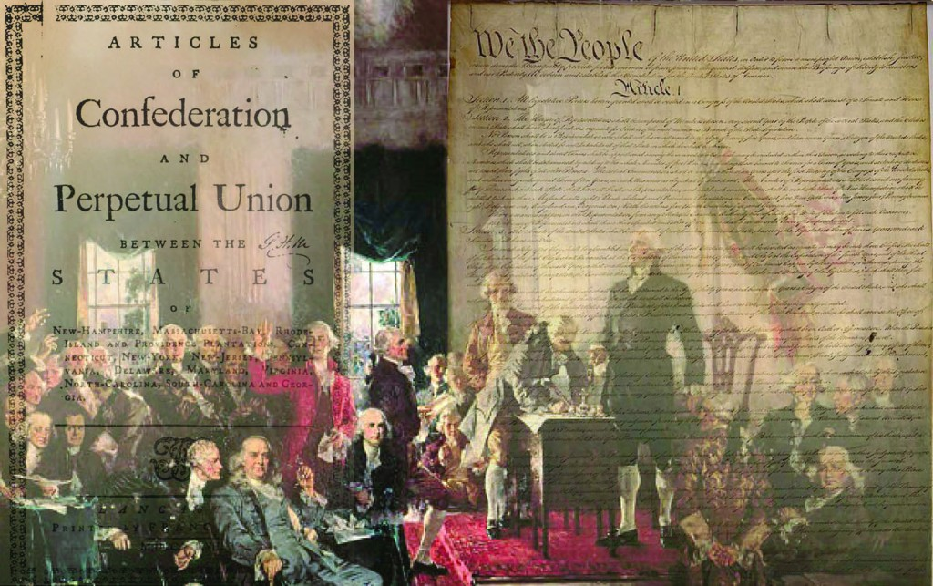
The Articles of Confederation
BUT RATIFICATION IS DELAYED!
Lands past Allegheny Mtns. = PROBLEM
RI and MD – lands belong to new central government
Jefferson told Maryland these lands would be made into new states (Maryland ☺)
NY and VA – give up their claims to these lands
The Articles of Confederation were RATIFIED in March 1781

Slide 6
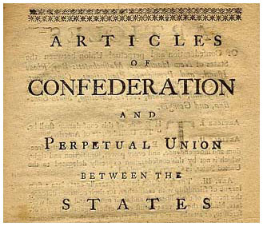
The New Structure of Government
National Government = ONE BODY (UNICAMERAL) = CONGRESS
Representation = ONE VOTE PER STATE (9 of 13 majority)
Amend the Articles? UNANIMOUS VOTE
Most of the power was held by the state governments, NOT the national gov’t, so the power was “decentralized”
Why not give more power to the national government INSTEAD?
The states feared a centralized government would limit their rights, and possibly lead to a dictator or king!

Slide 7
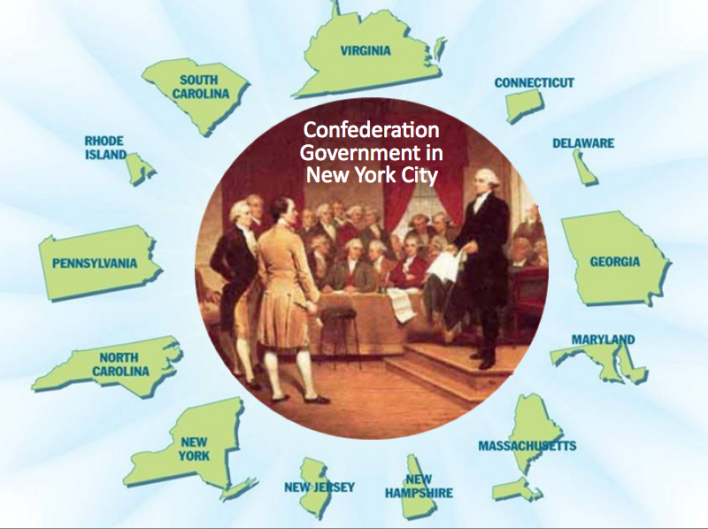
In a nutshell, this is what the nation looked like…

Slide 8
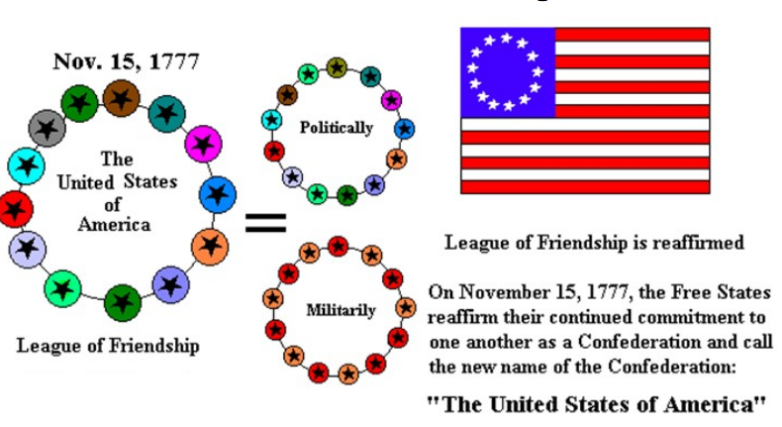
“Firm League of Friendship”
13 independent states were linked together for joint action in dealing with common problems.

Slide 9
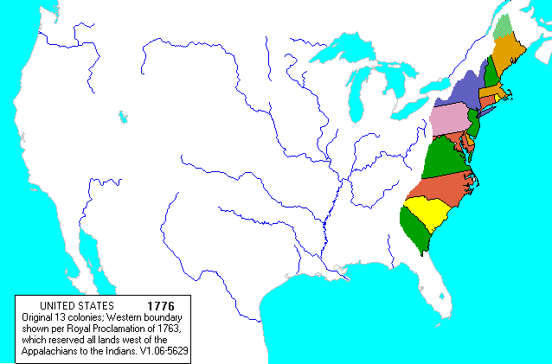
What do the Articles say?
“The said States hereby severally enter into a firm league of friendship with each other, for their common defense, the security of their liberties, and their mutual and general welfare, binding themselves to assist each other, against all force offered to, or attacks made upon them…”
Loosely connected states under WEAK nation gov’t
Unified for DEFENSE
13 separate countries with a defense alliance
Pro’s and Con’s of a
FRIENDSHIP?

Slide 10
Enough with the states, what could Congress do?
Congress COULD:
Declare WAR!
Build a navy
Send ambassadors/make alliances
Borrow/request money
Manage relations with natives
Congress COULD NOT:
Collect taxes (each state did it)
Draft soldiers
Regulate trade between states
Elect a leader
Settle disputes between states

Slide 13
AP MC REVIEW
Which of the following was one of the powers given to Congress in the Articles?
The power to tax the people directly
The power to borrow money
The power to regulate commerce between the states
The power to establish a federal judiciary

Slide 14
Always a consequence for weakness…
WEAKNESSES | STRENGTHS
1. No chief executive; the Congress worked through committees | 1. No coordination of committees and no uniform domestic or foreign policy
2. Required 9 of 13 states to approve laws (each state with ONE vote) | 2. Rarely delegates from all 13 states in Congress at once
3. All states required to approve amendments | 3. 13 states never agree!
4. No power to pass or collect taxes (make $$ only by borrowing) | 4. No reason for states to agree to requests
5. No power to enforce treaties | 5. No power to force British to abide by Treaty of Paris 1783
6. No power to enforce own laws | 6. Could only advise and request states abide by their laws

