Slide 1
AIM: Did the policies of Presidents Nixon, Ford, and Carter impact America more positively or negatively during the 1970s?

Slide 2
Richard Nixon
Presidential term:
January 20, 1969 – August 9, 1974

Slide 3
What is Nixon stepping into?
By the late 1960s, citizens had seen enough turmoil in U.S. foreign & domestic affairs:
The economic boom of the 1950s & 1960s was starting to come to an end
American prestige in the world was damaged by the failure in Vietnam
Anti-war protests, “hippie” culture, & liberal government programs led many citizens to believe that America was headed for moral decay & economic collapse

Slide 4
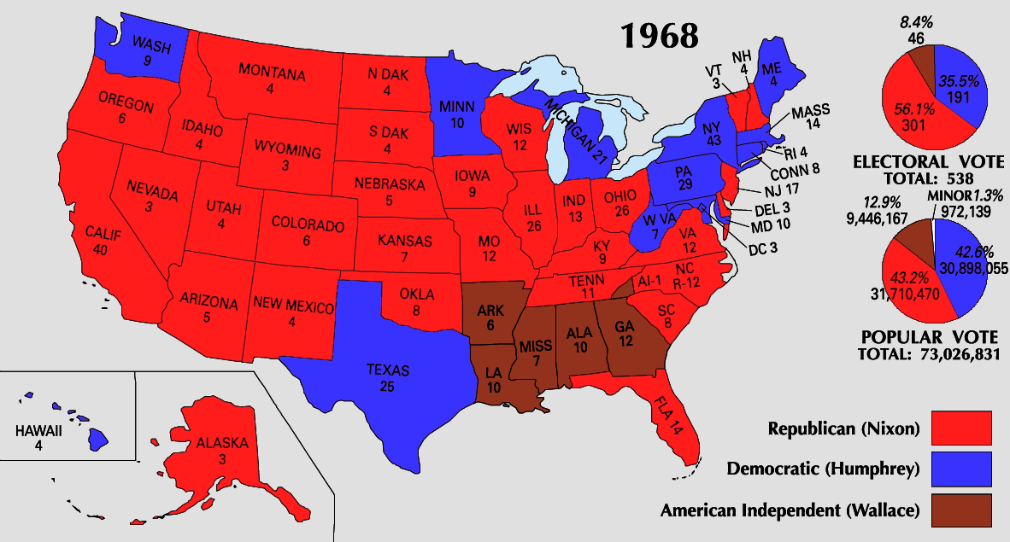
The Election of Richard Nixon
Nixon’s victory in 1968 was due to the turnout of a “silent majority” who wanted a more conservative government
In 1968, Americans elected conservative Republican Richard Nixon

Slide 5
Nixon’s Domestic Policy – NEW FEDERALISM
Conservative = limit size of the national government
Reduce or eliminate many Great Society programs – TOO $$
States more control over how money for welfare programs was spent

Slide 6
Nixon’s Domestic Policy - the Environment
Environmental Protection Agency (EPA)
regulate pollution, emissions, and other factors that negatively influence the natural environment
significant triumph for the environmentalist movement
Earth Day (1970)
Occupational Safety and Health Administration (OSHA)
assure safe and healthful working conditions for working men and women
Notes:
Clean Water---goals of how much toxin can be dumped
Endangered==establishes protection and lists of species

Slide 7
One Giant Leap for Mankind: Apollo 11 Mission
On July 20, 1969, astronaut Neil Armstrong became the first man to walk on the moon.
Fulfilled the goal JFK had set for the U.S. almost 10 years before, in 1961.

Slide 8
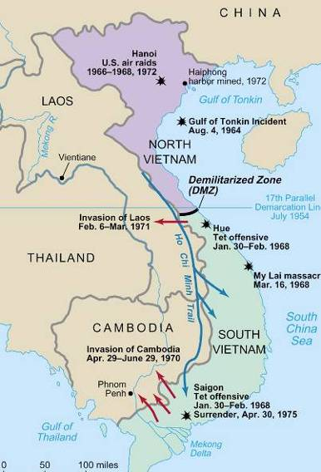
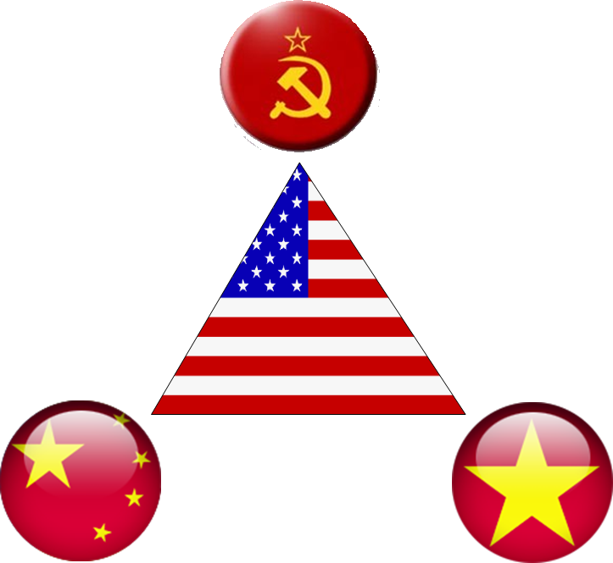
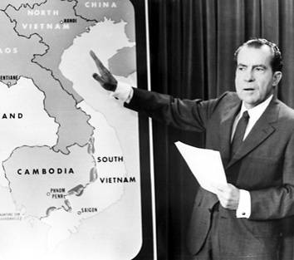
Nixon’s Foreign Policy - Vietnam
Nixon’s foreign policy included “peace with honor” in Vietnam
Nixon discussed plans for “Vietnamization” but secretly bombed Cambodia & Laos in 1970
In 1973, Nixon negotiated a cease fire, withdrew U.S. troops, & ended the Vietnam War

Slide 9
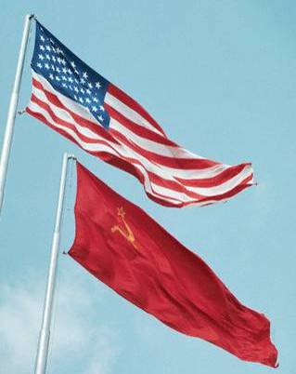
Nixon’s Foreign Policy - Détente
President Nixon successfully changed U.S. foreign policy
Instead of using containment to fight Communism & increase Cold War tensions…
First president to visit and recognize the People’s Republic of China
détente (relaxing of tensions) with America’s Cold War enemies
Allow for more US trade with China

Slide 10
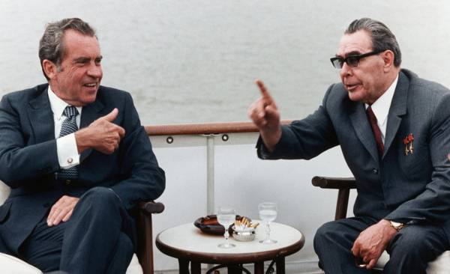
Richard Nixon & Foreign Policy
Nixon’s détente policy was aimed at easing Cold War tensions with the USSR
In 1972, Nixon became the 1st president to visit Moscow; His visit led to the Strategic Arms Limitation Talks (SALT) to limit missiles
By visiting China, Nixon pressured Soviet leader Brezhnev to negotiate with the United States

Slide 11
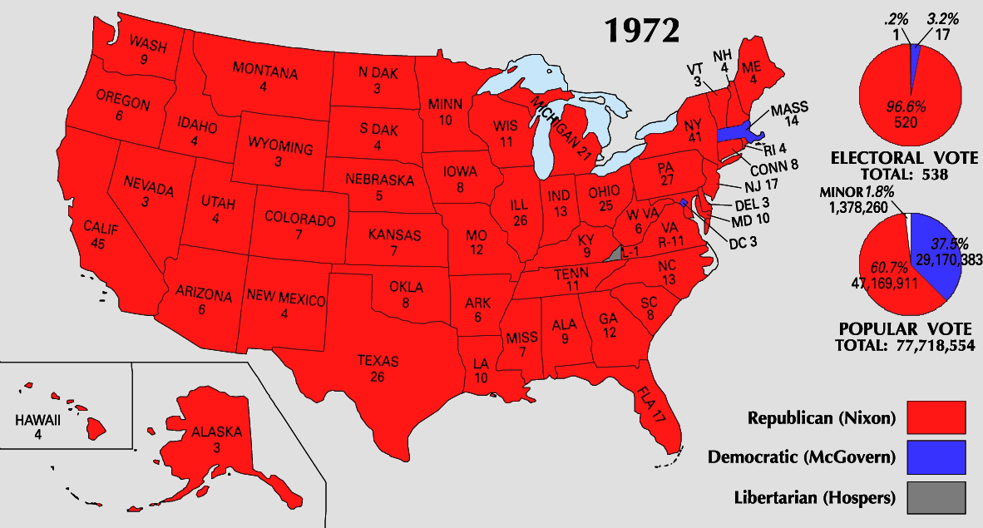
The Presidency of Richard Nixon
Nixon was a popular president by the end of his 1st term
His domestic policies reduced gov’t spending & revitalized middle-class, conservative, & Southern voters
His foreign policies led to the end of an unpopular war in Vietnam & eased tensions with America’s two biggest Cold War rivals
In 1972, Nixon won one of the biggest landslide victories in presidential history
But after Nixon’s re-election in 1972, the Watergate scandal broke…

Slide 12
WATERGATE: Take notes. Why was this such a SCANDAL?
VIDEO

Slide 13
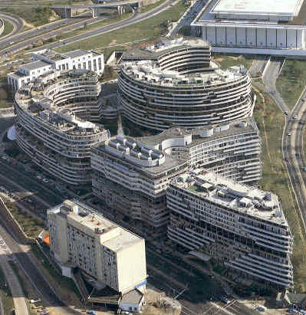
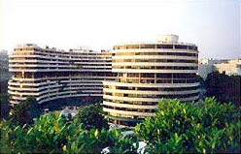
1972: a break-in at Democratic candidate headquarters (Watergate Complex) revealed a well-funded plan of espionage & sabotage by Nixon’s Committee to Re-Elect the President (CREEP)

Slide 14
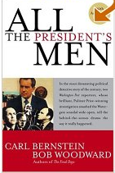
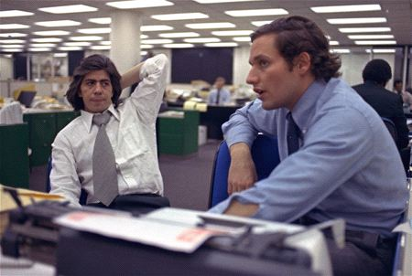
Bob Woodward & Carl Bernstein of the Washington Post broke the Watergate story
Their investigation revealed…

Slide 15
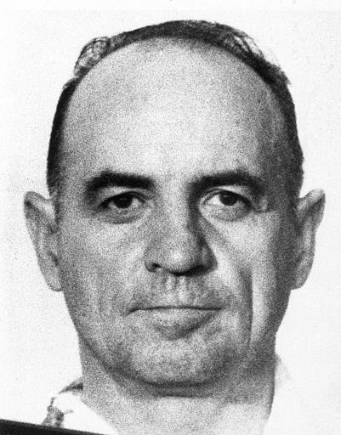
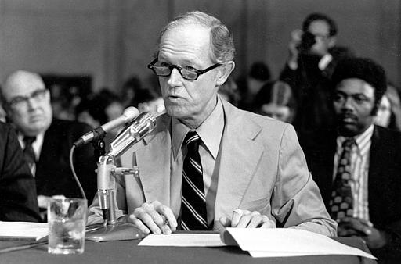
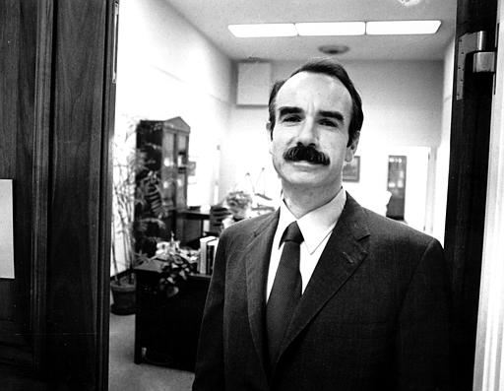
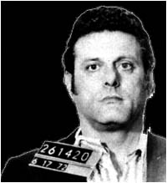
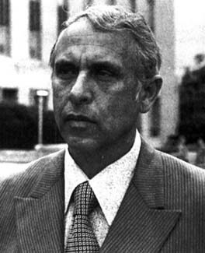
The Burglars

Slide 16
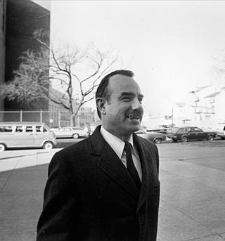
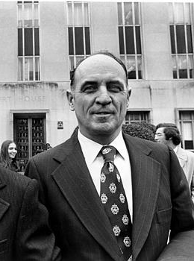
White House “Plumbers” stop ”leaks” of classified information (like the Pentagon Papers) to the news media

Slide 17
The Watergate Scandal
The Watergate scandal began to unravel in 1973:
The discovery that Nixon recorded conversations proved most damning
The Supreme Court ordered Nixon to turn over all tapes to a Senate investigative committee
The House brought 3 articles of impeachment against president
Obstruction of justice
Abuse of power
Contempt of Congress

Slide 18
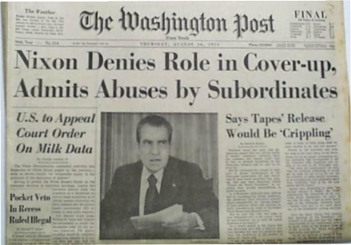
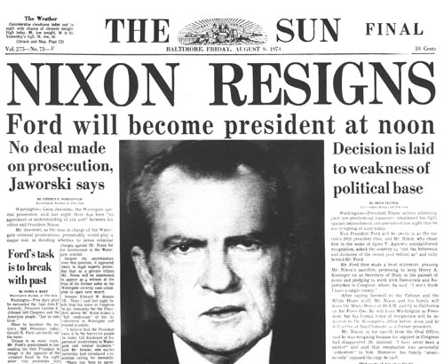
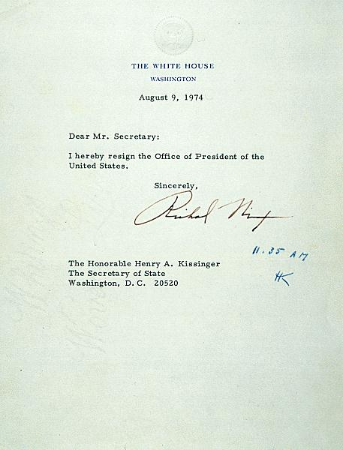

Slide 19
The Watergate Scandal
Teddy Roosevelt began the trend of a stronger president than Congress; a trend that continued throughout the 20th century until Nixon
Impact of the Watergate scandal:
26 members of Nixon’s administration were sent to jail
The press began to be seen as a “watchdog” over the gov’t
An independent judiciary branch was vital to protect individual freedom & national interests
Power shifted from the president to Congress
After Nixon, Congress enacted campaign finance reform, made it easier for the Justice Department to investigate the Executive Branch, took back some control of the federal budget
Notes:
No president went further than Richard Nixon in concentrating powers in the presidency. He refused to spend funds that Congress had appropriated; he claimed executive privilege against disclosure of information on administration decisions; he refused to allow key decision makers to be questioned before congressional committees; he reorganized the executive branch and broadened the authority of new cabinet positions without congressional approval; and during the Vietnam War, he ordered harbors mined and bombing raids launched without consulting Congress.
Watergate brought a halt to the "imperial presidency" and the growth of presidential power. Over the president's veto, Congress enacted the War Powers Act (1973), which required future presidents to obtain authorization from Congress to engage U.S. forces in foreign combat for more than 90 days. Under the law, a president who orders troops into action abroad must report the reason for this action to Congress within 48 hours.
In the wake of the Watergate scandal, Congress passed a series of laws designed to reform the political process. Disclosures during the Watergate investigations of money-laundering led Congress to provide public financing of presidential elections, public disclosure of sources of funding, limits on private campaign contributions and spending, and to enforce campaign finance laws by an independent Federal Election Commission. To make it easier for the Justice Department to investigate crimes in the executive branch, Congress now requires the attorney general to appoint a special prosecutor to investigate accusations of illegal activities. To re-assert its budget-making authority, Congress created a Congressional Budget Office and specifically forbade a president to impound funds without its approval. To open government to public scrutiny, Congress opened more committee deliberations and enacted the Freedom of Information Act, which allows the public and press to request the declassification of government documents.
Some of the post-Watergate reforms have not been as effective as reformers anticipated. The War Powers Act has never been invoked. Campaign financing reform has not curbed the ability of special interests to curry favor with politicians or the capacity of the very rich to outspend opponents.
On the other hand, Congress has had somewhat more success in reining in the FBI and the CIA. During the 1970s, congressional investigators discovered that these organizations had, in defiance of federal law, broken into the homes, tapped the phones, and opened the mail of American citizens; illegally infiltrated anti-war groups and black radical organizations; and accumulated dossiers on dissidents, which had been used by presidents for political purposes. Investigators also found that the CIA had been involved in assassination plots against foreign leaders--among them Fidel Castro--and had tested the effects of radiation, electric shock, and drugs (such as LSD) on unsuspecting citizens. In the wake of these investigations, the government severely limited CIA operations in the United States and laid down strict guidelines for FBI activities. To tighten congressional control over the CIA, Congress established a joint committee to supervise its operations.

Slide 20
Does the Constitution embrace a woman's right to terminate her pregnancy by abortion?
Roe v. Wade (1973)
Second-wave
Feminism
(1960s-1980s)
A woman's right to an abortion fell within the right to privacy protected by the 14th Amendment. All states laws prohibiting it were now unconstitutional.
Feminist author of "The Feminine Mystique” (1960)
Her book sparked a new consciousness among suburban women and helped launch the second-wave feminist movement
President of NOW (National Organization of Women)
Equal Rights Amendment (1972) – guaranteed for women
Betty Friedan
Challenged the widely-shared belief in 1950s that "fulfillment as a woman had only one definition for American women after 1949-- the housewife.

Slide 21
USA from 1974 to 1980
In the late 70s, the U.S. was “overextended”
Distrust in government as a result of Vietnam & Watergate
Economy in a recession with high unemployment & inflation
Decline in America’s status in the world
A series of presidents (Ford & Carter) that failed to inspire a sense of hope among the American people…

Slide 22
Gerald Ford
Presidential term:
August 9, 1974 – January 20, 1977

Slide 23
President Gerald Ford
When Nixon resigned in 1974, VP Gerald Ford became president
Ford was seen as an “honest man” & hoped to move America past the Watergate scandal
But, Ford was unable to move forward due to constant questions about a potential criminal trial of Nixon
In September 1974, Ford pardoned Nixon of any crimes related to Watergate; Ford lost popular support
What decision did Ford make that truly ruined his popularity and presidency?

Slide 24
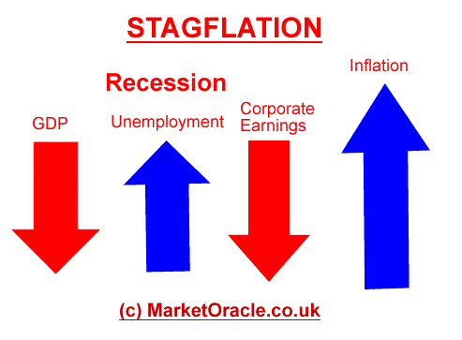
Another issue during Ford’s (and also Nixon’s) presidency was a growing economic recession
Since the early 1970s, the economy had grown stagnant with few new jobs or business profits
Inflation, interest rates, & unemployment were all on the rise
Together, a stagnant economy & high inflation are known as: STAGFLATION
Stagnant economy
High inflation

Slide 25
Ford’s Foreign Policy – OIL CRISIS
Since “automania” of the 1950s, U.S. use of oil was on the rise
In 1960, the oil rich nations in the Middle East & Latin America formed the Org of Petroleum Exporting Countries (OPEC)

Slide 26
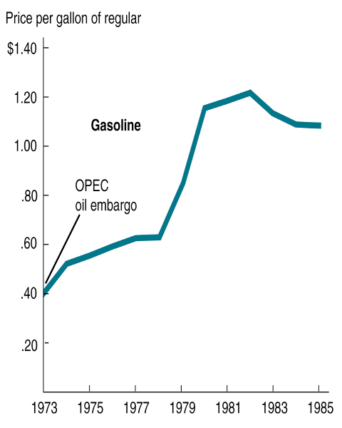
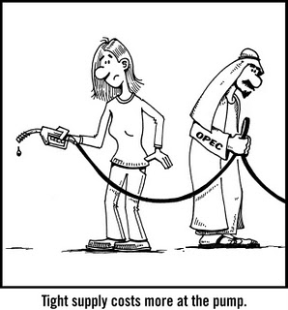
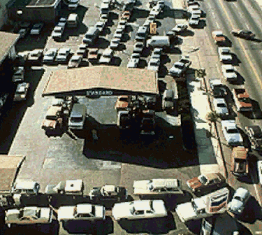
Ford’s Foreign Policy – OIL CRISIS
Making the economic situation worse was the oil crisis of the 1970s
In retaliation for American support of Israel, OPEC cut off oil to the U.S. in 1973
As a result, gas prices soared & shortages led to long lines for gasoline

Slide 27
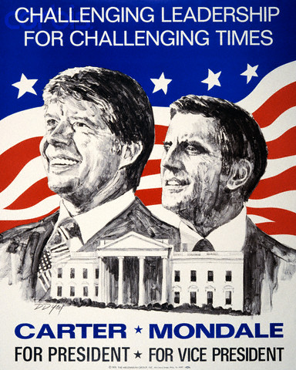
Bring In Jimmy Carter!
Ford had no answer for stagflation or the gas crisis & was challenged by Georgia Democrat Jimmy Carter in the 1976 election
Carter ran as an “outsider” who played no part in Vietnam, Watergate, or the recession

Slide 28
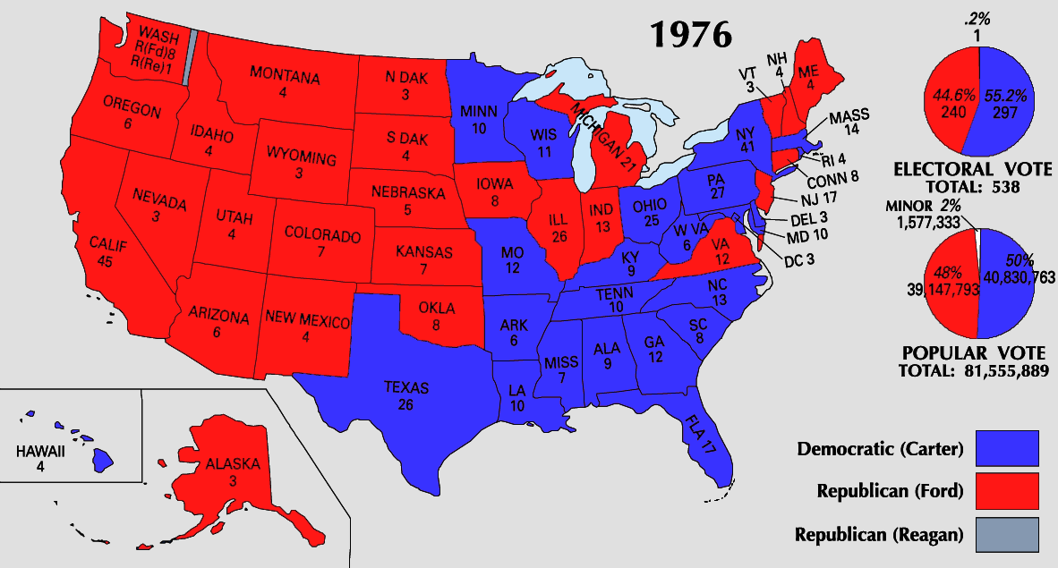
President Jimmy Carter
In the 1976 election, Carter beat Ford

Slide 29
Jimmy Carter
Presidential term:
January 20, 1977 – January 20, 1981

Slide 30
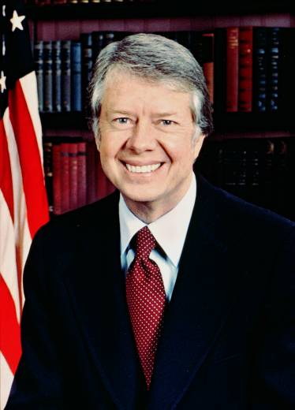
Carter’s Foreign Policy
Carter entered office committed to making “human rights” the basis of U.S. foreign policy
In 1977, Carter agreed that the U.S. would return the Panama Canal in Dec 1999
Carter hoped to gain peace in the Middle East between Israel & the Muslim nations

Slide 31
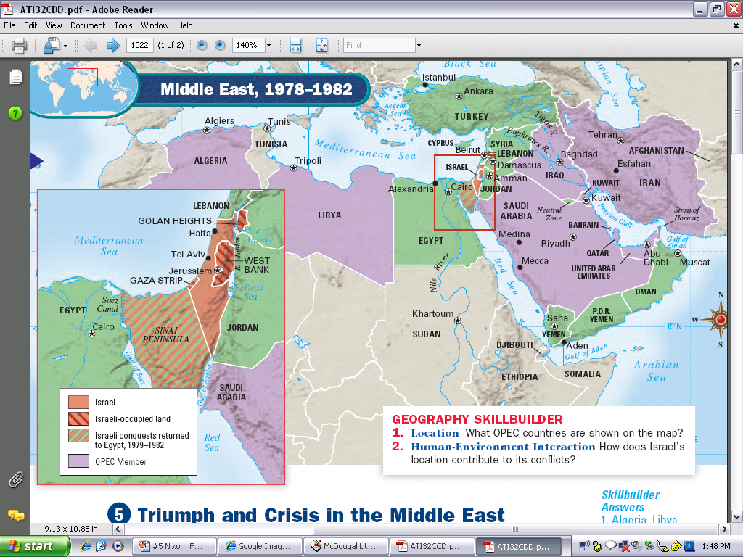
Since its creation in 1947, Israel was attacked by its Muslim neighbors in the 1940s, 1960s, & 1970s
By the 1970s, Egypt appeared ready to recognize Israel in exchange for the return of land in the Sinai Peninsula
1973 Yom Kippur War between Egypt and Syria against Israel

Slide 32
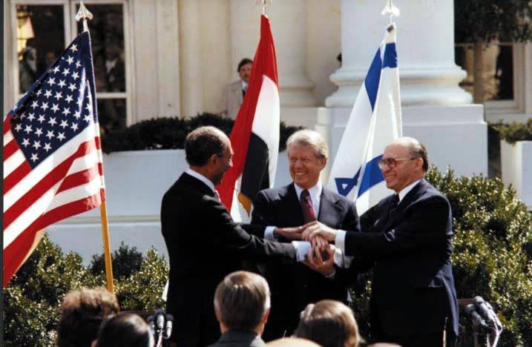
Carter’s Foreign Policy – Middle East
Carter brought Egyptian leader & Israeli leader to the U.S. for the
Camp David Accords (September, 1978)
VID
?
Carter did the impossible
?
Egypt recognized Israel’s right to exist
Israel agreed to leave the Sinai Peninsula

Slide 33
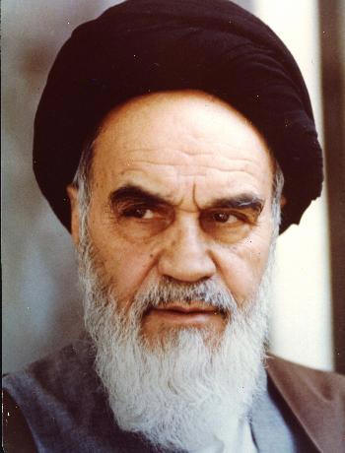
Carter’s Foreign Policy – Middle East
But, the situation in the Middle East got worse in 1979 when fundamentalist Islamic cleric Ayatollah Khomeini led the Iranian Revolution

Slide 34
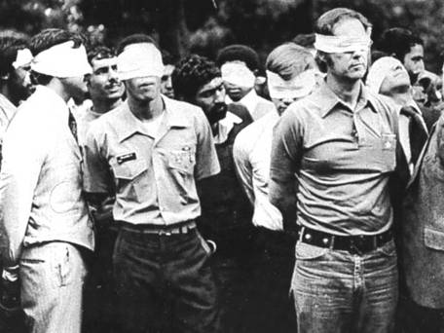
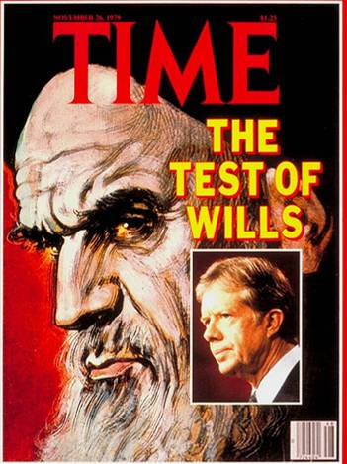
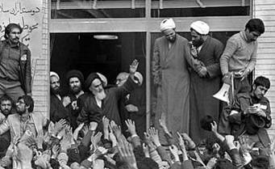
Carter’s Foreign Policy – Middle East
Iranians seized the U.S. embassy & captured 52 American hostages (Iranian Hostage Crisis)
Carter tried negotiation, economic threats, & a rescue mission to return the hostages but all efforts failed
The 52 hostages were held for 444 days (released when Reagan was elected!)

Slide 35
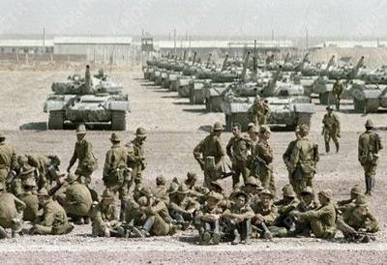
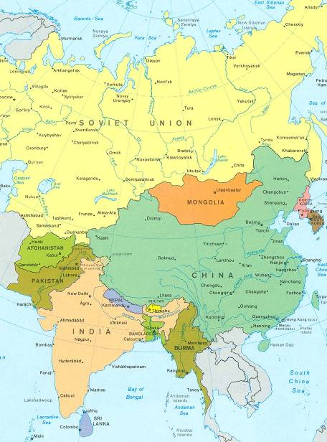
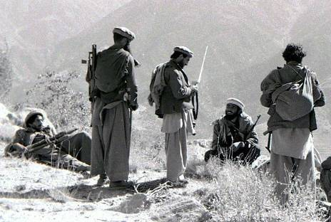
Carter’s Foreign Policy – Middle East
To make matters worse, the Soviet Union invaded Afghanistan in 1979 to defeat an anti-communist uprising
The invasion signaled an end to Nixon’s détente with the USSR as the United States sent aid to the Afghan rebels

Slide 36
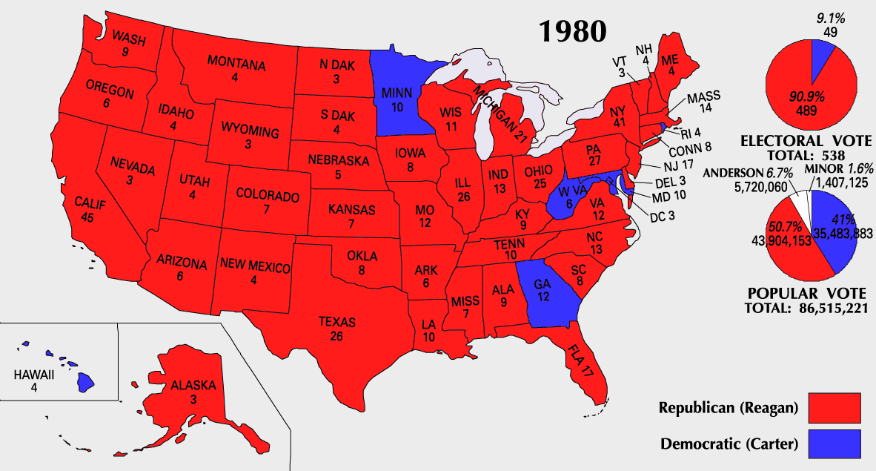
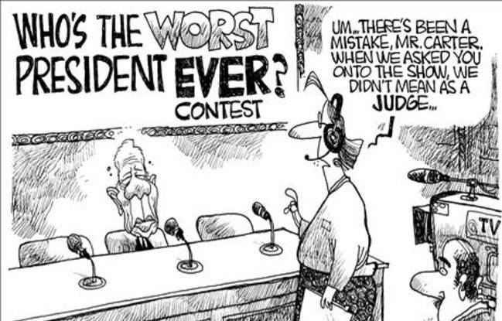
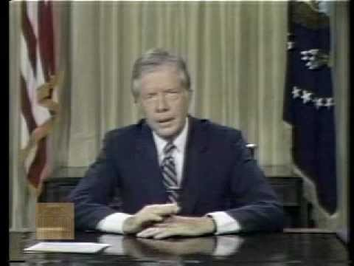
The Election of 1980
By 1980, Carter had been unable to end stagflation, free the U.S. hostages in Iran, or restore America’s place in the world
In the election of 1980, Americans in search of answers elected Ronald Reagan as president
July 1979
Carter’s “Malaise Speech”
Americans ignored conservation efforts he proposed – due to inflation and the oil crisis
Criticized the American public for falling into a "moral and spiritual crisis
Too concerned with material goods

Slide 37
By 1980, the USA seemed to be losing its place as the top nation in the world:
The 1970s presented failures in the Cold War & new problems in the Middle East
The social protests & counter culture seemed to divide liberals & conservatives
Stagflation & the economic recession were growing worse, not better
The failures of Johnson, Nixon, Ford, & Carter left citizens in search of optimism, strong leadership, & conservative policies

