Slide 1
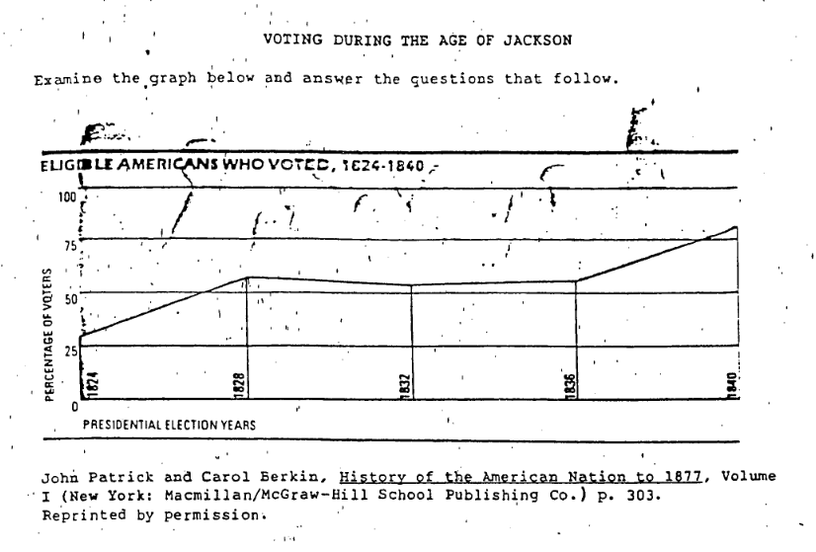
Continuing PERIOD 4: 1800-1848
DO NOW:

Slide 2
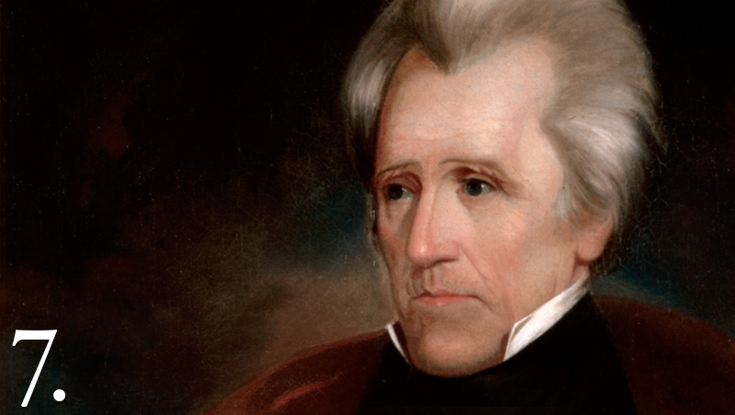
Aim: How did Andrew Jackson introduce a new form of “Jacksonian democracy” upon becoming President?

Slide 3
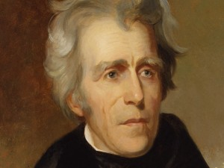
Corrupt Bargain
Indian Removal
SC Exposition and Protest
Spoils system
National Bank Crisis
Nullification Crisis
Tariff of Abominations
Panic of 1837
Rise of the Whigs
“Common Man”
Universal White Male
Suffrage
Pet Banks
Two-Party
System
I’m sorry, Mr. Jackson, are you for real?

Slide 4
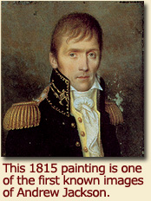
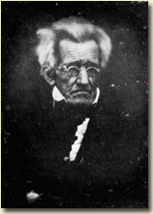
TRANSFORMATION TUESDAY with Andrew Jackson
1767 - 1845
Photo of Andrew Jackson in 1844 (one year before his death)
First Known Painting of Jackson, 1815

Slide 5
Key Events Leading to Jackson’s Presidency
Battle of New Orleans (January 1815)
“Corrupt Bargain of 1824”
Election of 1828

Slide 6
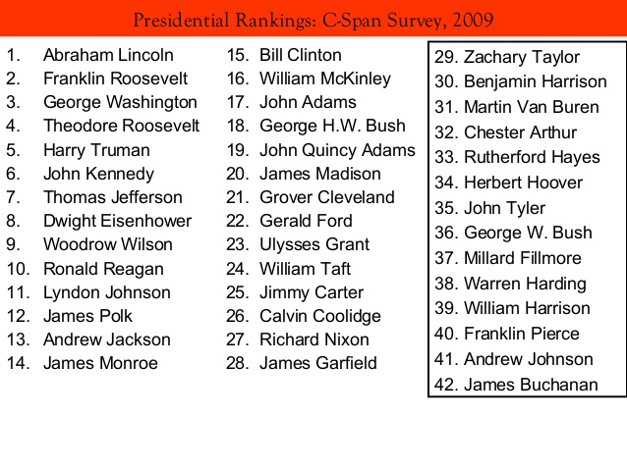
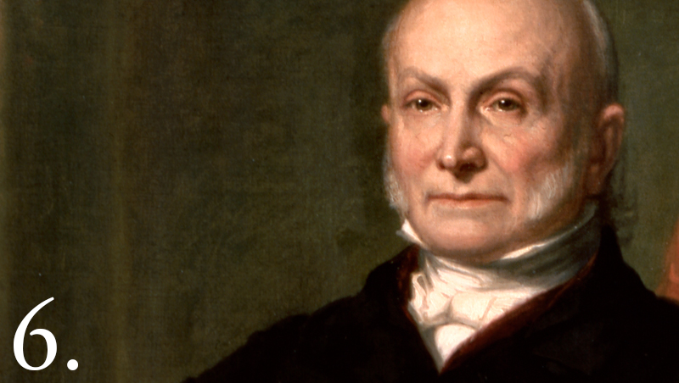
The man, the myth, the legend?
60-second Presidents (PBS) - All you need to know about John Quincy Adams (JQA)
While you watch…answer the following questions...
What kind of “bribe” made John Quincy Adams the President of the US in the election of 1824?
How did Andrew Jackson react to JQA becoming President of the US?
VIDEO

Slide 7
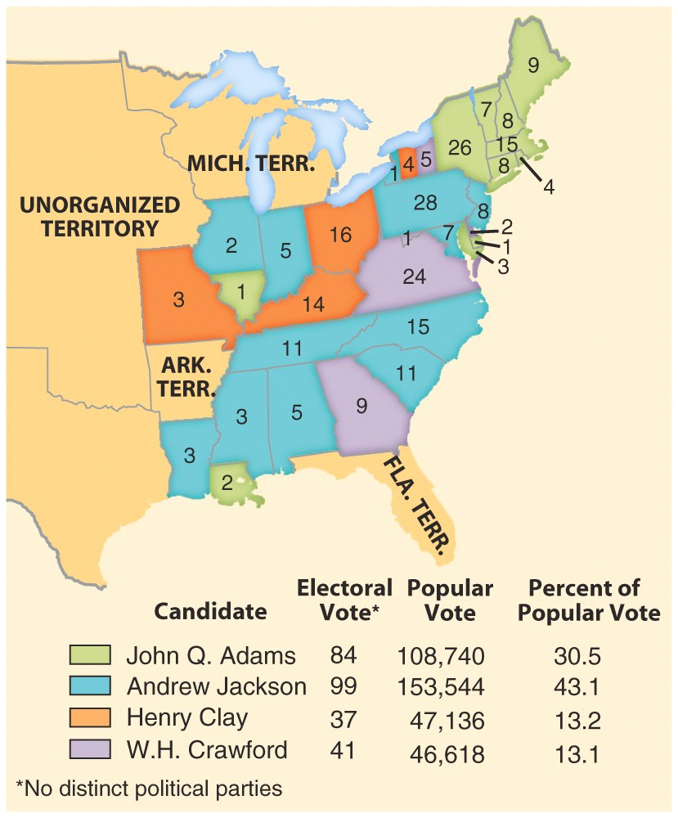
The Election of 1824
BYE! Era of Good Feelings
261 electoral votes and 131 needed to win.

Slide 8
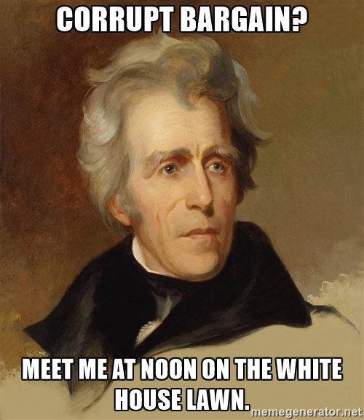
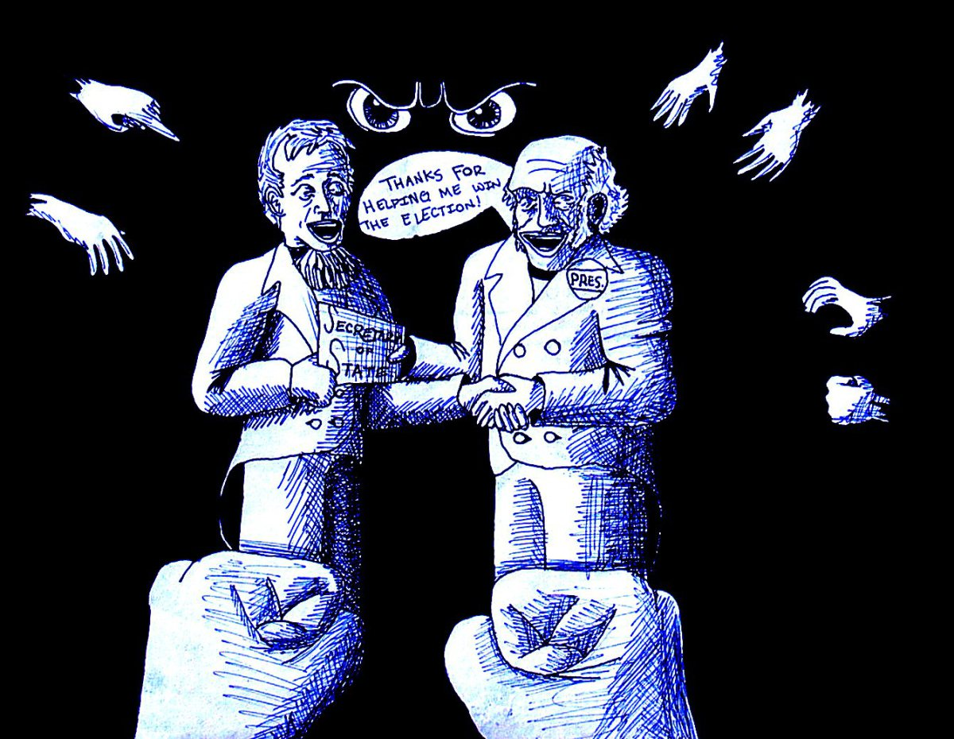
ADAMS VS JACKSON
corrupt
The Corrupt Bargain
Henry Clay supports John Q. Adams and the House of Representatives chooses Adams as the President
Adams appoints Henry Clay as his Secretary of State….
Jackson cries out “CORRUPTION!” and calls this the “Corrupt Bargain”
Jackson promises he would run again for the Presidency in 1828 and would smash Adams!
VIDEO

Slide 9
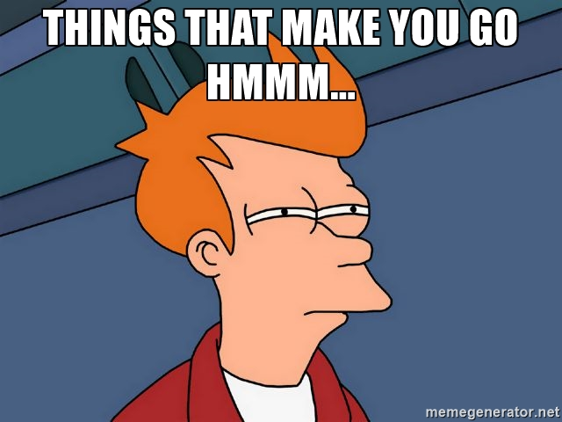
corrupt1
The Corrupt Bargain
Suspicions of a “corrupt bargain” have been strengthened by entries in the diary of John Q. Adams. On January 1, 1825, after a public dinner, he wrote,
“He (Clay) told me (in a whisper) that he should be glad to have with me soon some confidential conversation upon public affairs. I said I should be happy to have it whenever it might suit his convenience.”
In the diary entry for January 9, reads in part,
“Mr. Clay came at six and spent the evening with me in a long conversation explanatory of the past and prospective of the future.”
Exactly a month later, with Clay’s backing, Adams was elected. This happened because Clay was Speaker of the House…..They also hated Andrew Jackson…...

Slide 10
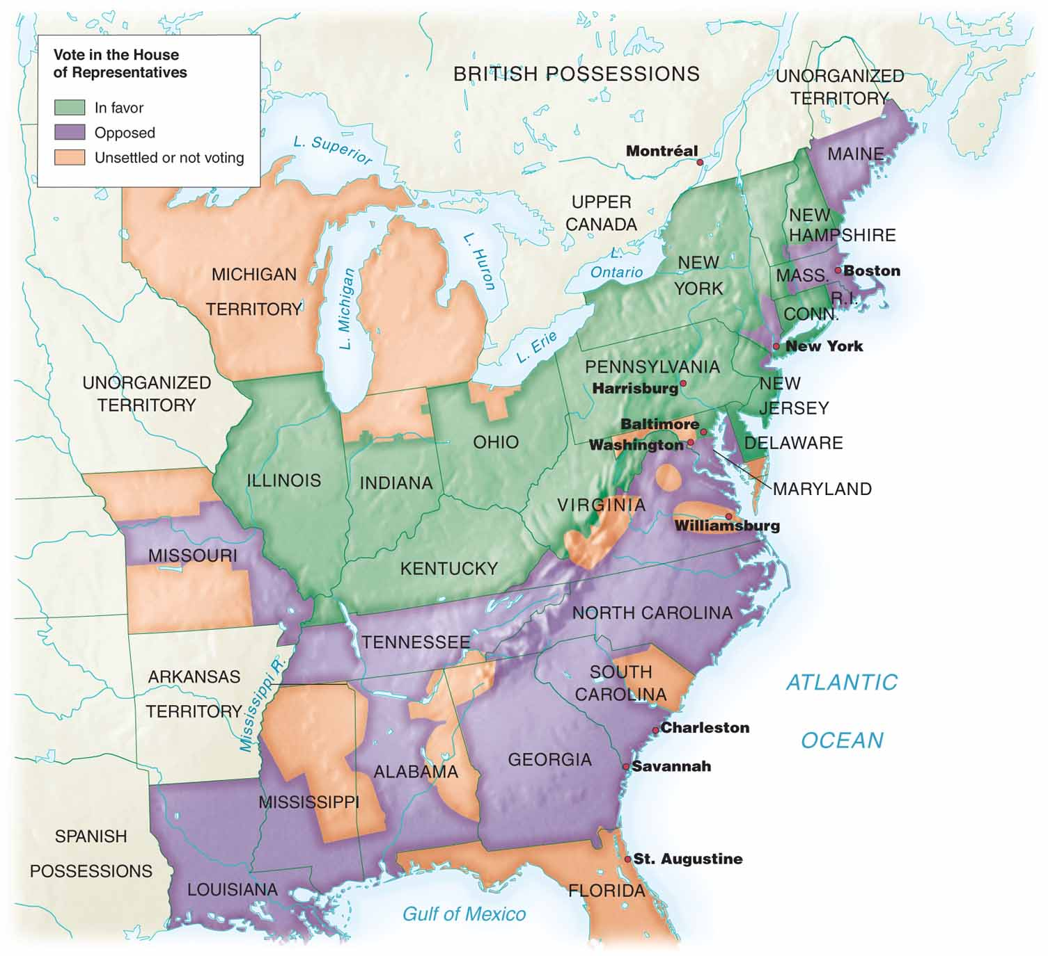
One more thing before you go, JQA…
Tariff of Abominations (AKA Tariff of 1828)
Raised tariffs on imported hemp, wool, fur, etc = favored Northern manufacturers
In the South, it raised the cost of manufactured goods = ANGRY!
SECTIONALISM

Slide 11
Andrew Jackson:
1767 - 1845
U.S. President from
1829-1837

Slide 12
New parties
POLITICAL PARTIES
AFTER ELECTION OF 1824
JACKSONIAN DEMOCRACY
Political world changed during the “New Democracy”. Two new political parties emerge:
NATIONAL REPUBLICANS
Adams, Clay and Webster
Strong national govt.
Favored the BUS, tariffs, internal improvements, industry, public schools and moral reforms such as prohibition of liquor and abolition of slavery.
Best/privileged run the govt.
DEMOCRATS
Jackson and Calhoun
Believed in state’s rights and federal restraint in economic and social affairs.
Favored the liberty of the individual and were fiercely on guard against the progress of privilege into the government.
Protected the common man.

Slide 13
JACKSON THE MAN
Emotional, arrogant and passionate
Dueled---could drink, smoke, curse and fight with the best of them
Lawyer, Judge, senator, general and finally President
First president from the West
Appealed to the Common Man because he was one…

Slide 14
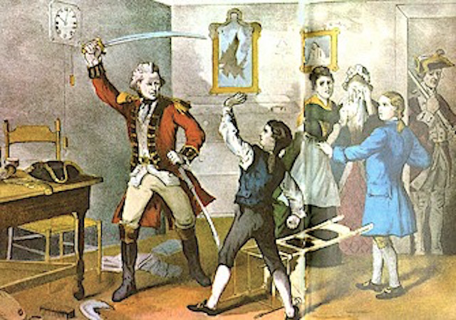
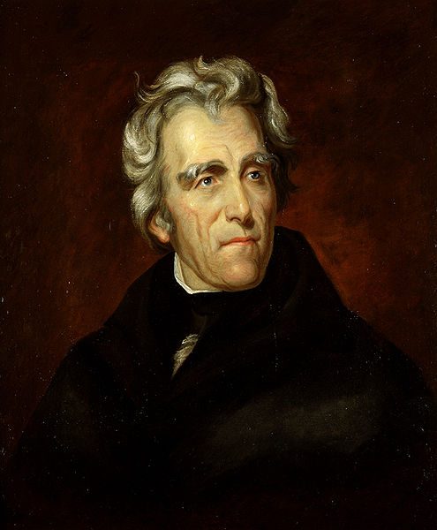
FUN FACT!
He was the only president to have been a former prisoner of war. During the Revolutionary War, the 13-year-old Jackson joined the Continental Army as a courier. In April 1781, he was taken prisoner along with his brother Robert. When a British officer ordered Jackson to polish his boots, the future president refused. The infuriated Redcoat drew his sword and slashed Jackson’s left hand to the bone and gashed his head, which left a permanent scar. The British released the brothers after two weeks of ill treatment in captivity, and within days Robert died from an illness contracted during his confinement.

Slide 15
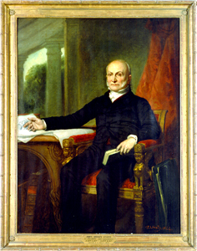
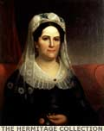
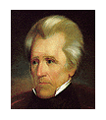
Election of 1828
was REVOLUTIONARY!
Jackson and J. Q. Adams ran against each other for the presidency
One anti-Jackson newspaper declared,
“General Jackson’s mother was a common prostitute, brought to this country by the British soldiers! She, afterwards married a mulatto man with whom she had several children, of which one was Andrew Jackson.”
Anti-Adams people accused him of hiring a servant girl a visiting Russian ambassador…
Adams was accused of gambling in the White House.
One of the worst elections in US History for its “mudslinging.”
As a result of this, Jackson’s wife Rachel, died of a heart attack just before he became President…He blamed Adams and Clay and never forgave them…..

Slide 16
The 1828 Election
Jackson’s campaign was engineered by Senator Martin Van Buren of NY
He created the Democratic Party from the remains of Jefferson’s old party:
Planter Elite in the South
Frontier people
Artisans [competition from factory labor]
Immigrants in the cities

Slide 17
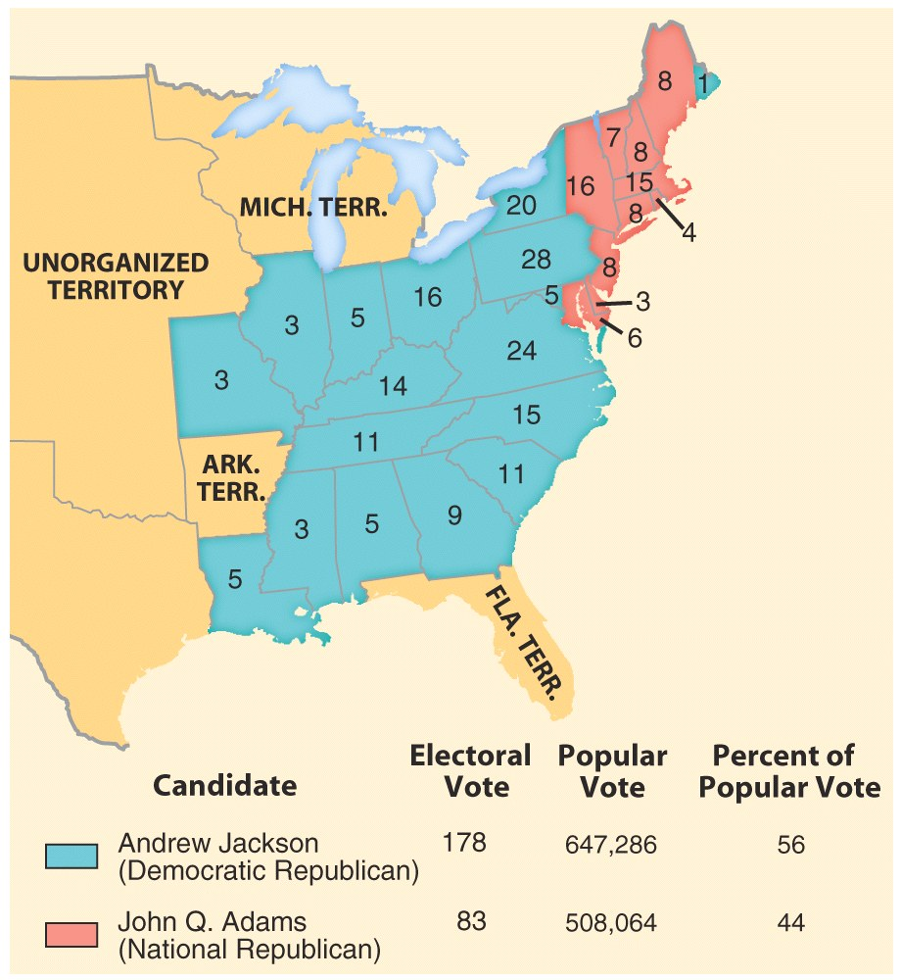
The Election of 1824
The Election of 1828
Election of 1824, 355,817 voted.
Election 1828, 1,155,350 voted.
WHY did the numbers increase so much?
UNIVERSAL MALE SUFFRAGE = new states say ALL free white males could vote and hold office without having to own land or belong to a particular religious group

Slide 18
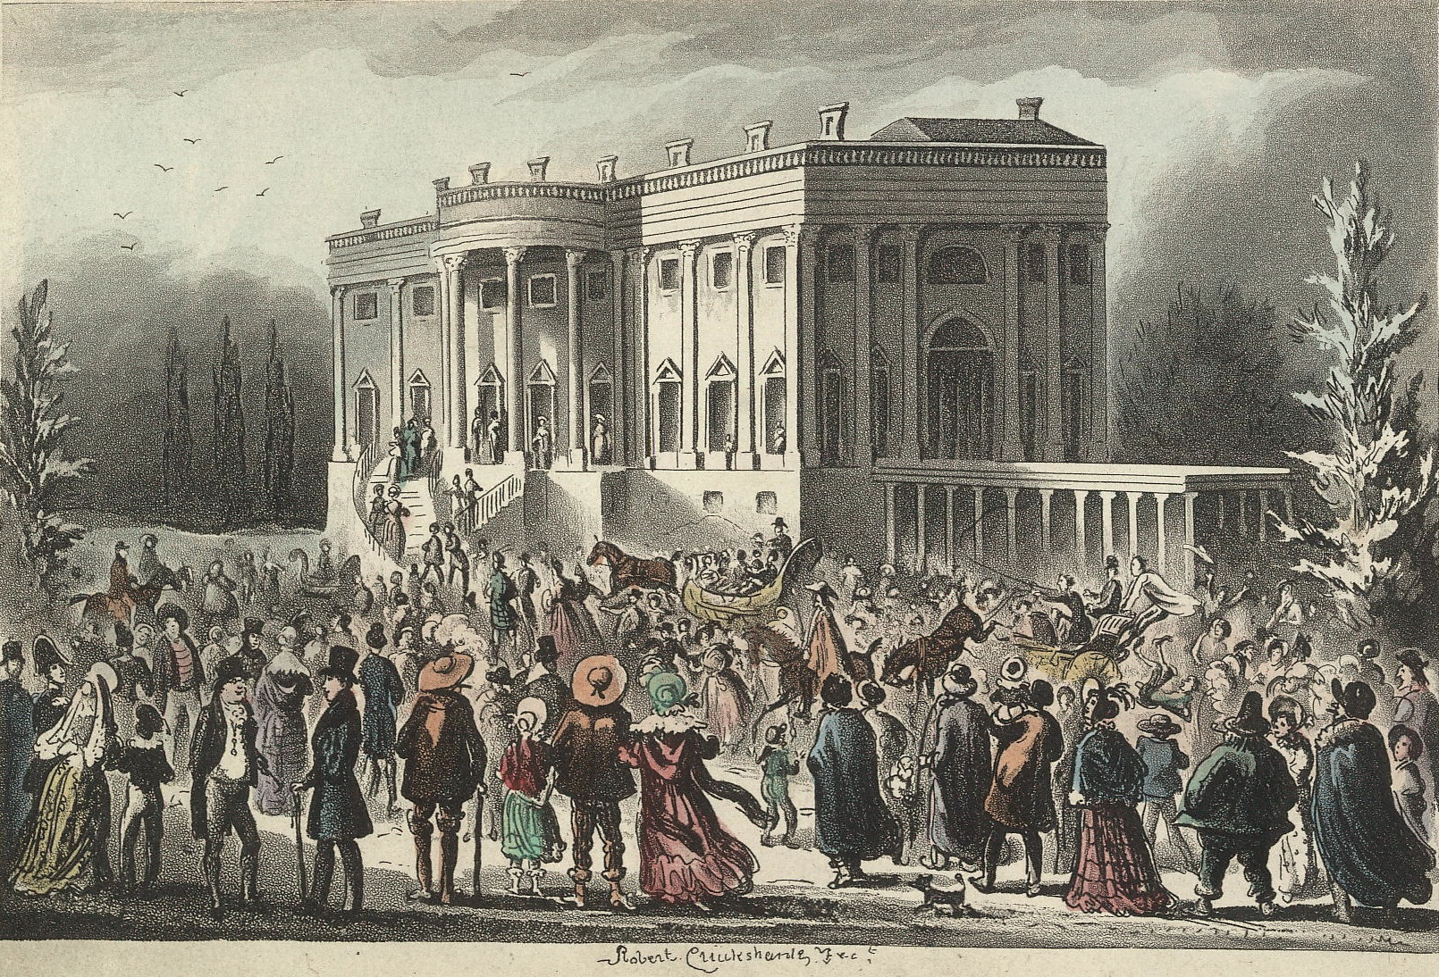
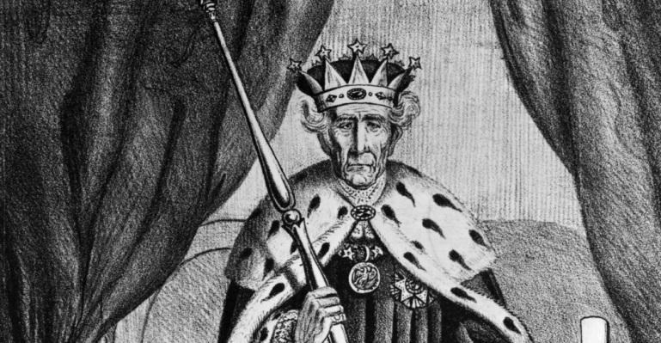
Jackson allowed “commons” into the White House on the night of his inauguration; they created a mob, wrecking china and furniture and causing Jackson to have to sneak out for his safety.
“KING MOB”

Slide 19
GREAT NEWS!
MARKET REVOLUTION
PROJECTS NOW DUE
THURSDAY 12/22
(we will start presentations on Thursday as well)

Slide 20
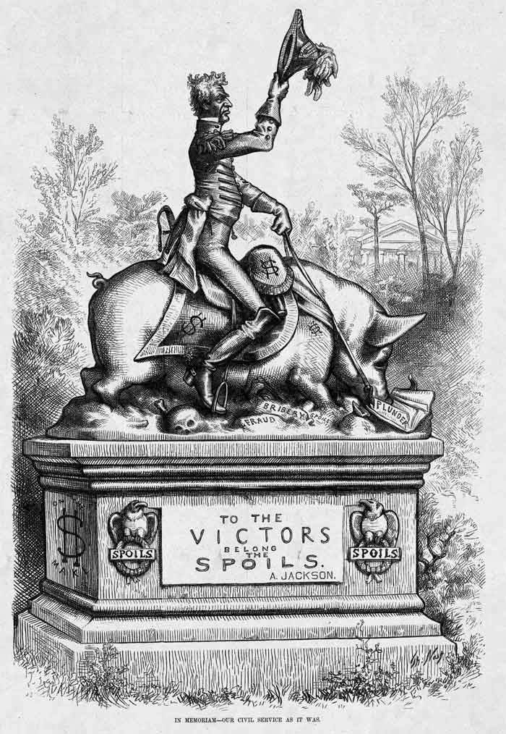
DO NOW:
To the Victor Belong the Spoils…
Circle symbols that stick out to you.
Who is shown riding the hog? Label it.
What might the hog symbolize? Label it.
What does it mean “to the victor belong the spoils”?
Is this cartoonist FOR or AGAINST the spoils system? Why or why not?

Slide 21
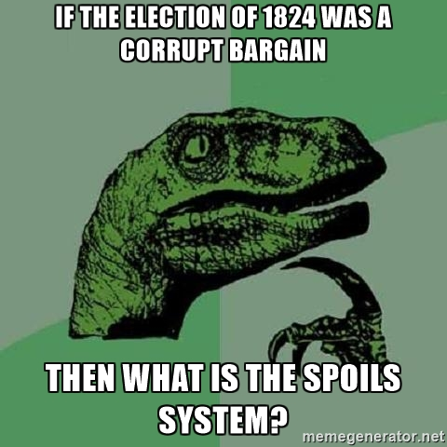
As President, Jackson REWARDED his supporters with GOVERNMENT JOBS = SPOILS SYSTEM
“To the victor, belong the spoils.”
People who couldn’t read or were just incompetent given jobs.
Where have we seen something like this already happen?
VIDEO

Slide 22
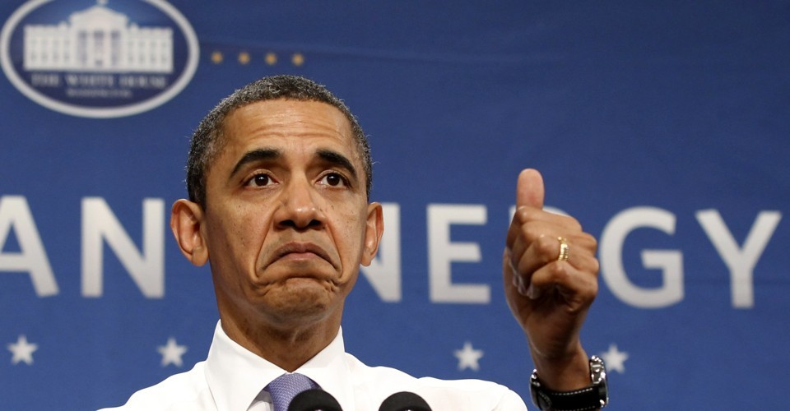
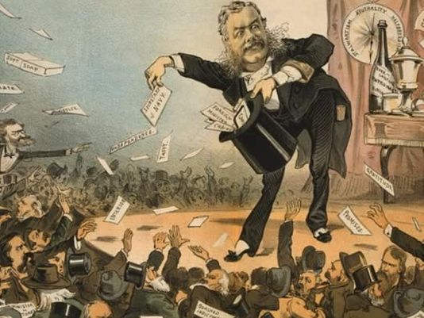
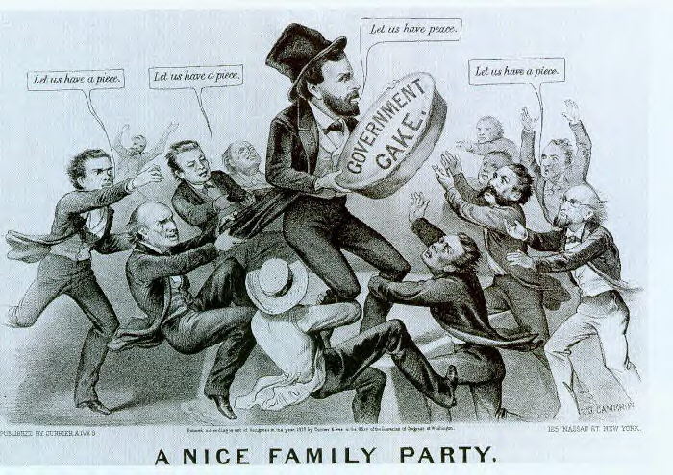
Do you agree with the idea of a “spoils system”?
Obama handed out posts (47 administration jobs to top bundlers overall)

Slide 23
Corrupt Bargain
Indian Removal
Kitchen
Cabinet
Two-Party
System
Spoils system
National Bank War
Nullification Crisis
Tariff of Abominations
Panic of 1837
Rise of the Whigs
“Common Man”
Universal White Male
Suffrage
Eaton Affair
Pet Banks
I’m sorry, Mr. Jackson, are you for real?

Slide 24
Aim: Was Andrew Jackson more of a champion of the “common man” or “King” Andrew?

Slide 25
Jackson will face
FOUR BIG ISSUES
as President of the US…
Peggy Eaton Affair
Nullification Crisis
Bank War
Indian Removal

Slide 26
Draw this in your notebook…
Unique characteristics
of Jackson
Battle of the Pettycoats/Eaton Affair
Jackson’s Kitchen Cabinet
Nullification Crisis
The Bank War
Jackson’s Legacy
**Focus on the CAUSES and EFFECTS of each event while you listen…
VIDEO

Slide 27
Think-Pair-Share - Discussion
#1 On your own (4-5 minutes) look at the events/characteristics on your chart that shaped Jackson’s presidency and decide which ONE was most significant to his LEGACY…
Make a list of AT LEAST 3 reasons why this specific event was so significant to Jackson’s legacy
While you work, think about why other events were NOT as significant/important to his legacy
#2 After 5 minutes, you’ll break into teams (3-4), and DISCUSS which event you chose with your group mates and explain to them WHY…
#3 We’ll then talk as a class to see what you all have decided on…

Slide 28
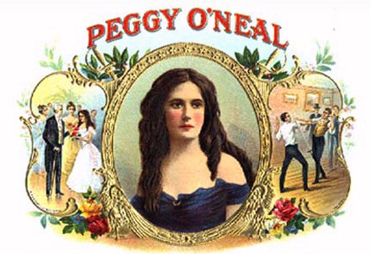
EATON AFFAIR
Peggy (O’Neal) Eaton was the wife of Jackson’s secretary of war (John Eaton) who was the target of malicious gossip by other cabinet wives
Jackson became her “champion” and stood up for her because of what happened to his late wife, Rachel….

Slide 29
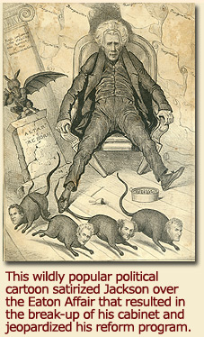
EATON AFFAIR
When Jackson tried to force the cabinet wives to accept Eaton socially, most of the cabinet resigned
Vice President John C. Calhoun RESIGNS and goes back to South Carolina
Jackson creates the “kitchen cabinet” which were informal advisers, Jackson’s “good ole boys”.

Slide 30
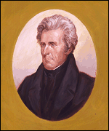
ISSUE #2 = NULLIFICATION CRISIS
John C. Calhoun, former VP under Jackson, US Senator from South Carolina
President Jackson
Two REALLY STUBBORN guys, who should’ve been BROS, GOING AT IT!

Slide 31
NULLIFICATION CRISIS
Tariff of 1828
(Tariff of Abominations)
North LIKED tariff, WHY? South HATED it, WHY?
Protective tariff would be raised to 45% on a dollar….
South upset with this b/c they saw the US Govt. favoring the North and industry…
Feared the US Govt. would take away slavery too!

Slide 32
JACKSON VS CALHOUN
John C. Calhoun becomes a US Senator from South Carolina and defends slavery and state’s rights
Calhoun threatened secession (leaving the US) if tariff was not lowered!
Calhoun believed in the nullification theory
each state had the right to decide whether to obey a federal law or to declare it null and void
“The Union, next to our liberties, most dear!” - Calhoun

Slide 33
JACKSON VS CALHOUN
VIDEO
Jackson persuaded Congress to pass a Force Bill giving the president authority to take military action in SC
“People of South Carolina: NULLIFICATION and DISUNION are acts of TREASON! Don’t make me send the federal troops down to knock you out!”
In the end…no federal troops were sent, and Jackson also suggested that Congress lower the tariff to make everyone ☺

Slide 34
JACKSON VS CALHOUN
The Nullification Crisis
Compromise of 1833
Henry Clay
Tariffs were gradually lowered---25% over 10 years
South Carolina dropped nullification
Jackson preserved the Union!!!
Southerners believed they were becoming a permanent minority, like they GAINED from this whole crisis

Slide 35
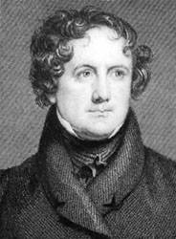
ISSUE #3 =The National Bank Debate
Nicholas Biddle
President Jackson
To recharter or not to recharter, THAT IS THE QUESTION!

Slide 36
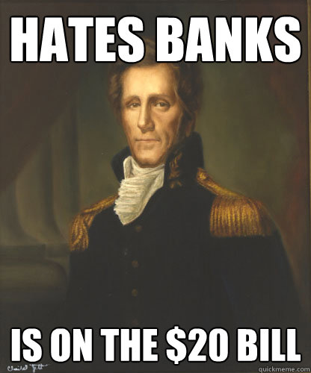
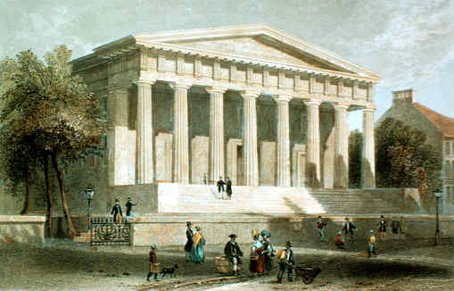
THE BANK WAR
Jackson - Bank of the US was too powerful because it was privately owned
SAID IT WAS UNCONSTITUTIONAL!
Jackson: should be controlled more by government and the people because it was corrupt
Nicholas Biddle (President of the Bank), Henry Clay and Daniel Webster supported the Bank
Notes:
The Bank War inspired numerous cartoons. The boxers are Nicholas Biddle and Andrew Jackson. The lady holding a bottle of port says, "Darken his daylights, Nick. Put the Screws to him my tulip!" Daniel Webster: "Blow me tight if Nick ain't been crammed too much. You see as how he's losing his wind!" Henry Clay: "Hurrah Nick my kiddy! Hit him a pelt in the smellers!" Martin Van Buren: "Go it Hickory, my old Duffer! give it to him in the bread basket, it will make him throw up his deposits!" Major Jack Downing (a mythical Jacksonian hero): "I swan if the Ginral hain't been taken lessons from Fuller!" The man standing next to the whiskey bottle: "Hurrah my old yallow flower of the forrest, walk into him like a streak of Greased lightning through a gooseberry bush!"

Slide 37
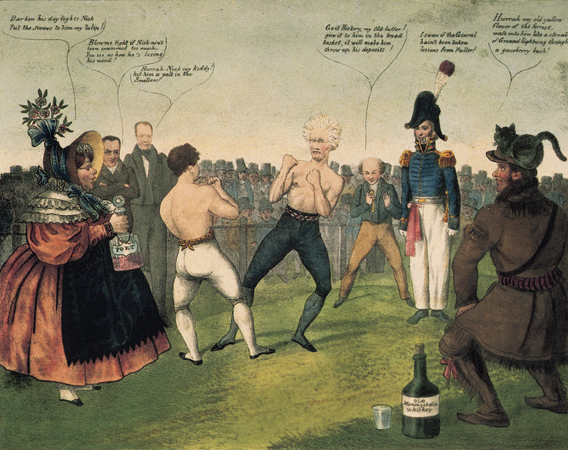

Slide 38
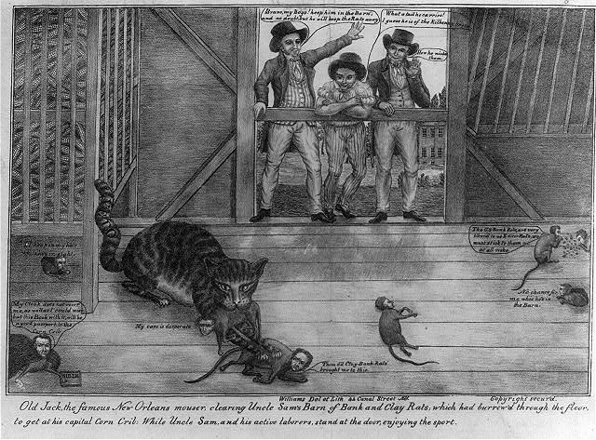
THE BANK WAR
In 1832, an election year, Henry Clay decided to challenge Jackson on the bank issue by persuading a majority in Congress to pass a bank recharter bill
Jackson vetoed this bill
The Cartoon from the 1832 presidential cartoon depicts Jackson as a cat with “Veto” written on his tail clearing Uncle Sam’s barn of bank and clay rats

Slide 39
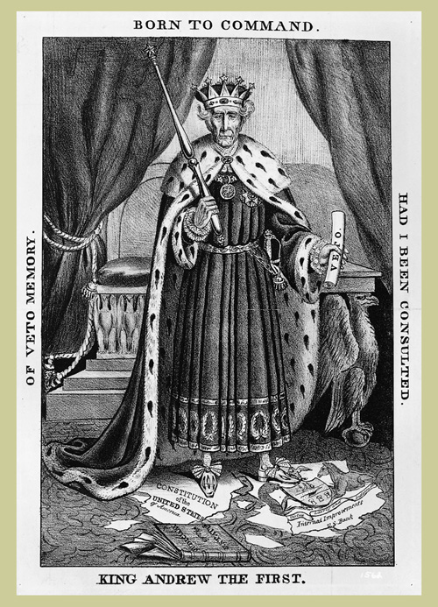
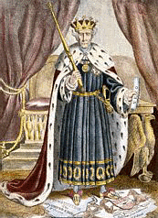
King Andrew
KING ANDREW
The Bank War inspired numerous cartoons.
Opponents referred to him as King Andrew because used the veto more than any president to that time…..12 times
Destroyed the Bank of the US in 1832 with the veto.
Picture shows President Jackson holding a veto in his left hand and scepter in his right. US Constitution is torn up and Jackson is standing on it…
VIDEO

Slide 40
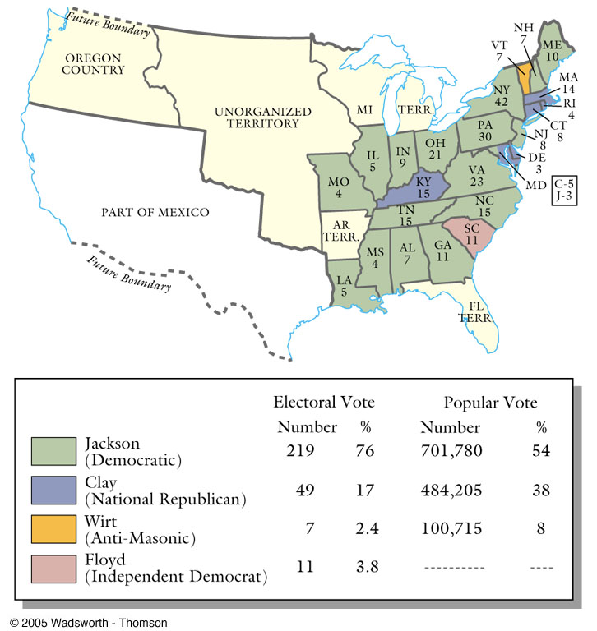
THE BANK WAR
An overwhelming majority of voters approved of Jackson’s veto
Jackson won reelection with more than ¾ of the electoral vote
The 1832 Election

Slide 41
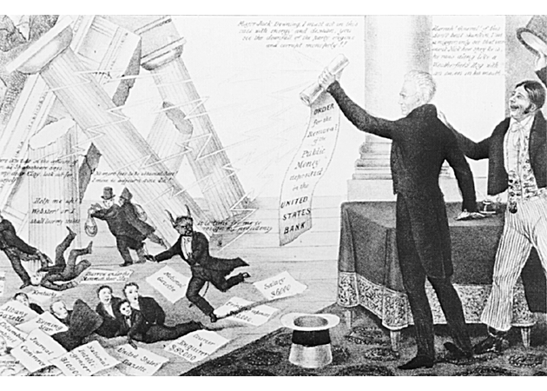
THE BANK WAR
A triumphant Jackson holds his order to remove government deposits from the bank as the bank crumbles and a host of demonic characters scurry from its ruins.
Transfers funds to state banks
Critics called them PET BANKS
Notes:
The Bank War inspired numerous cartoons. The boxers are Nicholas Biddle and Andrew Jackson. The lady holding a bottle of port says, "Darken his daylights, Nick. Put the Screws to him my tulip!" Daniel Webster: "Blow me tight if Nick ain't been crammed too much. You see as how he's losing his wind!" Henry Clay: "Hurrah Nick my kiddy! Hit him a pelt in the smellers!" Martin Van Buren: "Go it Hickory, my old Duffer! give it to him in the bread basket, it will make him throw up his deposits!" Major Jack Downing (a mythical Jacksonian hero): "I swan if the Ginral hain't been taken lessons from Fuller!" The man standing next to the whiskey bottle: "Hurrah my old yallow flower of the forrest, walk into him like a streak of Greased lightning through a gooseberry bush!"

Slide 42
Was Andrew Jackson more of a champion of the “common man” or “King” Andrew?

Slide 43
EXIT Assessment
OPTION #1: Answering the Aim: How did Andrew Jackson introduce a new form of Jacksonian democracy throughout the United States?
Use historical facts and details from today’s lesson to support your answer.
OPTION #2: So far, is Andrew Jackson a
HERO or VILLAIN?
Use historical facts and details from today’s lesson to support your answer.

