Slide 1
AIM: How did the 2nd Great Awakening lead to social reform movements of the antebellum era?

Slide 2
Mini Lecture
The 1st Great Awakening (1730s -1740s)
The Great Awakening was a movement rooted in spiritual growth of Colonial America
Certain Christians began to disassociate themselves with the established/institutional approach to worship

Slide 3
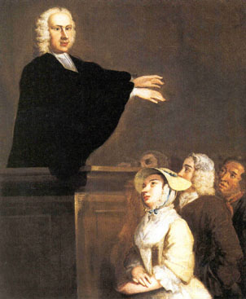
The 1st Great Awakening (1730s -1740s)
George Whitfield
People felt that religion was dry, dull and distant
Preachers felt that people needed to be concerned with inner emotions
People in the New England area could now read and interpret the Bible for themselves (individualism rather than institutionalism)

Slide 4
Why did the 2nd Great Awakening BEGIN? (1790s -1800s)
Society during the Jacksonian era was undergoing deep and rapid change
The revolution in markets brought both economic expansion and periodic depressions.
To combat this uncertainty reformers sought stability and order in religion
Religion = social control
Church-goers embraced the values of hard work, punctuality, and sobriety
Revivals brought unity and strength and a sense of peace

Slide 5
2nd Great Awakening
Similar to First Great Awakening:
Recall from the 1st GA- Evangelists (Preachers) “Sinners in the hands of and Angry God”
Jonathan Edwards 1741
Popular throughout society
New Religious Sects→ Baptists and Methodists
Revival Meetings → Camps
Revivals increase popularity of reform movements to purify society

Slide 6
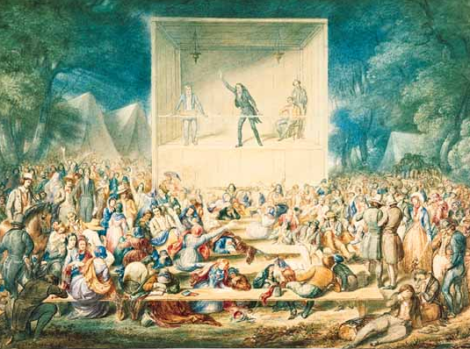
REVIVALS = “giving new life,” to bring back to life specifically Popular Religion (1830s)

Slide 7
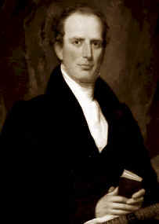
Charles Finney and the Conversion Experience
“Father of modern revivalism”
Meetings night after night to build excitement
Speaking openly and honestly
Encouraging women to testify in public
Speaking out against alcohol and slavery
Placing those struggling with conversion on the “anxious bench” at the front of the congregation
Notes:
Such techniques all heightened the emotions of the conversion process (born again)

Slide 8
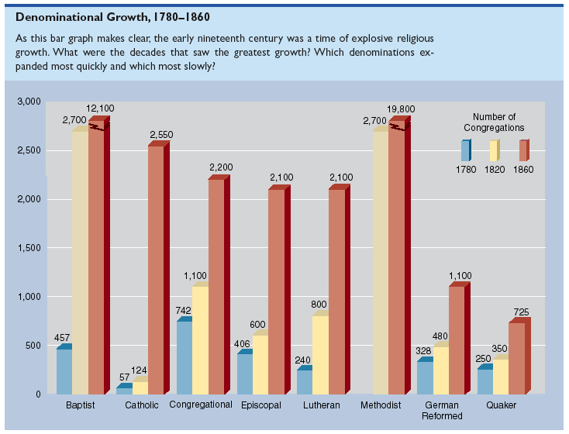
1816 -> American Bible Society Founded

Slide 9
Mormons rise too…
Founded in 1830 – Joseph Smith
Book of Mormon
Connection between American Indians and lost tribes of Israel
Brigham Young led them to western frontier (UTAH)
Cooperative/social organization helped them thrive
Polygamy – made US government ANGRY

Slide 10
The Second Great Awakening
“Spiritual Reform From Within” [Religious Revivalism]
Social Reforms & Redefining the Ideal of Equality
Temperance
Abolitionism
Education
Asylum & Prison Reform
Women’s Rights

Slide 11
The 2nd Great Awakening in a nutshell…
Every person could be saved through revivals.
It enrolled millions of new members, and led to the formation of new denominations.
Many converts believed that the Awakening heralded a new millennial age.
The Second Great Awakening stimulated the establishment of many reform movements designed to remedy the evils of society before the Second Coming of Jesus Christ (Millennialism – Millerites – Seventh-Day Adventists)

