Slide 1
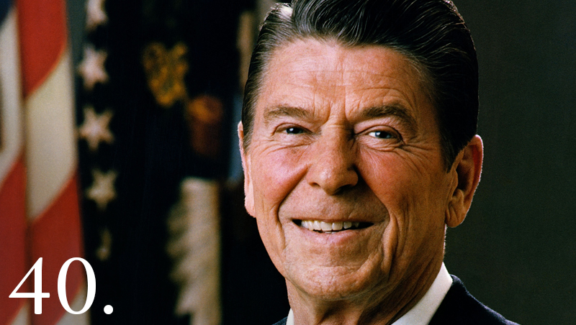
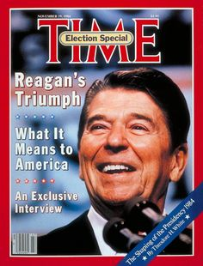
AIM: How did the two-term presidency of Ronald Reagan influence American foreign policy and the economy?
Ronald Reagan
Presidential term:
January 20, 1981 – January 20, 1989

Slide 2
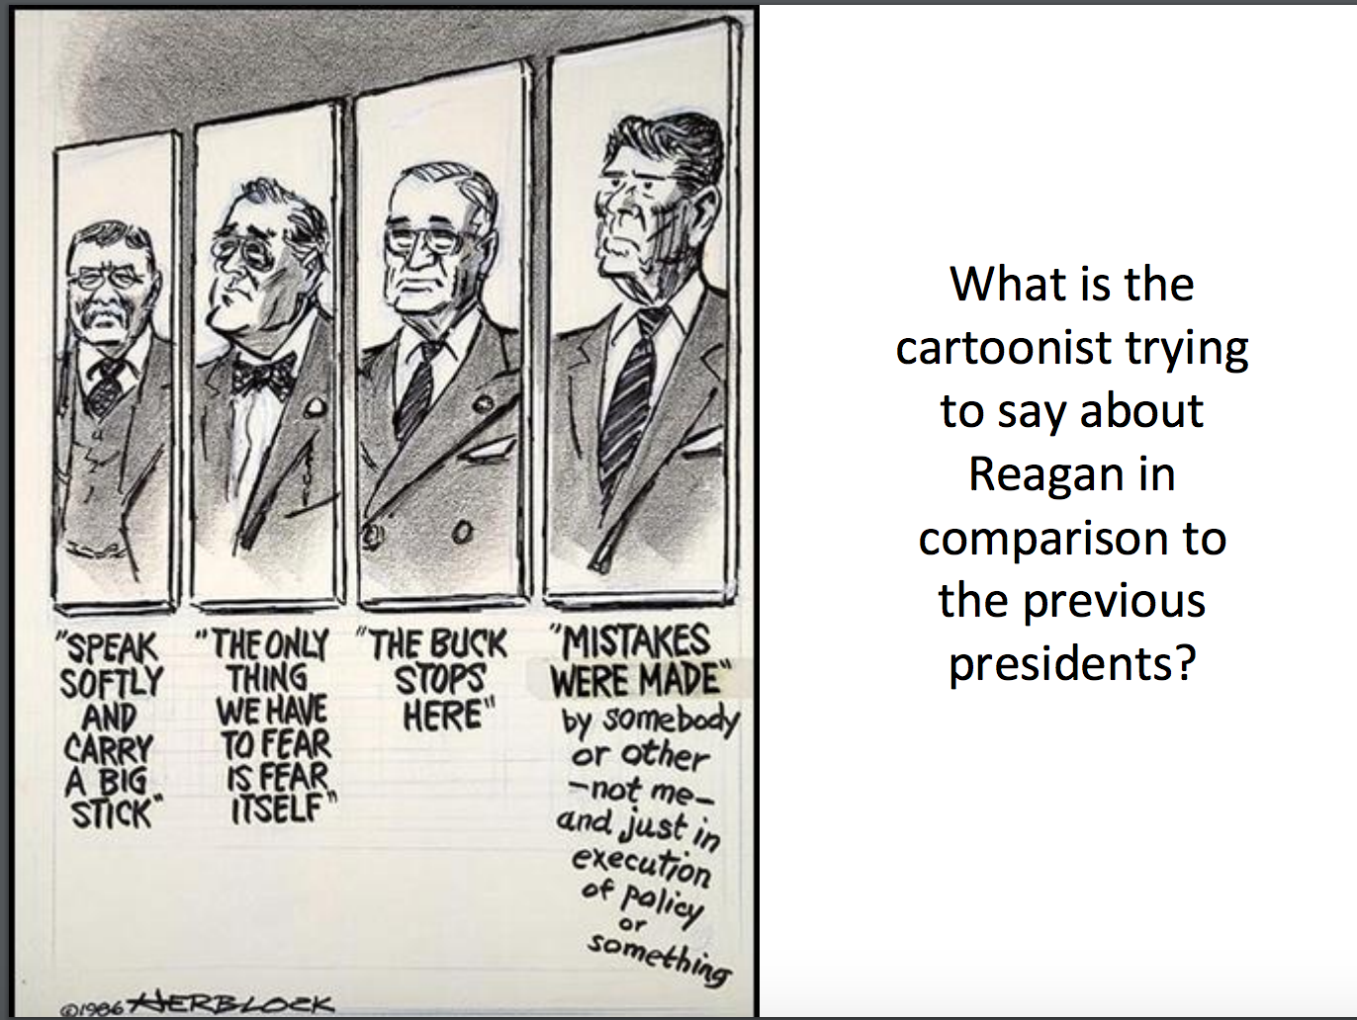

Slide 3
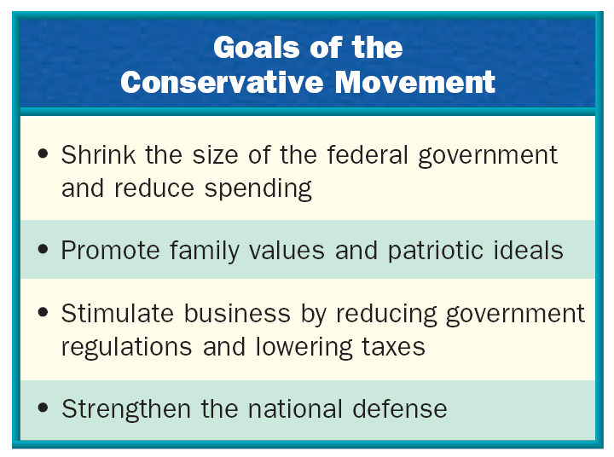
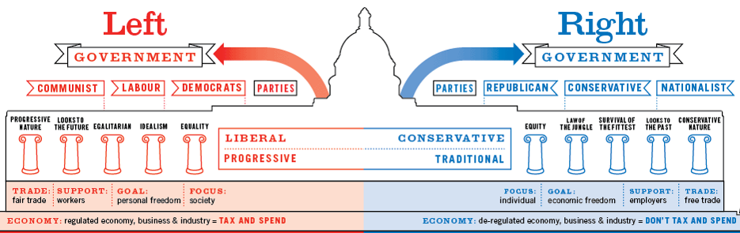
The Conservative Movement (1980s)
The 1980s saw the rise of a new conservative movement known as the “New Right”
By 1980, government programs cost $300 billion yearly
Conservatives believed civil rights had gone
too far & attacked affirmative action (reverse discrimination) & school busing plans

Slide 4
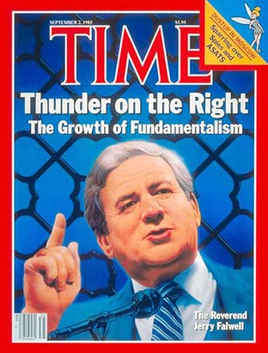
The Conservative Movement
The 1980s saw the rise of a new conservative movement known as the “New Right”
Devout Christians were disturbed by the decline in morality of the 1970s (hippies, sexual revolution, etc)
Evangelist Jerry Falwell formed the religious group, the Moral Majority, to promote family values & to raise money for conservative politicians
New Right promoted school prayer & tough punishment for crimes; Attacked abortion, the ERA, & homosexuality

Slide 5
The Conservative Movement
The 1980s saw the rise of a new conservative movement known as the “New Right”
Conservatives wanted business growth, lower taxes, & free enterprise (freedom from gov’t interference in the economy)
The New Right
hoped to restore the superpower status of the United States

Slide 6
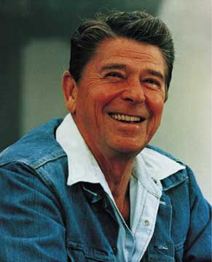
Who was Ronald Reagan?
Went to California to launch an acting career during the Great Depression
  Successful actor
  Eventual president of the Screen Actors Guild (Union for Actors)
Became increasingly conservative in face of radical socialists and communists in the movie industry
Switched from Democratic to Republican Party in the late 50s/early 60s
Major goals as President:
Less government
Lower taxes
Traditional family values

Slide 7
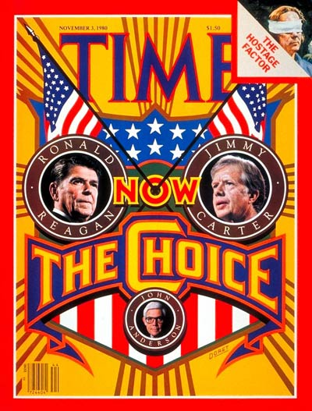
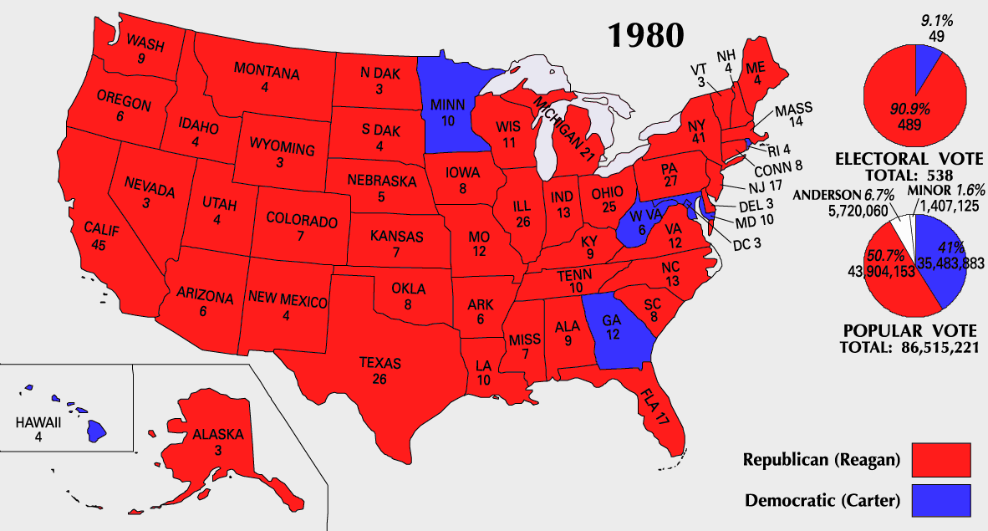
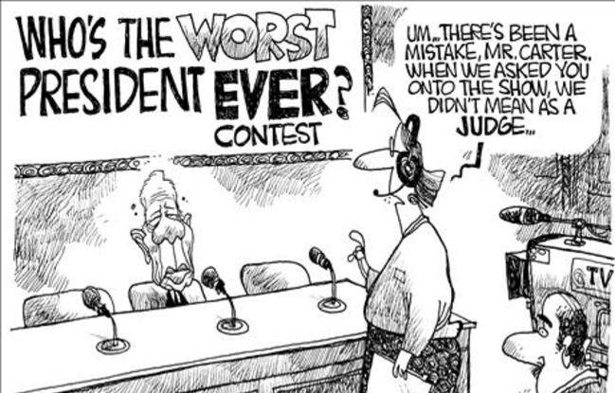
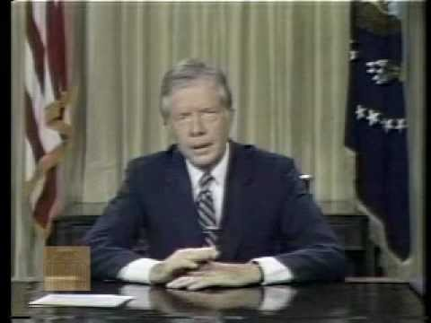
The Election of 1980
By 1980, Carter had been unable to end stagflation, free the U.S. hostages in Iran,
or restore America’s place in the world
In the election of 1980, Americans in search
of answers elected Ronald Reagan as president
Reagan took advantage
of Carter’s failures with the economy & in foreign policy by asking “Are you better off today than you were four years ago?”
July 1979
Carter’s “Malaise Speech”
Famous quips: “A recession is when your neighbor loses his job. A depression is when you lose yours. And recovery is when Jimmy Carter loses his.” – Ronald Reagan
Americans ignored conservation efforts he proposed – due to inflation and the oil crisis
Criticized the American public for falling into a "moral and spiritual crisis”
Too concerned with material goods

Slide 8
The Reagan Revolution –
Reagan’s 1st Inaugural Address
What was so “revolutionary”?
“In the days ahead I will propose removing the roadblocks that have slowed our economy and reduced productivity. Steps will be taken aimed at restoring the balance between various levels of government. Progress may be slow, measured in inches and feet, not miles, but we will progress. It is time to reawaken this industrial giant, to get government back within its means, and to lighten our punitive tax burden. And these will be our first priorities, and on these principles there will be no compromise.” - Ronald Reagan 1981

Slide 9
Reagan &
Domestic Policy

Slide 10
Reagan’s DOMESTIC Policy – LESS GOVERNMENT
Reagan believed that the national government had grown too large & needed to be downsized
  Budget cuts (reduced Medicaid, welfare and job training programs)
  Deregulation (stimulate businesses by reducing the power of government agencies)
  He appointed four conservatives to
  the Supreme Court, like Sandra Day O’Connor, the 1st female justice

Slide 11
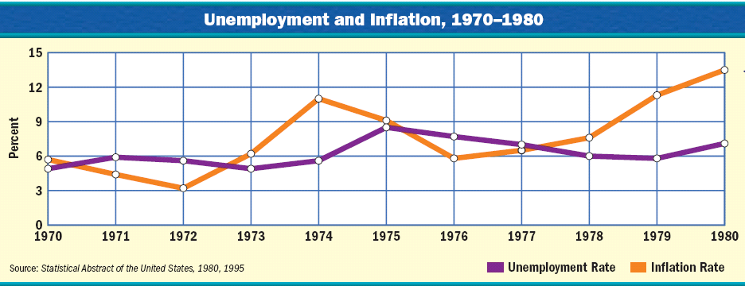
Reagan’s DOMESTIC Policy – REAGANOMICS
In 1980, interest rates were at 20% & the value of the dollar dropped to 36¢
When Reagan entered office, the biggest crisis facing America was stagflation in the economy

Slide 12
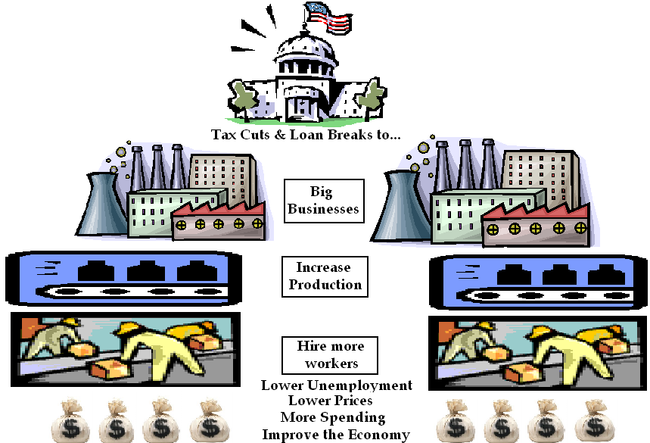
Reagan believed in Supply-Side Economics (Trickle-Down)
Economy was suffering
in the 1970s because:
government taxes were too high
people did not have enough money to spend
1981 - Reagan urged Congress to pass 25% tax cut over 3 years to stimulate spending, increase production, & lower prices

Slide 13
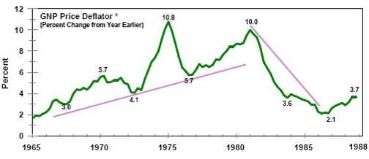
Reaganomics
By 1983, “Reaganomics” worked, stagflation ended, & the economy boomed
Inflation, Unemployment, & Interest Rates
The U.S. gained 16 million new jobs, unemployment fell, & inflation declined

Slide 14
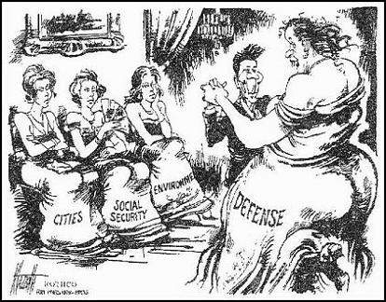
What’s the main idea?

Slide 15
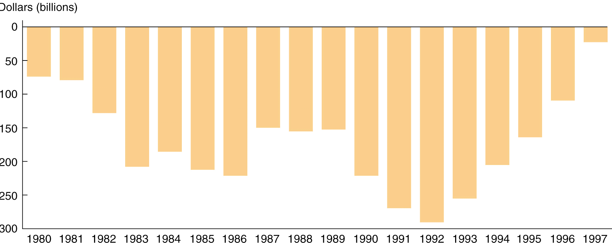
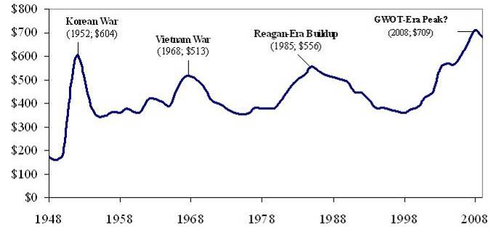
Reagan’s DOMESTIC Policy – DEFENSE SPENDING
BUT, because military spending increased while tax revenue decreased, the government experienced massive deficits due to “Reaganomics” – LED TO RECESSIONS, POVERTY, ETC.
Reagan increased defense spending (to restore USA’s place in the world)
Government Deficits Per Year, 1980-1997
The Reagan Years (1981-1989)

Slide 16
1980s American Society

Slide 17
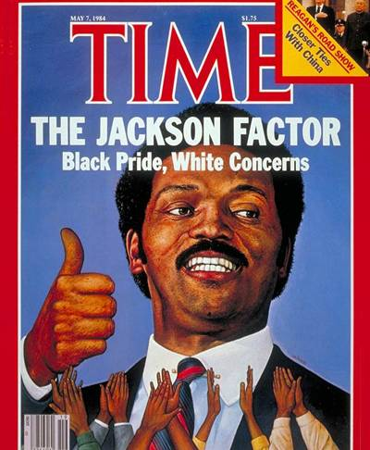

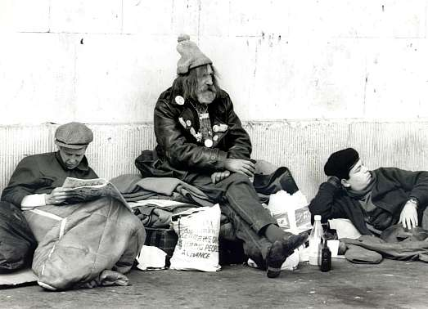
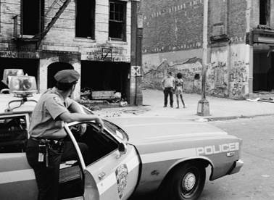
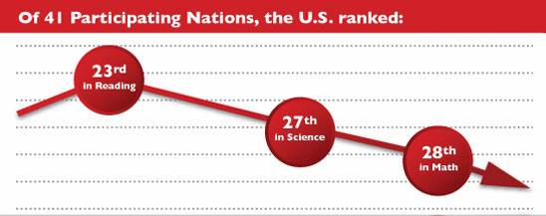
Family Values & Social Concerns
Reagan’s commitment to conservative values
& cuts to social programs contributed to growing problems in the 1980s:
America saw increases in school dropout rates, homelessness, attacks on affirmative action, & urban & minority poverty
1983 exposé on American education

Slide 18
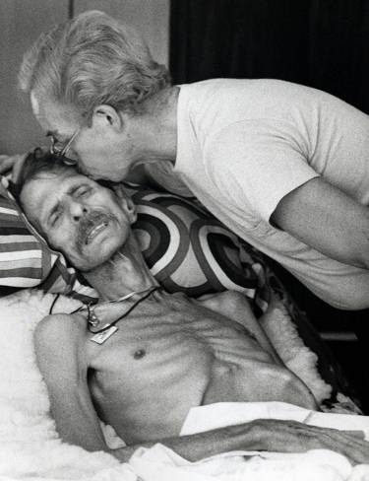
Family Values & Social Concerns
Reagan’s commitment to conservative values
& cuts to social programs contributed to growing problems in the 1980s:
The 1st documented cases of AIDS were reported, but the Reagan administration did not move swiftly because the disease was among many homosexual men

Slide 19
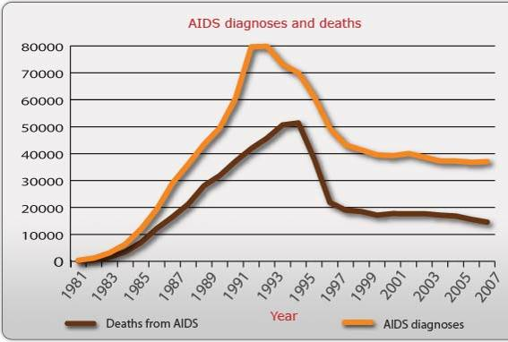
HIV/AIDS Statistics, 1981-2007
The 1st AIDS cases were among homosexual men in San Francisco & NY in 1981
Notes:
http://www.avert.org/usa-statistics.htm

Slide 20
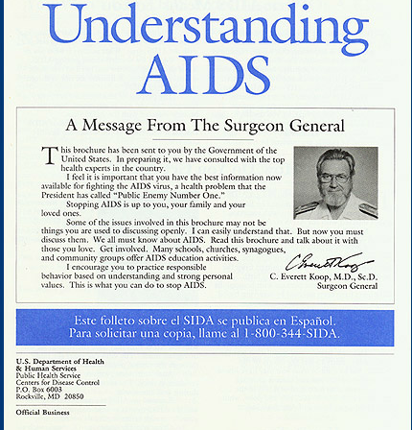
Mailed to every US household in 1988 by U.S. Public Health Service: Understanding AIDS is the largest public health mailing in U.S. history

Slide 21
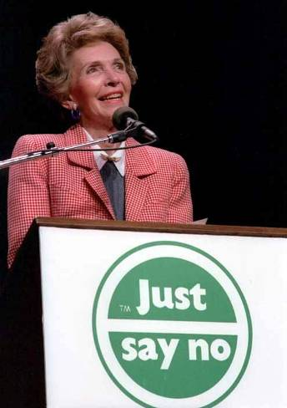
Family Values & Social Concerns
Reagan’s commitment to conservative values
& cuts to social programs contributed to growing problems in the 1980s:
Crack cocaine was 1st introduced in the 1980s
The “crack epidemic”
led Reagan to begin a “War on Drugs” & the “Just Say No” campaign

Slide 22
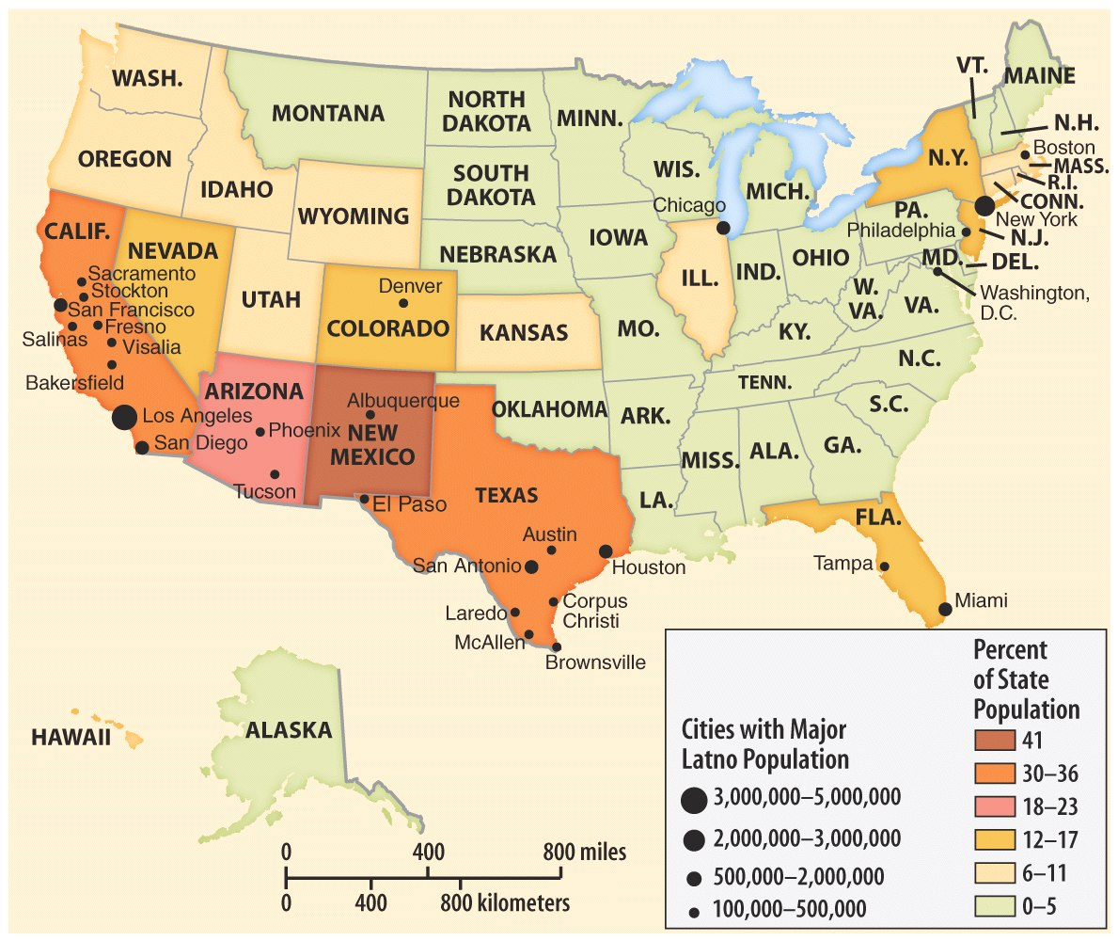
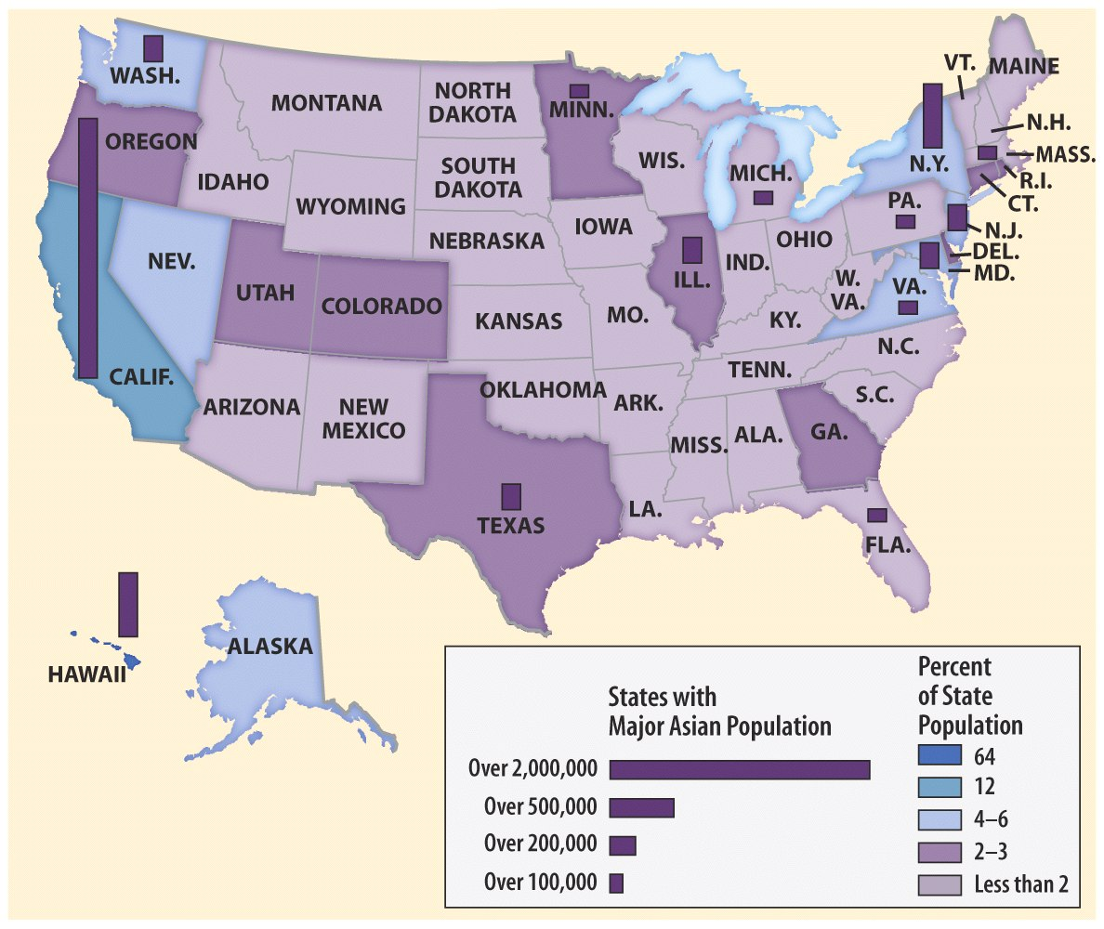
Immigration Reform and Control Act (1986) - less about restricting the numbers of immigrants
Stronger sanctions on employers who hired undocumented aliens
Improving access to American citizenship for undocumented aliens within the United States
In the 1970s & 1980s, the 3rd wave of American immigration began
Mexican, Haitian, & Dominican immigration increased but 20-30% lived in poverty by the 1980s
Immigrants from Korea, Vietnam, & Philippines tended to thrive in America

Slide 23
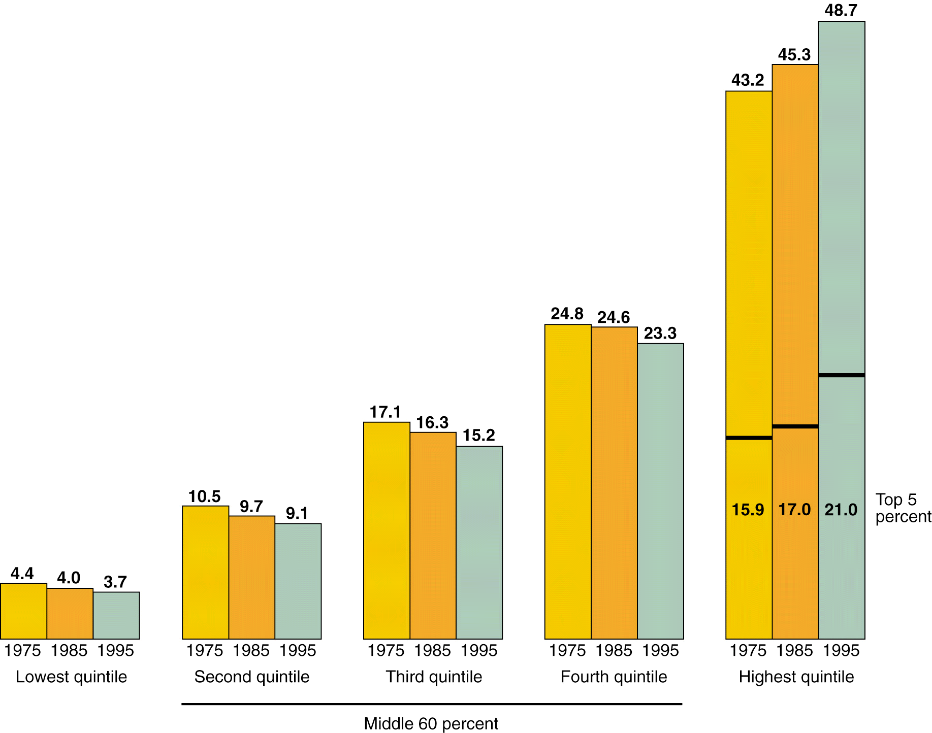
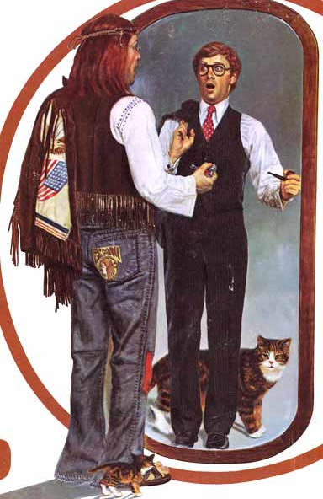
Share of Household Income
The 1980s was defined by the “Me Generation”— money, status, & wealth
The economic gap hurt blacks the most (60% lived in cities with high unemployment)
In the 1980s, the rich got richer at the expense of middle class & the poor

Slide 24
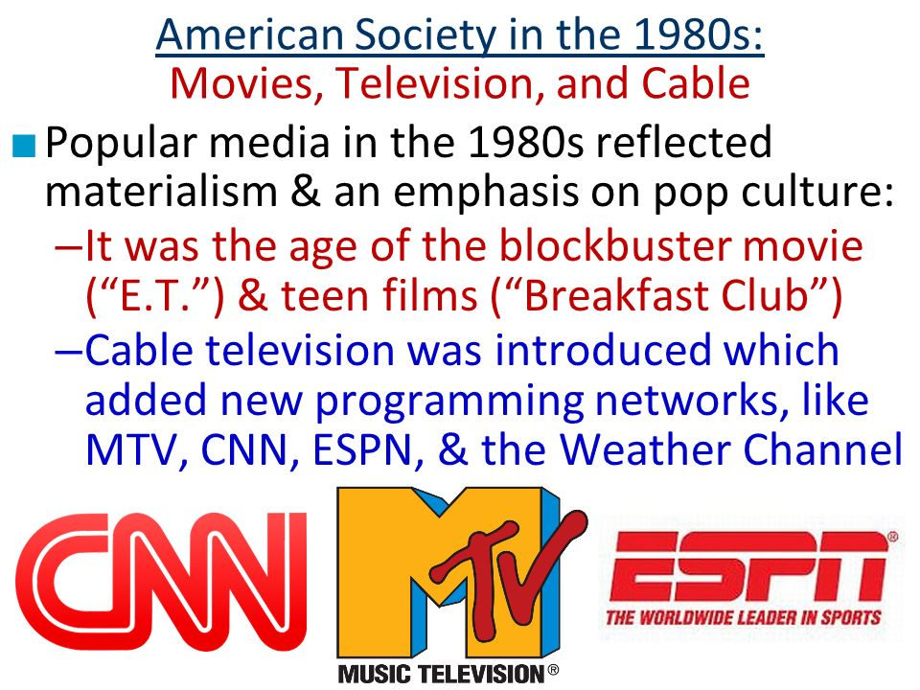

Slide 25
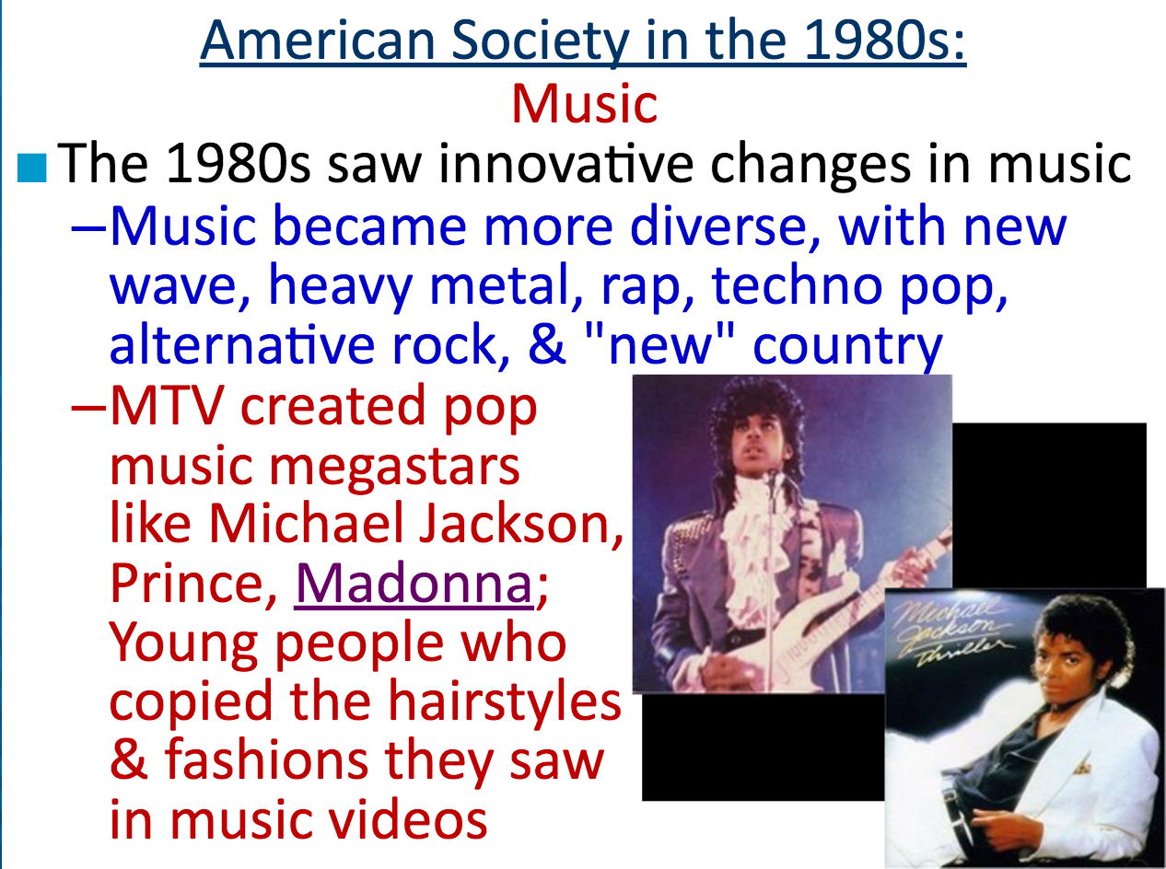

Slide 26
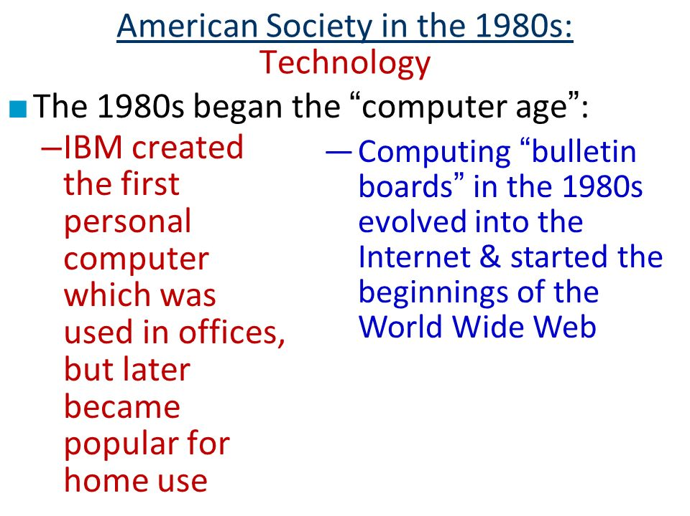
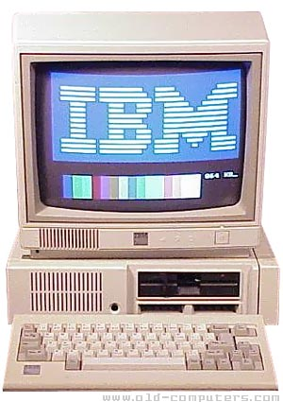

Slide 27
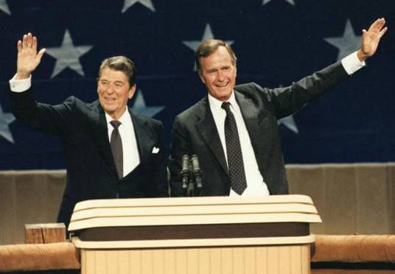
The Election of 1984
Despite the social problems, Reagan was popular among voters by the election of 1984

Slide 28
Reagan &
Foreign Policy

Slide 29
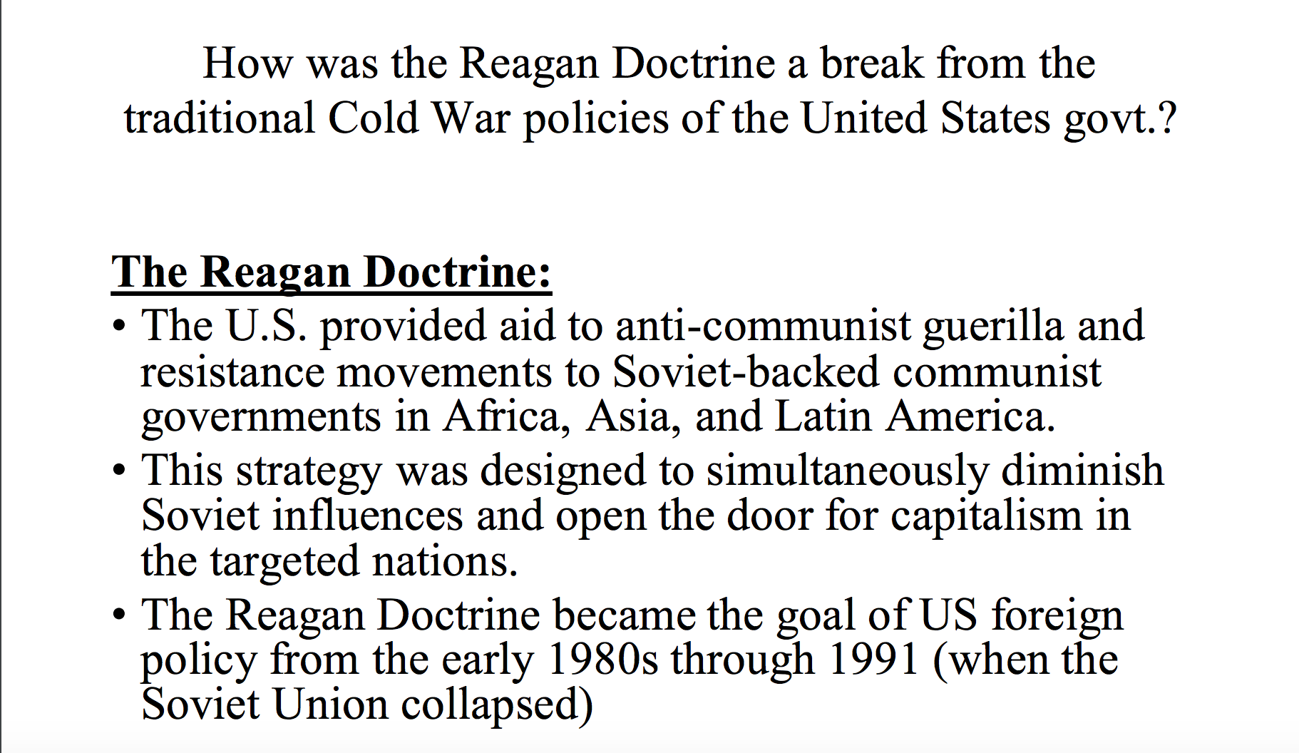

Slide 30
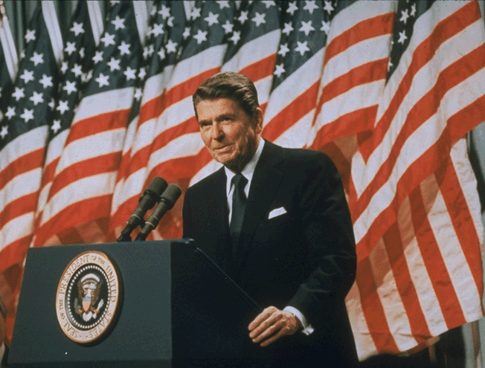
Reagan & Foreign Policy
Reagan wanted to restore U.S. foreign policy
  Blamed Carter for allowing America’s international prestige & influence to fall
  Increased military
  spending
  Confronted challenges
  in the Middle East &
  in Latin America
  And win the Cold War
  with the Soviet Union

Slide 31
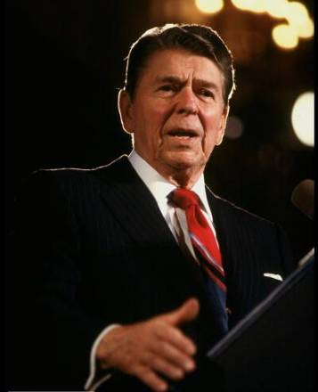
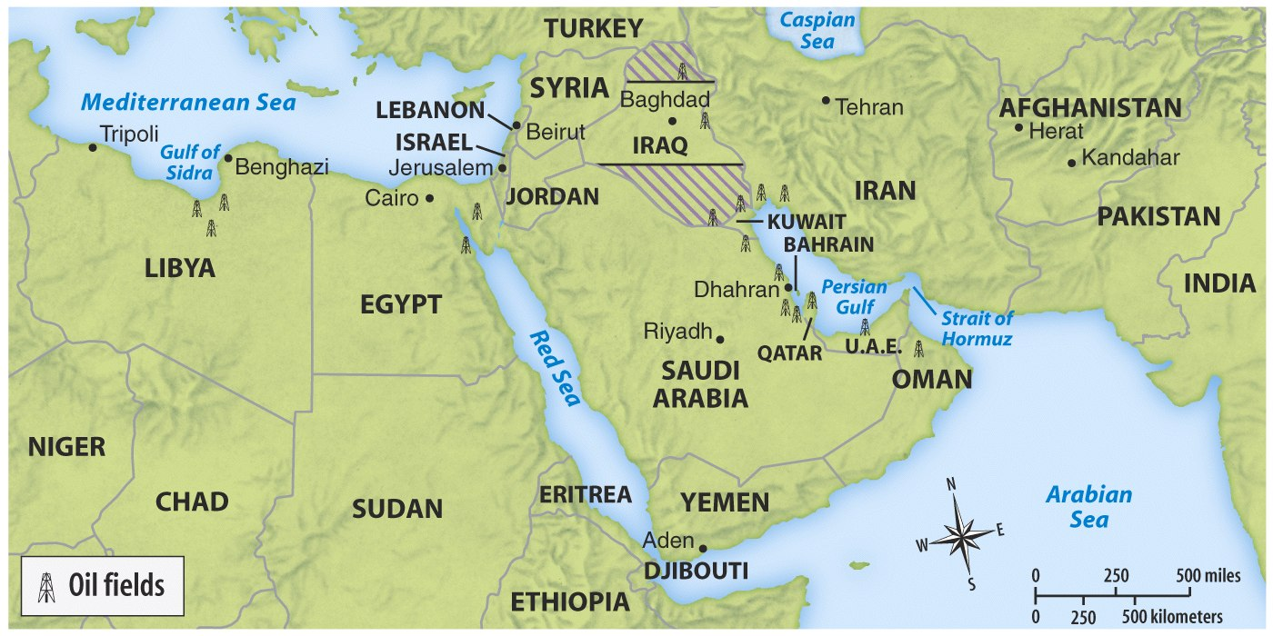
Reagan & Foreign Policy
Reagan intervened in Lebanon when violence broke out between Israelis & Arabs in 1982
Meanwhile…
Reagan’s response was to
“not negotiate with terrorists”
But, anti-American hostility led a terrorist group to seize
6 U.S hostages in Iran in 1983

Slide 32
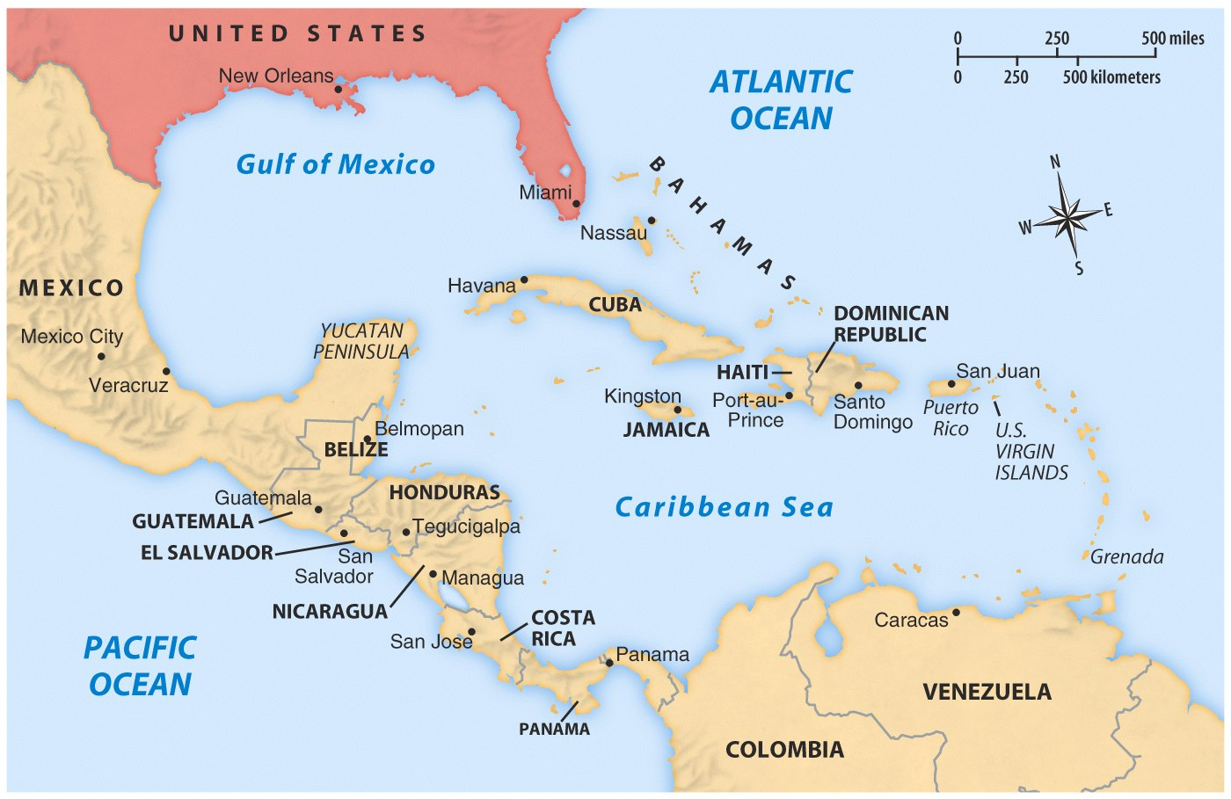
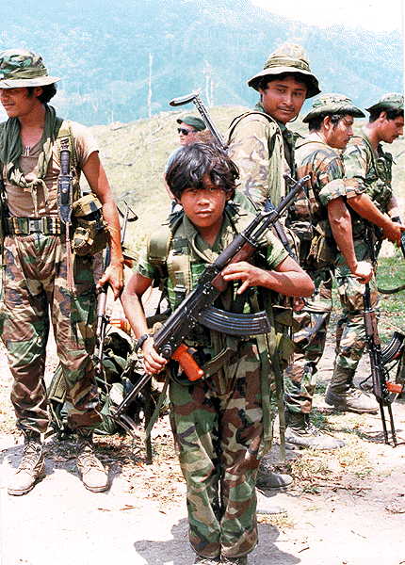
Reagan & Foreign Policy
In 1979, a communist group came to power in Nicaragua
Congress denied Reagan’s plea to help Nicaraguan counter-revolutionaries (Contras) take back power
…Reagan committed to fighting communism & maintaining order in Latin America
Notes:
In 1983, Congress denied Reagan’s request to aid Nicaraguan efforts to overthrow the Sandinista gov’t (Contras)

Slide 33

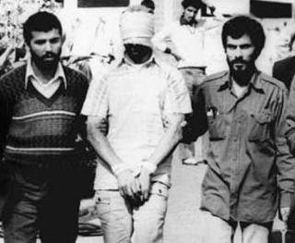
Six hostages in Iran
The government then gave money from the profits of the arms sales to Iran to anti-communist Contras in Nicaragua
The government illegally sold Iran weapons in exchange for the release of the 6 hostages (arms for hostages)
The Reagan administration developed a plan to solve both the problem in Iran & in Nicaragua
Contras in Nicaragua

Slide 34
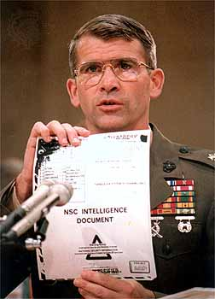
The Iran-Contra Affair (1987)
These illegal activities were discovered & became the Iran-Contra Affair (hurt Reagan administration)
Reagan said he had no knowledge of the scandal
& some admitted
to running the operation behind the president’s back
Reagan escaped from the scandal
Notes:
Reagan avoided implication through “plausible deniability”

Slide 35
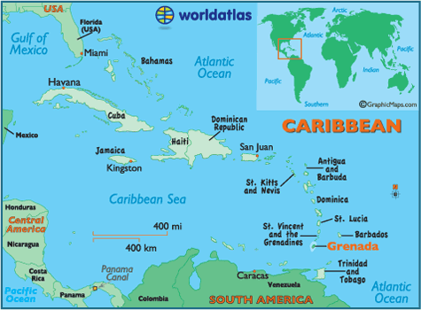
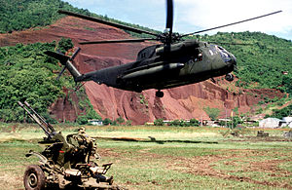
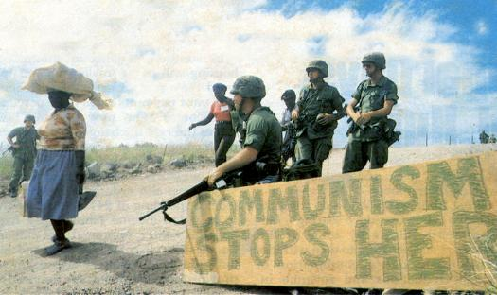
Invasion of Grenada (September, 1983)
1983 Communist coup stranded 800 U.S. medical students.
Cuba’s role and students’ safety concerned Reagan.
Reagan sent in soldiers who took the island in two days with a loss of 19 soldiers.
The invasion resulted in the appointment of an interim government, followed by democratic elections in 1984.

Slide 36
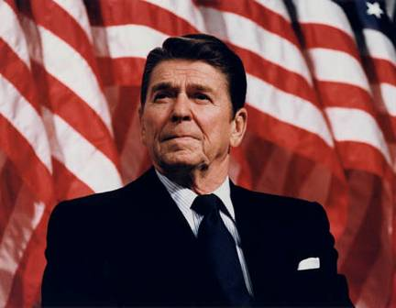
Ending the Cold War!
Reagan took a
strong stand against communism &
the Soviet Union
Reagan viewed the USSR as the "focus of evil in the modern world” & as a threat to U.S. security
His most ambitious plan was a massive defensive system of satellites called the Strategic Defense Initiative
(“star wars” program)
He used “zero option”
& sent 572 nuclear missiles within range
of Moscow to match USSR ICBMs aimed at NATO nations
Notes:
Zero option

Slide 37
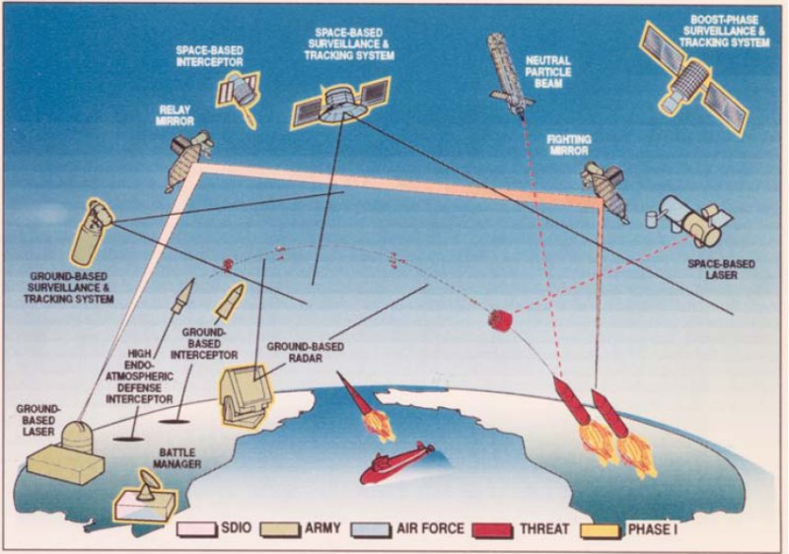
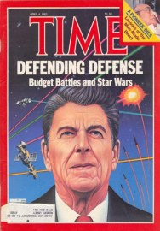
SDI would have
cost the U.S. gov’t trillions of dollars
at a time when “Reaganomics” involved slashing budgets for social programs

Slide 38
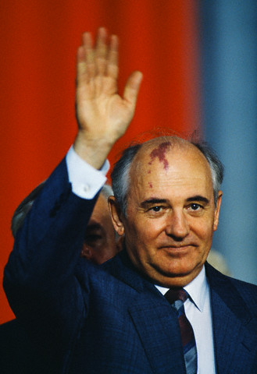
Winning the Cold War
As Reagan was coming to power, communist nations (including the USSR) were beginning to face economic failure
In 1985 Mikhail Gorbachev took charge of the USSR & began creating moderate reforms to save Russia
Reagan was able to work with Gorbachev to reduce Cold War tensions
Perestroika: Introducing moderate capitalism & allowing some business & property ownership
Glasnost: Freedom of speech & competitive elections

Slide 39
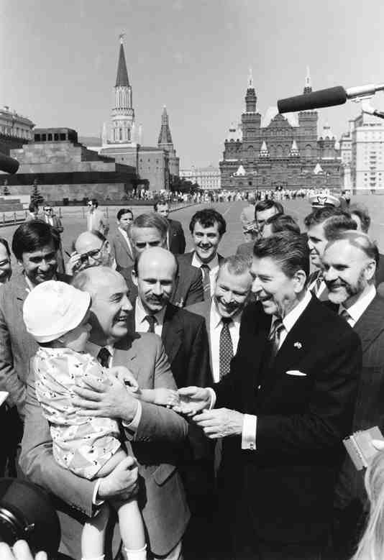



In 1987, Reagan & Gorbachev signed the INF Treaty eliminating ICBMs in Europe

Slide 40



Winning the Cold War
By the late 1980s, communism was failing across Eastern Europe
In 1990, states within the Soviet Union broke off & formed new democratic nations;
In 1991, the USSR dissolved & the
Cold War ended
VIDEO
In 1989, East Germans denounced communism & the Berlin Wall came down
In 1989 & 1990, Eastern European nations embraced democracy
Notes:
For 40 years, Communist Party leaders in Eastern Europe had ruled confidently. Each year their countries fell further behind the West; yet, they remained secure in the knowledge that the Soviet Union, backed by the Red Army, would always send in the tanks when the forces for change became too great. But they had not bargained on a liberal Soviet leader like Mikhail Gorbachev.
As Gorbachev moved toward reform within the Soviet Union and détente with the West, he pushed the conservative regimes of Eastern Europe outside his protective umbrella. By the end of 1989, the Berlin Wall had been smashed. All across Eastern Europe, citizens took to the streets, overthrowing 40 years of Communist rule. Like a series of falling dominos, Communist parties in Poland, East Germany, Hungary, Czechoslovakia, Romania, and Bulgaria fell from power.
Gorbachev, who had wanted to reform communism, may not have anticipated the swift swing toward democracy in Eastern Europe. Nor had he fully foreseen the impact that democracy in Eastern Europe would have on the Soviet Union. By 1990, leaders of several Soviet republics began to demand independence or greater autonomy within the Soviet Union.
Gorbachev had to balance the growing demand for radical political change within the Soviet Union with the demand by Communist hardliners. The hardliners demanded that he contain the new democratic currents and turn back the clock. Faced with dangerous political opposition from the right and the left and with economic failure throughout the Soviet Union, Gorbachev tried to satisfy everyone and, in the process, satisfied no one.
In 1990, following the example of Eastern Europe, the three Baltic states of Lithuania, Latvia, and Estonia announced their independence, and other Soviet republics demanded greater sovereignty. Nine of the 15 Soviet republics agreed to sign a new union treaty, granting far greater freedom and autonomy to individual republics. But in August 1991, before the treaty could be signed, conservative Communists tried to oust Gorbachev in a coup d'etat. Boris Yeltsin, the President of the Russian Republic, and his supporters defeated the coup, undermining support for the Communist Party. Gorbachev fell from power. The Soviet Union ended its existence in December 1991, when Russia and most other republics formed the Commonwealth of Independent States.

Slide 41

Why was it that the USSR fell under Reagan’s presidency?

Slide 42



George Bush
VP George Bush won the presidential election of 1988 by promising to maintain Reagan’s conservative policies

