Slide 1
Aim: Did the political actions of Nixon affect the nation more positively or negatively?
Richard Nixon
Presidential term:
January 20, 1969 – August 9, 1974

Slide 2
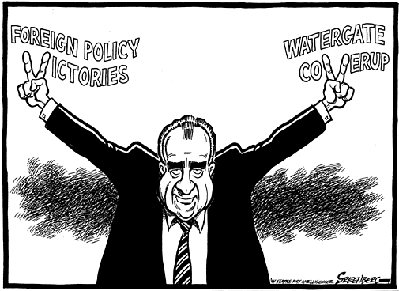
What will Nixon forever be remembered for?

Slide 3
What is Nixon stepping into?
DON’T COPY!
By the late 1960s, citizens had seen enough turmoil in U.S. foreign & domestic affairs:
The economic boom of the 1950s & 1960s was starting to come to an end
American prestige in the world was damaged by the failure in Vietnam
Anti-war protests, “hippie” culture, & liberal government programs led many citizens to believe that America was headed for moral decay & economic collapse

Slide 4
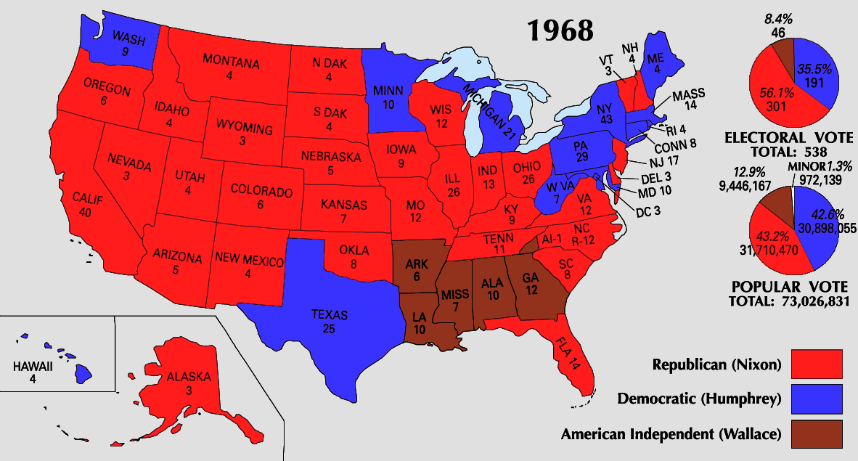
The Election of Richard Nixon
Nixon’s victory in 1968 was due to the turnout of a “silent majority” who wanted a more conservative government
In 1968, Americans elected conservative Republican Richard Nixon

Slide 5
Nixon’s Domestic Policy – CONSERVATIVISM
What do you think he wanted to do with LBJ’s Great Society?
Reduce or eliminate many Great Society programs – TOO $$

Slide 6
Nixon’s Domestic Policy – One Giant Leap for Mankind: Apollo 11 Mission
On July 20, 1969, astronaut Neil Armstrong became the first man to walk on the moon.
Fulfilled the goal JFK had set for the U.S. almost 10 years before, in 1961.

Slide 7
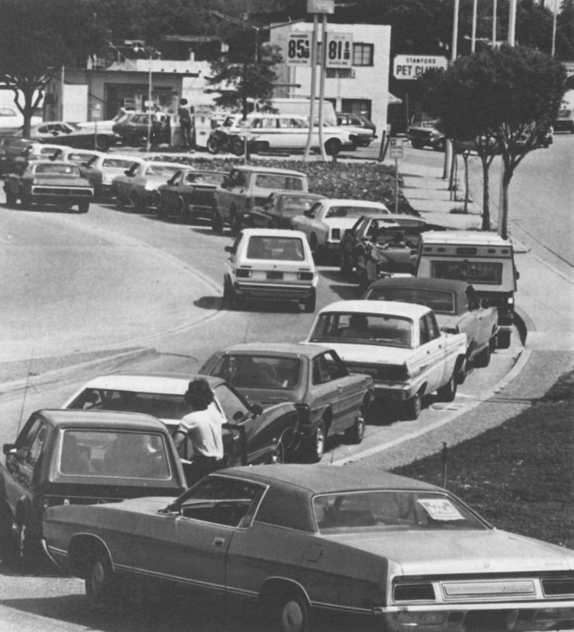
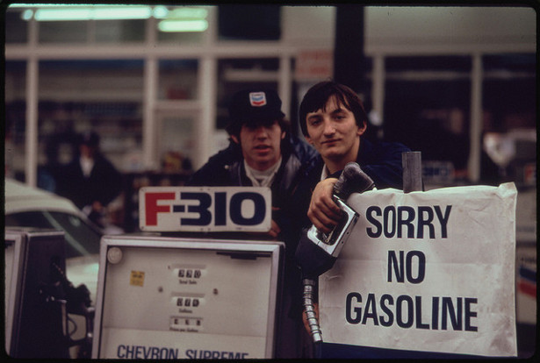
Nixon’s FOREIGN Policy – Vietnam and the Middle East
Escalation and final removal of troops from Vietnam, 1973 - also known as Vietnamization
Oil Crisis 1973-1974
OPEC countries (Middle East) refused to sell oil to US resulted in HUGE gas shortages in the USA! – WHY DID THEY REFUSE?
In retaliation for US support of Israel!

Slide 8
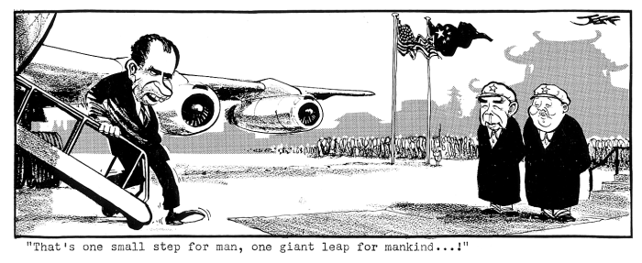
Nixon’s FOREIGN POLICY What does the artist mean by the caption?

Slide 9
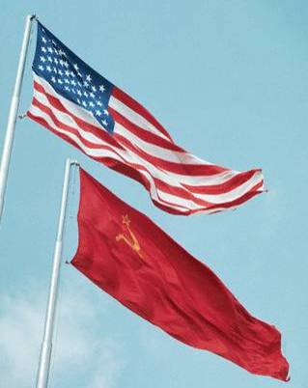
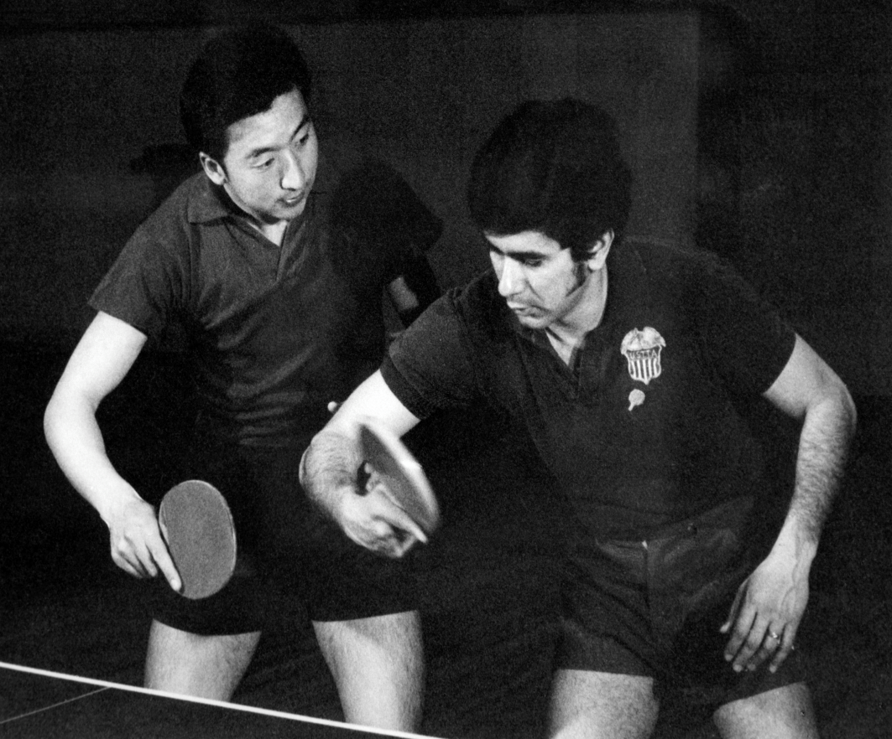
Nixon’s Foreign Policy - Détente
Instead of using containment to fight Communism & increase Cold War tensions…
1st US president to visit the People’s Republic of China (communist)
Détente (relaxing of tensions) with America’s Cold War enemies
Allowed for more US trade with China!
But how did he do it?
Forrest Gump

Slide 10
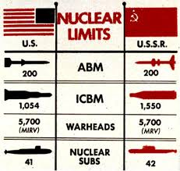
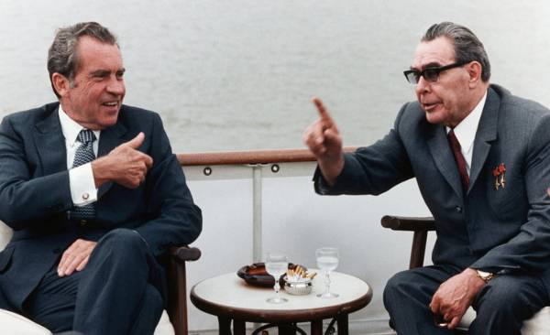
Nixon’s Foreign Policy - Détente
Nixon’s détente policy was aimed at easing Cold War tensions with the USSR
In 1972, Nixon became the 1st president to visit Moscow; His visit led to the Strategic Arms Limitation Talks (SALT) to limit missiles
By visiting China, Nixon pressured Soviet leader Brezhnev to negotiate with the United States

Slide 11
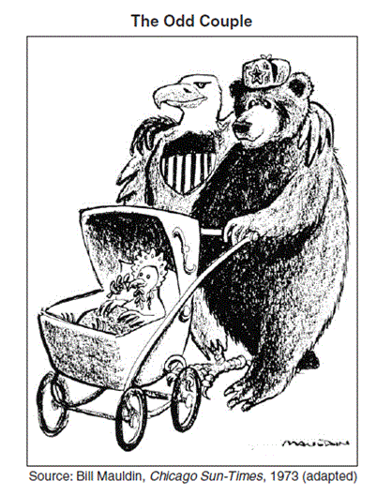
Based on what we’ve learned so far, what is the main idea of this cartoon?
Détente

Slide 12
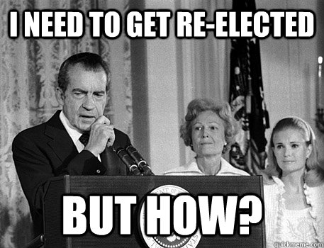

Slide 13
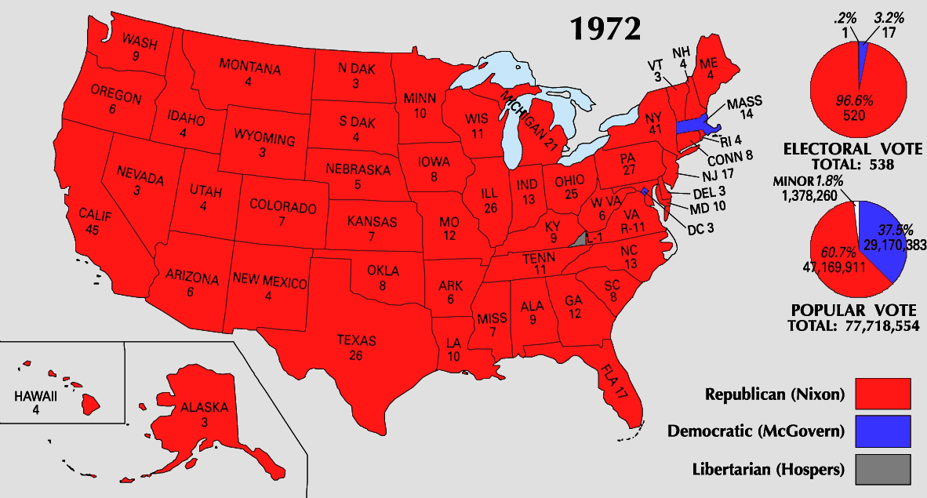
DON’T COPY!
Nixon was a popular president by the end of his 1st term
His domestic policies reduced gov’t spending & revitalized middle-class, conservative, & Southern voters
His foreign policies led to the end of an unpopular war in Vietnam & eased tensions with America’s two biggest Cold War rivals
In 1972, Nixon won one of the biggest landslide victories in presidential history
But after Nixon’s re-election in 1972, the Watergate scandal broke…

Slide 14
WATERGATE: Take notes. Why was this such a SCANDAL?
VIDEO

Slide 15
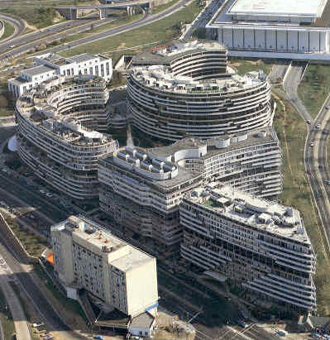
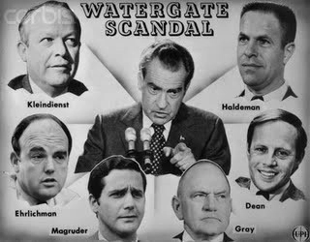
WHAT WAS THE CRIME?
There was a break-in at the Democratic candidate headquarters (Watergate Complex) by Nixon’s Committee to Re-Elect the President (CREEP)
THEY’RE CAUGHT and a cover-up ensues
Forrest Gump

Slide 16
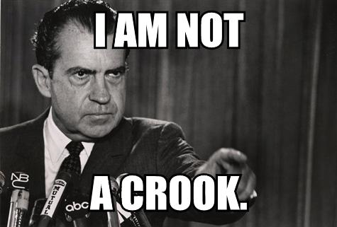
The Watergate Scandal
The Watergate scandal began to unravel in 1973: US v. Nixon Supreme Court case
The discovery that Nixon recorded conversations proved most damning
Recordings in the Oval Office called the “White House Tapes”
The Supreme Court ordered Nixon to turn over all tapes to a Senate investigative committee
…Nixon REFUSES!
The House brought 2 articles of IMPEACHMENT against president
How does Nixon react?

Slide 17
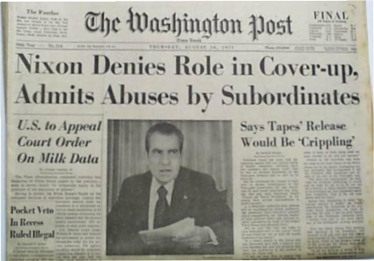
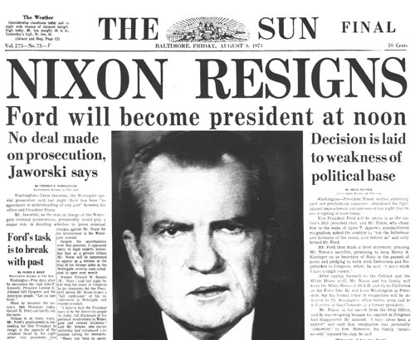
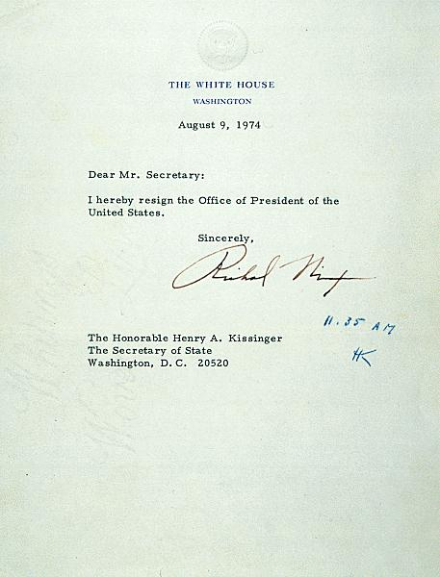

Slide 18
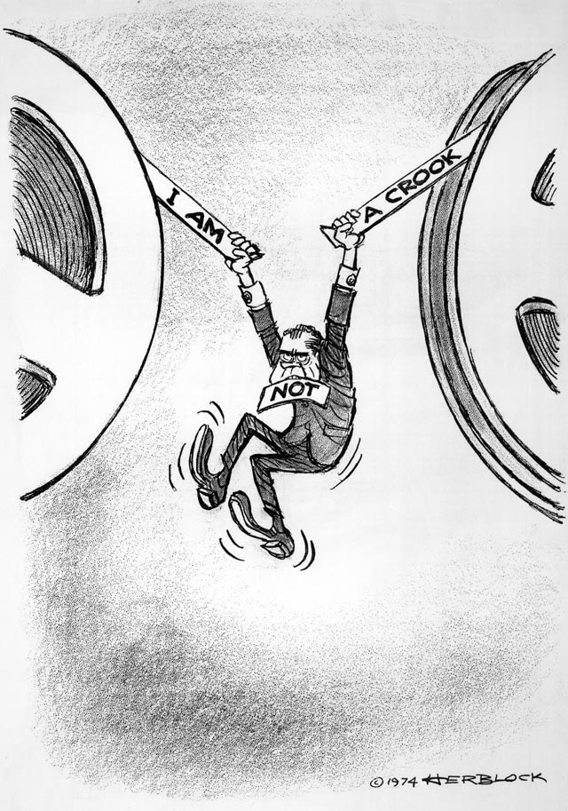
What is the main idea of the cartoon?

Slide 19
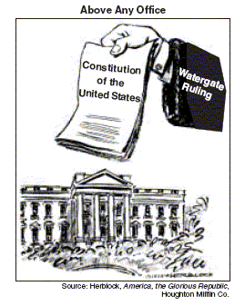
What is the main idea of the cartoon?
Power now shifting more from the President to Congress…who began this trend of a stronger President than Congress?

Slide 20
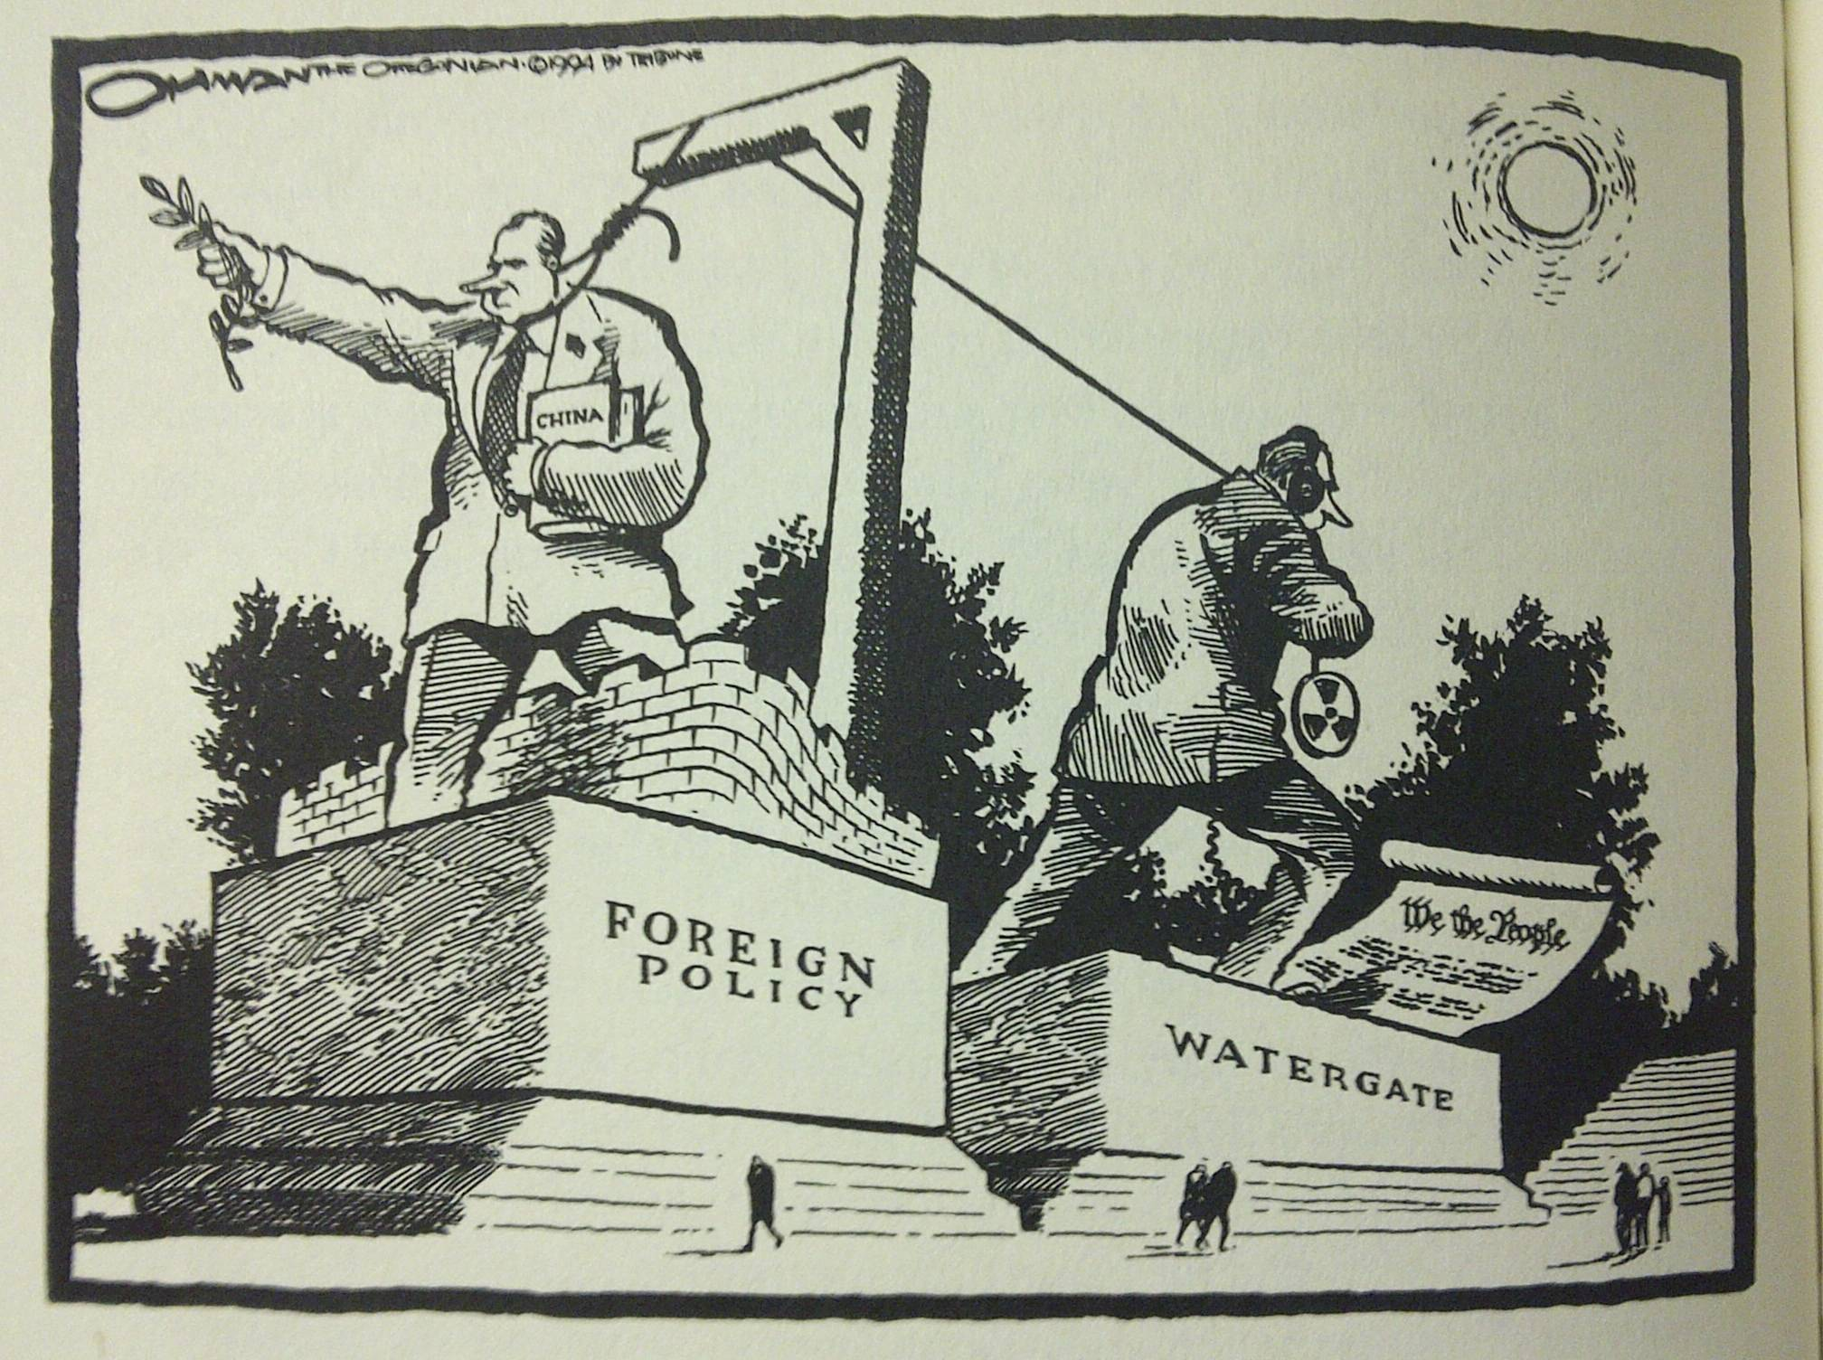
What is the main idea of the cartoon?

